Slide 1




Overview of the
STATE OF MAINE
LOCAL EMERGENCY MANAGEMENT DIRECTOR HANDBOOK
JANUARY 1, 2025
Presented by
MEMA, MALEM and MEMCDC

Slide 2


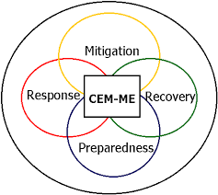
Partner Overview: Our Shared Missions
  Maine Emergency Management Agency (MEMA): MEMA's mission is to support and coordinate the state’s efforts in preparing for, responding to, and recovering from emergencies and disasters.
  Maine Association of Local Emergency Managers (MALEM): MALEM's mission is to advocate for and provide resources, training, and support to local emergency management professionals across Maine.
  Maine Emergency Management County Directors Council (MEMCDC): MEMCDC’s mission is to enhance collaboration and communication among county-level emergency management directors to improve disaster response and preparedness throughout Maine.

Slide 3

Presenter Introductions
Insert Name
Insert Name
Insert Title
Insert Name
Insert Title
Insert Title
Notes:
Introduce the presentation speakers.
Provide a brief synopsis of the presenters experience that is relevant to today’s topics.
Presenter contact information is included at the end of today's presentation.

Slide 4


Acknowledgements
The Maine Local Emergency Handbook was originally created in 1998, updated by MEMA in 2006 and updated by the County EMA Directors Council in 2018.
It was most recently updated through a collaborative partnership between the Maine Emergency Management Agency (MEMA), the Maine Association of Local Emergency Managers (MALEM), and the Maine County EMA Director’s Council. The handbook was updated in 2023 to reflect current information and emergency management best practices.

Slide 5





Presentation Objectives
Local Emergency Manager Handbook
Understand the purpose and intent of this resource, and walk through an overview of its 6 Chapters
Statutory Foundation
Understand the state statutues which are applicable to Emergency Managers in Maine
Whole Community Concepts
Define and apply the Whole Community Concept and its integral role in Emergency Management
Tools and Resources
Identify tools and resources which can support Emergency Managers in their duties

Slide 6


Why This Matters
The Local EMA Handbook is an essential resource for emergency managers in Maine, providing guidance, tools, and strategies to effectively plan for, respond to, and recover from emergencies.
Emergency managers play a crucial role in safeguarding communities by coordinating efforts among local agencies, state resources, and community stakeholders. In Maine, a state prone to natural disasters like severe winter storms, flooding, and coastal weather events, emergency managers ensure resilience through:
  Enhancing Preparedness
  Community Coordination
  Disaster Recovery
Notes:
Expand on the importance of the role of the emergency manager, and their continued professional development through training and resources like this guide.
Enhancing Preparedness: They develop and implement emergency plans tailored to local needs, ensuring readiness for diverse scenarios.
Community Coordination: By acting as a central point of communication, they bridge gaps between first responders, public officials, and citizens.
Disaster Recovery: Emergency managers play a pivotal role in helping communities rebuild and restore normalcy after disasters.

Slide 7
Handbook Module Overview
01
03
02
04
Response Coordination
Introduction
Covers fundamental concepts and the roles of local, state, and federal partners.
Preparedness
Provides guidance on coordinating resources, managing operations centers, and ensuring effective communication during disasters.
Recovery
Focuses on community risk assessments, emergency plans, and public outreach.
Details steps for restoring services, documenting damages, and securing state or federal aid.

Slide 8
Handbook Module Overview
05
06
Mitigation
Homeland Security
Discusses strategies to reduce the impact of future disasters through policy and infrastructure improvements.
Focuses on collaborating with federal partners to address threats like terrorism, cyber risks, and critical infrastructure vulnerabilities​.

Slide 9




Module 1
Legal Authority for Maine’s Emergency Managers
The Maine Civil Emergency Preparedness Act (Title 37-B, MRSA Chapter 13) addresses the requirements of local Emergency Management programs and authorities of local EMA directors.
Directors should have a working knowledge of the laws and other documents listed in this handbook under References and Authorities (See Appendices F and G).
The Local EMA Director is appointed by and responsible to the governing body of the community.
Notes:
In addition, all emergency management activities are coordinated by the Director of the Maine Emergency Management Agency (MEMA).
The MEMA Director is responsible for assessing the effectiveness of each local EMA program. (Title 37B ' 704)

Slide 10

Module 1
Local Emergency Management Ordinances
Maine’s home rule legislation
Local governing bodies have the authority to enact local ordinances under Maine’s home rule legislation [see: Maine Constitution Article VIII. Part Second].
Local Ordinances
A local emergency management ordinance can assist by:
  taking the guesswork out of planning and response
  protecting people and property within the community
  clarifying roles and responsibilities
  legally conferring responsibilities to government officials and agencies
Notes:
Ordinances need to be prepared before a disaster.
The ordinance should clearly state who has authority to declare both the effective date and termination of a State of Emergency or disaster in the community and what is involved under that authority.
Local policies regarding liability issues should be clearly stated, including the authority to redirect funds for emergency use, and to suspend standard procurement procedures to obtain necessary services and/or equipment.

Slide 11
Module 1
Duties and Responsibilities of Local EMA Directors
Local EMA Directors are appointed by municipal officers of their jurisdiction. They cannot be an executive officer or member of the executive body of the jurisdiction. They may be removed for cause.
Local EMA Directors will meet annually with the MEMA Director or the agency’s representative (typically a County Director) to review performance and goals for the coming year
The Local EMA Director shall work with public and private agencies to create mutual aid agreements for sharing resources during major disasters, ensuring they align with state plans and are approved by the MEMA director.
Notes:
The duties and responsibilities of local EMA Directors are outlined in Title 37-B and are summarized as follows:

Slide 12
Module 1
Local Emergency Plans
Maine’s Legislation
  Each County or Regional EMA organization will receive the support and cooperation of the municipalities within its jurisdiction.
  Each EMA in the state, in consultation with MEMA, will prepare and keep a current disaster emergency plan for the area subject to its jurisdiction.
Local Emergency Plans
The plan will include without limitations:
  An identification of disasters to which the jurisdiction is or may be vulnerable, specifically indicating the area’s most likely to be affected.
  Actions to minimize damage.
  Identification of personnel, equipment, and supplies required to implement the preceding actions, to include procedures for accessing these resources.
  Recommendations to appropriate public and private agencies of all preventive measures found reasonable considering risk and cost; and
  Other elements required by MEMA rule.
Notes:
In addition... All planning should be coordinated with the hospitals in the jurisdiction. (Although not defined by law, MEMA also recommends that planning be coordinated with airports, major industries, schools, and volunteer agencies such as the American Red Cross, Maine VOAD, and local food banks, food pantries soup kitchens, etc.)

Slide 13



Module 1: Discussion Questions
Putting it Together
What are the key roles and responsibilities of a local EMA director in Maine?
Scenario
You are a newly appointed emergency management director for your municipality. What are some of the first action items you would take on day 1 of the job? Within the first week? First 30 days?
Mentorship
Who can I reach out to for guidance, advice and/or education throughout the process of learning my role as a Local EMA Director?
Notes:
Key roles and responsibilities of a local EMA director in Maine (beyond the guide)
Foster collaboration with public, private, and nonprofit sectors for integrated emergency preparedness.
Advocate for community-wide education on resilience and disaster response.
Act as a liaison between local government, the Maine Emergency Management Agency (MEMA), and federal resources like FEMA.
Action items for a new local EMA director
Day 1: Review existing emergency plans, meet key stakeholders, and assess available resources.
First week: Evaluate current threats and hazards, and establish communication protocols with local partners.
First 30 days: Conduct an initial risk assessment, identify gaps in preparedness, and schedule community engagement meetings.

Slide 14

Module 2
Preparedness
  Hazard Analysis
    Threats and Hazards Identification
    Vulnerabilities and Impacts
    FEMA Community Lifelines
    Capabilities Assessments & Resource Identification
    Assessments Tools and Products
  Planning
  Training
  Exercises
  Volunteers
Notes:
Chapter 2 of the Local EMA Handbook focuses on Preparedness and includes the following key components:
Hazard Analysis: Understanding local risks by identifying natural, technological, and human-caused hazards, along with their likelihood and potential impact.
Threats and Vulnerabilities: Assessing specific weaknesses within the community that could be exploited during emergencies.
Community Involvement: Engaging all sectors of the community, including public, private, and nonprofit entities, to ensure preparedness efforts are inclusive and comprehensive.
Resource Identification: Cataloging available local resources, including personnel, equipment, and facilities, that can be mobilized during emergencies.
Consistent Tools and Standards: Point out the importance of using standardized assessment tools and templates provided by MEMA and FEMA to streamline documentation and reporting and make the process easier.
Emergency Planning: Developing, reviewing, and updating Emergency Operations Plans (EOPs) to address response strategies and define roles for stakeholders.
Training and Exercises: Conducting regular drills and workshops to test and refine emergency response capabilities and ensure readiness.

Slide 15
THIRA
What are some practical steps or methods a local EMA could take to conduct a Threat and Hazard Identification Risk Assessment (THIRA) in their jurisdiction?
Module 2: Discussion Questions
Planning
The local EMA handbook contains a list of elements than an EOP should have. What are some techniques you have used to efficiently, yet effectively, develop your EOP?
Resource Constraints
What are some ways a local EMA director can build a mass care and/or volunteer programs with limited budget and resources?
Training and Exercise
As a local emergency management director, what training and exercise resources are available to you and your stakeholders?
Notes:
Steps to conduct a THIRA
Identify potential hazards using local data and historical records.
Collaborate with community stakeholders to assess vulnerabilities and impacts.
Steps for a capability assessment and resource identification
Inventory local emergency assets (personnel, facilities, equipment).
Compare resources against identified risks to highlight capability gaps.
Tactics for developing EOPs efficiently
Use templates from MEMA and FEMA to structure plans.
Prioritize hazards based on community-specific risks and address them incrementally.
Training and exercise resources
FEMA’s Independent Study courses and MEMA’s training programs.
Regional drills with neighboring jurisdictions to test readiness.
Building mass care/volunteer programs on a budget
Partner with local organizations (churches, schools) for shelter and volunteer support. Leverage federal programs like CERT for volunteer training or Until Help Arrives.

Slide 16
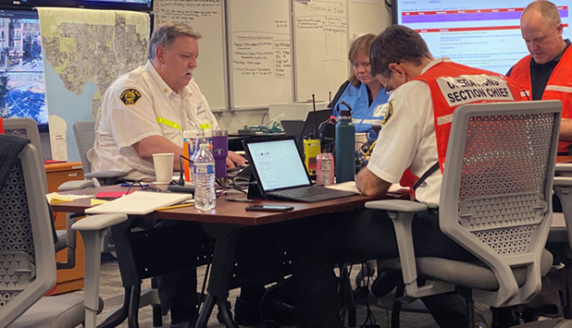


Module 3
Response Coordination
Emergency Operations Centers
Incident Documentation & WebEOC
Communication
Notes:
Chapter 3 of the Local EMA Handbook focuses on Response, detailing the immediate actions required during emergencies. It emphasizes the importance of implementing emergency operations plans, coordinating between local agencies and external partners, and effectively managing resources and communication during incidents.
The chapter outlines the critical steps in activating local emergency operations centers (EOCs), providing situational awareness, and facilitating response actions that protect lives, property, and infrastructure.
Additionally, it highlights the integration of Incident Command System (ICS) principles and collaboration with state and federal resources to streamline disaster response efforts

Slide 17
EOC Location
Module 3: Discussion Questions
What are your most important considerations when selecting an emergency operations center? How about a backup location?
Staffing
What are some strategies you have used to staff your EOC?
Virtual EOCs
For individuals who operate virtual EOCs. Describe how you incorporated the virtual operating environment into your plans, and how you adapted your incident documentation.
Notes:
Considerations for EOC selection
Accessibility, security, and communication infrastructure are key for primary EOCs.
Backup locations should be geographically separate and equally equipped.
Strategies for staffing an EOC
Pre-identify trained personnel from local agencies and community groups.
Rotate shifts to prevent fatigue and ensure continuous coverage.
Incorporating virtual EOCs
Use cloud-based tools for real-time coordination and resource tracking.
Train personnel on virtual documentation processes to maintain consistency.

Slide 18
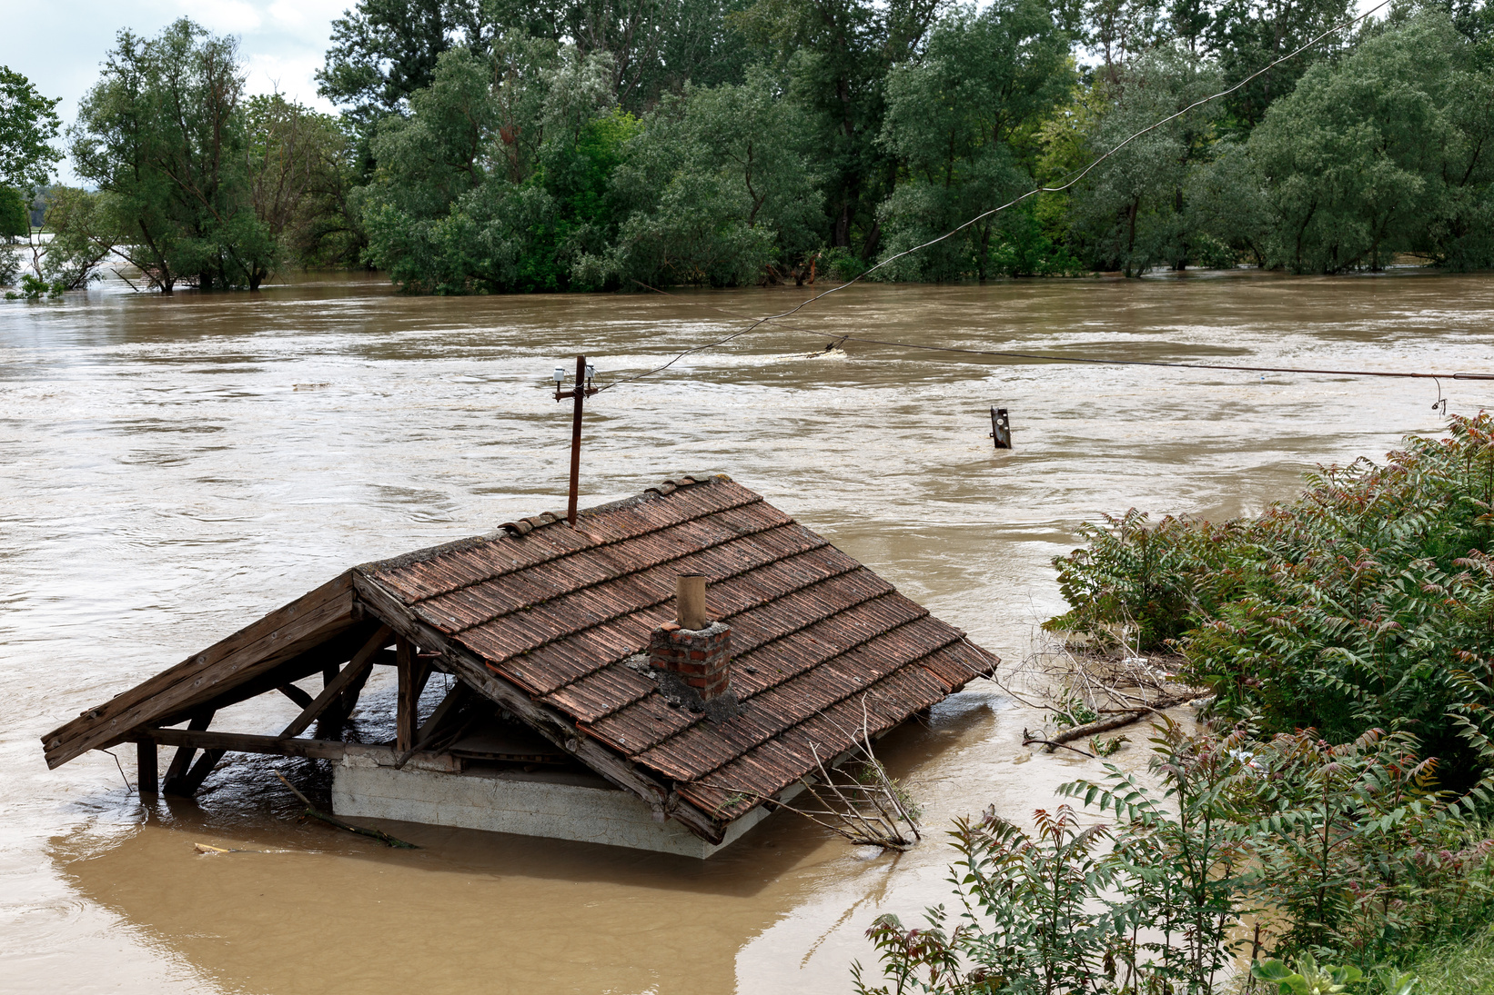
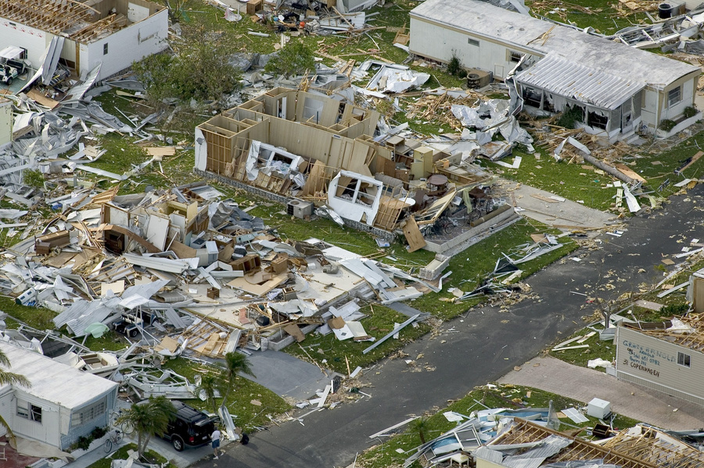

Module 4
Recovery
Emergency & Disaster Assistance
Damage Assessments
Funding
Notes:
Chapter 4 of the Local EMA Handbook focuses on Recovery, which involves guiding communities to rebuild and return to normalcy after disasters. Key highlights include:
Initial Recovery Phase: Local Emergency Management Agencies (EMAs) are responsible for assessing immediate needs, ensuring the safety of affected populations, and stabilizing conditions in the community.
Coordination with State and Federal Agencies: Local EMAs collaborate with Maine Emergency Management Agency (MEMA), FEMA, and other agencies to apply for disaster recovery funding and implement recovery programs effectively.
Community Engagement: Emphasizing the importance of involving local residents and stakeholders in recovery efforts to address specific needs and priorities.
Documentation and Funding: Accurate record-keeping and reporting are essential to accessing federal and state recovery funds, as well as tracking progress.

Slide 19
Initial Recovery
Module 4: Discussion Questions
What steps should Local EMA Directors take during the initial recovery phase after a disaster?
Funding
How can Local EMA Directors collaborate with state and federal agencies to access recovery funding?
Community
How can Local EMA Directors engage with affected residents to address their recovery needs?
Notes:
Steps during the initial recovery phase
Conduct damage assessments and prioritize critical infrastructure restoration.
Coordinate with local agencies to address immediate community needs.
Collaborating with state and federal agencies for funding
Submit timely and accurate damage reports to MEMA for federal aid.
Utilize FEMA Public Assistance and Hazard Mitigation Grant Programs.
Engaging residents during recovery
Establish communication hubs to provide updates and gather feedback.
Partner with nonprofits to offer recovery support tailored to residents' needs.

Slide 20


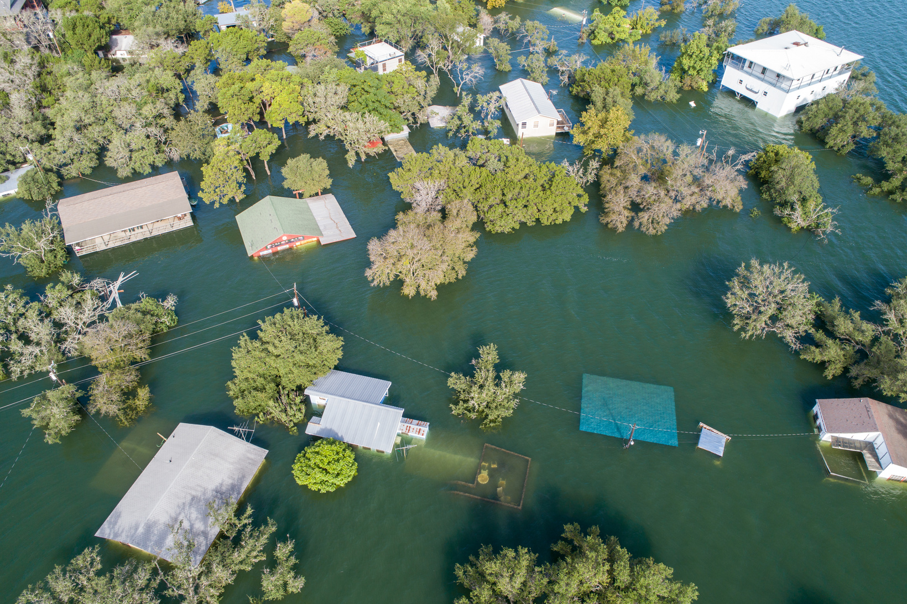
Module 5
Mitigation
Mitigation Actions
Mitigation Grants
EMA’s Role
Notes:
Chapter 5 of the State of Maine Local Emergency Management Director Handbook focuses on Mitigation. Mitigation involves actions to eliminate or reduce the effects of hazards such as flooding, severe storms, or wildfires. These actions can include communication, education, training, planning, or construction projects. The chapter highlights the importance of mitigation in preventing repetitive loss and hardship.
​
Key points include:
Types of mitigation actions: non-construction projects (e.g., town ordinances, training) and construction projects (e.g., upsizing culverts, removing houses from floodplains).
Mitigation grants: Flood Mitigation Assistance (FMA), Hazard Mitigation Grant Program (HMGP), and Pre-Disaster Mitigation-Competitive (PDM-C). These grants have specific eligibility criteria, including a 75/25 federal/local cost split and the requirement for FEMA-approved plans.
The role of the Maine Emergency Management Agency (MEMA) in administering these grants and providing support for mitigation planning and projects.

Slide 21
Mitigation
Module 5: Discussion Questions
What strategies can Local EMA Directors employ to proactively reduce hazard risks in their communities?
Community
What role does community engagement play in successful hazard mitigation efforts?
Funding
What funding sources are available for hazard mitigation projects in Maine?
Notes:
Strategies to reduce hazard risks
Enforce building codes and land-use policies that minimize disaster impacts.
Invest in infrastructure projects like flood barriers or fire-resistant construction.
Role of community engagement
Involve residents in identifying local risks and solutions to ensure buy-in.
Host workshops to educate the public on mitigation efforts and benefits.
Funding sources for mitigation in Maine
FEMA’s Hazard Mitigation Assistance programs (e.g., BRIC and FMA).
State and local grants tailored to specific risks like flooding or wildfires.

Slide 22



Module 6
Homeland Security
Dam Safety
MIAC
EMA’s Role
Notes:
Chapter 6 of the State of Maine Local Emergency Management Director Handbook covers Homeland Security. It outlines the roles and responsibilities of local Emergency Management Agencies (EMAs) in supporting homeland security efforts.
​Key points include:
Dam Safety:
The chapter also addresses dam safety, emphasizing the importance of regular inspections, emergency action plans (EAPs) for high and significant hazard potential dams, and remedial action plans (RAPs) to correct deficiencies.
It outlines the classification of dams based on hazard potential and the requirements for EAPs to ensure public safety.
Maine Information and Analysis Center (MIAC):
MIAC is Maine's designated fusion center, responsible for collecting, analyzing, and sharing intelligence between federal, state, and local agencies.
It provides analytical and investigative support for complex crimes and helps citizens report suspicious activities.
​
Local EMA’s Role in Homeland Security:
Local EMAs assist in identifying threats and vulnerabilities, securing infrastructure, preparing first responders, and strengthening public health preparedness.
They also play a role in informing and engaging the public, securing political and financial support, and upgrading communication networks.
Local EMAs are encouraged to promote citizen preparedness, report suspicious activities, and participate in training and exercises.
​

Slide 23
Integration
Module 6: Discussion Questions
How does local emergency management integrate with broader homeland security initiatives?
Resources and Partners
What resources are available to support local emergency management efforts related to homeland security? Who are some of the key partners to know?
Notes:
Integrating emergency management with homeland security initiatives
Align local response plans with state and federal strategies, including intelligence sharing.
Coordinate with the Maine Fusion Center to address emerging threats.
Resources and key partners
FEMA, DHS, CISA, and MEMA provide funding, training, and guidance.
Key partners include law enforcement, cybersecurity experts, and local critical infrastructure owners.

Slide 24
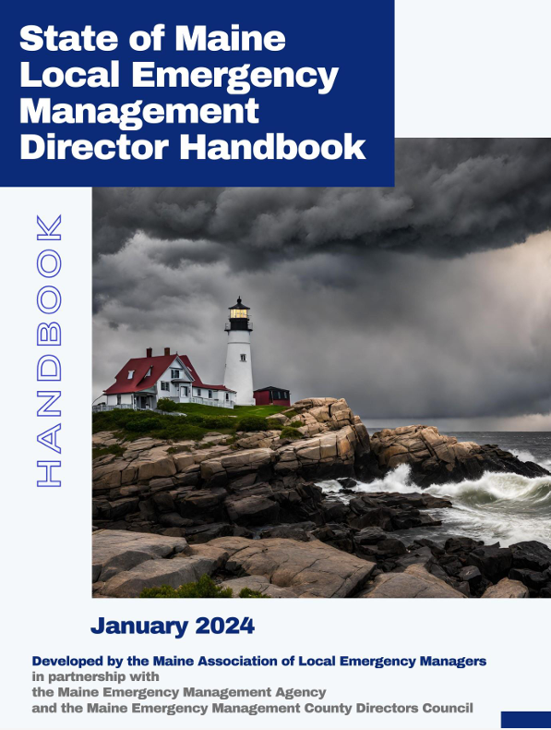
Tools and Resources
  WebEOC Info Sheet
  County EMAs
  Life Cycle of a Disaster
  Request for Assistance Flow Chart
  Acronyms
  References
  Authorities
  Commonly Used Web Links

Slide 25

Professional Development
  We recommend that emergency managers work on obtaining their Maine Basic Emergency Manager recognition. (MBEM-1 and MBEM-2). This program has two levels which are not difficult to obtain.
  Next step would be the Maine Certified Emergency Manager (CEM-ME).
  The International Association of Emergency Managers also have a Certified Emergency Manager designation that you can pursue.

Slide 26

Still Have Questions?
Notes:
Integrating emergency management with homeland security initiatives
Align local response plans with state and federal strategies, including intelligence sharing.
Coordinate with the Maine Fusion Center to address emerging threats.
Resources and key partners
FEMA, DHS, and MEMA provide funding, training, and guidance.
Key partners include law enforcement, cybersecurity experts, and local critical infrastructure owners.

Slide 27

Our Contact Information
Presenter Contact Information Here
Presenter Contact Information Here
Presenter Contact Information Here

Slide 28


THANK YOU
FOR ATTENDING
If you have any further questions or would like to explore opportunities to work together, please don't hesitate to reach out to us.

