Slide 1
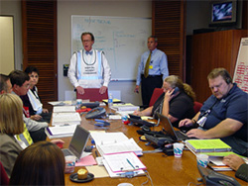
State of Maine Type IV
Emergency Operations Center Management

Slide 2

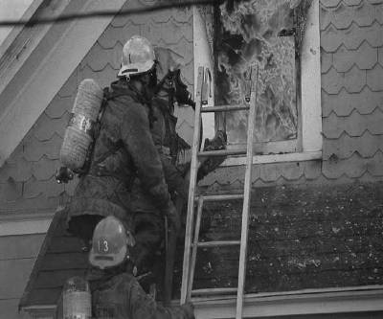
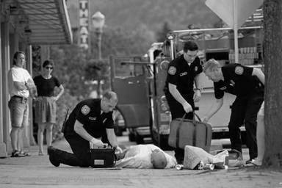

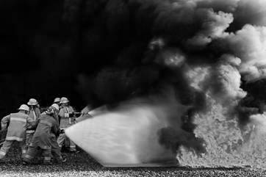
Terminal Objective
The goal of the course is to train the participants to set up and manage an EOC that can interface with incident commanders in the field while supporting local government, residents and businesses during a Type IV incident
2

Slide 3

Instructor & Participant Introductions
  Name
  Organization
  ICS Experience
  EOC Experience

Slide 4
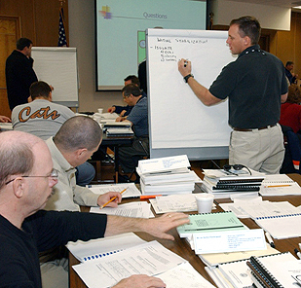
Enabling Objectives
Describe the relationship between the on-scene Incident Commander and the EOC
Discuss the decision making process that triggers the activation of the EOC
Identify staffing, communication systems, and equipment needs at the EOC.
Participate in a Table Top Exercise

Slide 5
LOCAL EMERGENCY MANAGEMENT PROGRAMS
Title 37B, §782. Agency directors
A director must be appointed for each municipal and county or regional emergency management agency. A director of an emergency management agency may not be at the same time an executive officer or member of the executive body of a municipality or inter-jurisdictional or county or regional agency of the State or a county commissioner. Notwithstanding this section or any other law, a town manager or administrative assistant may also be appointed to serve as the director of an emergency management agency.

Slide 6
NPP Emphasizes Partnerships
Federal Government Last Resort!
State Government Provides Support
Local Government First Response!
Individuals and Households
Private
Sector
Nongovernmental Organizations

Slide 7
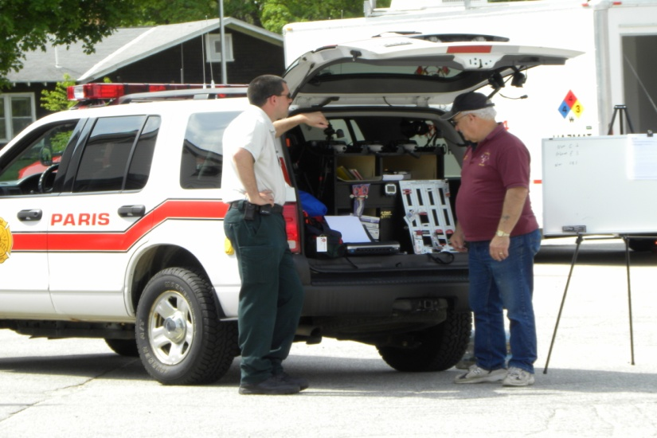
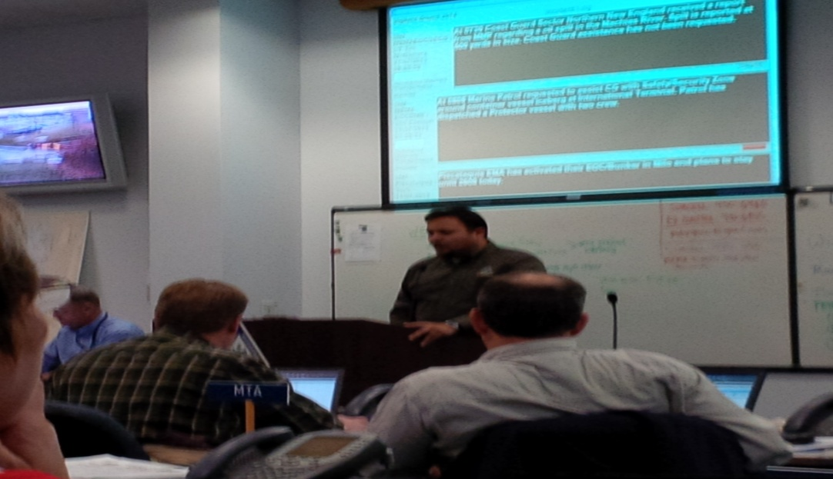
Objective
Describe the relationship between the on-scene Incident Commander and the local EOC.

Slide 8
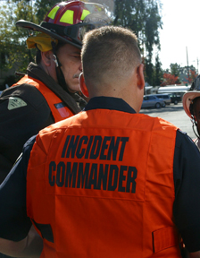
ICS Review - Incident Commander
Overall responsibility for response
Establish Command Post
Identify overall response strategy
Appoint staff
Manage the incident
Terminate the incident

Slide 9
ICS Review -Expanding the Organization
EOC
Incident
Command
Command Staff: Provide information, safety, and liaison services for the entire organization.
Public Information
Officer
Safety
Officer
Liaison
Officer
General Staff: Delegated functional responsibilities.
Operations
Section
Planning
Section
Logistics
Section
Finance/Admin
Section

Slide 10
ICS Review - Unified Command
EOC
Policy Group
Unified Command
Fire/EMS Incident Law Enforcement Public Works
Commander Incident Commander Incident Commander
Unified Incident Objectives
Liaison Officer
Planning Section Chief
Logistics Section Chief
Finance/ Administration Section Chief
Operations Section Chief
Public Information Officer
Safety Officer

Slide 11
EOC Purpose
Local
Emergency
Ops Center
(EOC)
County
Emergency
Ops Center
(EOC)
State
Emergency
Ops Center
(EOC)
. . . to provide a central location where government at any level can provide interagency coordination and executive decision making in support of the incident response.
Incident
Command
Notes:
tart l

Slide 12

Emergency Operations Center
Central location from
which to provide
logistical support
Interagency
coordination
  Communications
  Decision making
Orders, tracks, and
coordinates resources

Slide 13
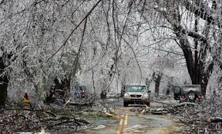
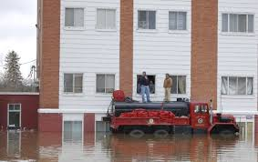
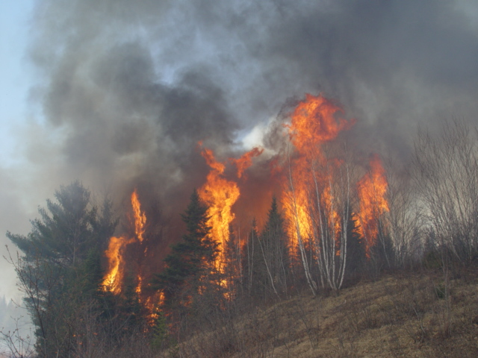
Events that call for EOC
Manmade disaster
  Terrorist event
  Building collapse
  Fires
Natural disaster
  Hurricane
  Blizzard
  Floods
Major events
  Sports
  Fairs
  Political conventions

Slide 14
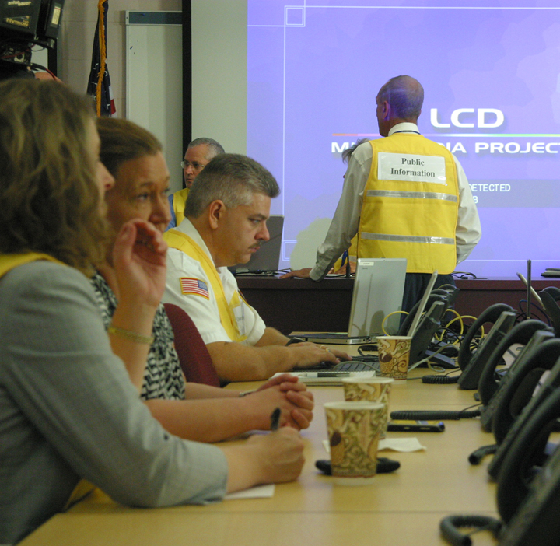
Duties of EOC
Support IC - Setting priorities
Collect & evaluate information
Provide situational awareness
Acquire, assign & track needed resources
Anticipate future resource requirements
Support on-scene activities
Logistical support/liaison with other jurisdictions
Declare local “state of emergency” if needed
Provide policy level support from chief exec’s or elected officials
Continue to manage the communities other needs

Slide 15
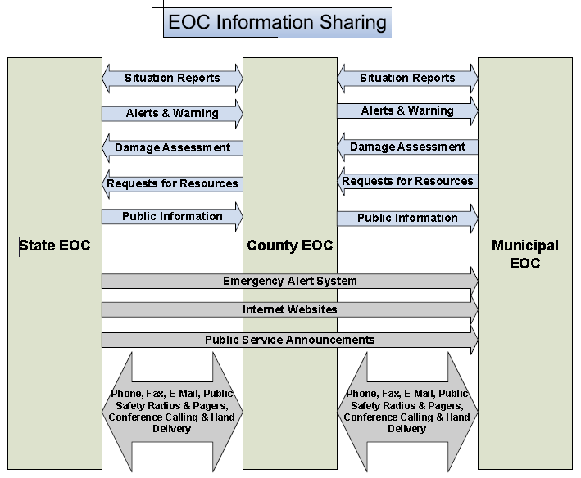

Slide 16
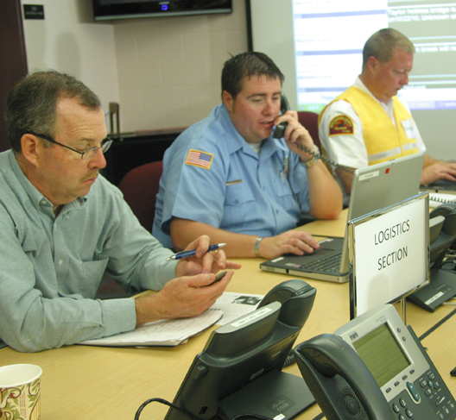
EOC staff
Come from various agencies
Come from various disciplines
Depends on the size of the jurisdiction & level of incident
From area agencies,
as well county and regional agencies.

Slide 17
Key Players at the EOC
  Local Emergency Manager
  Chief Elected Official(s)
  Town/City Manager/Clerk
  Chiefs of Police, Fire and EMS departments
  Directors of Public Works/Utilities/Facilities
  Chief Financial Officer
  Communications personnel (e.g., 911, Dispatch, ARES)
  Others?

Slide 18
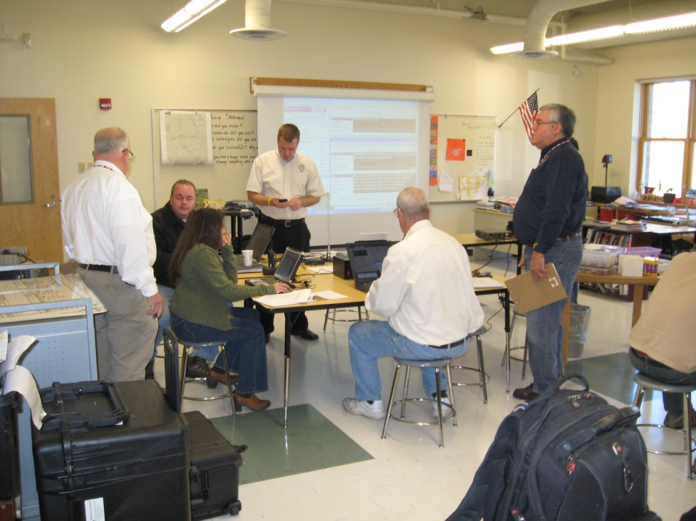
The Policy Group
The Policy Group is comprised of the Chief Elected Official, or designee, and immediate staff. The Policy Group focuses on the overall strategy for the response (beyond the strategy developed by the Incident Commander at the scene), the overall response priorities, and policy setting.

Slide 19
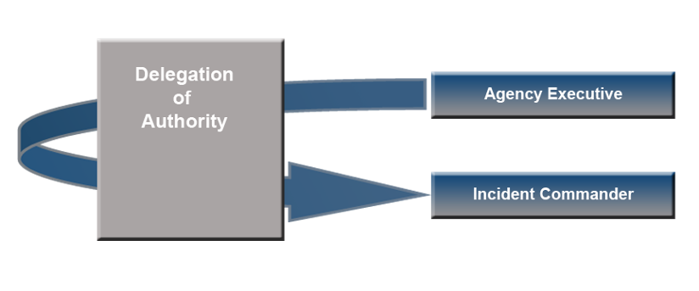
Delegation of Authority obj 1
A statement provided to the Incident Commander by the Agency Executive delegating authority and assigning responsibility.
  Delegations to the Incident Commander should be prepared and signed by the Agency Executive.

Slide 20
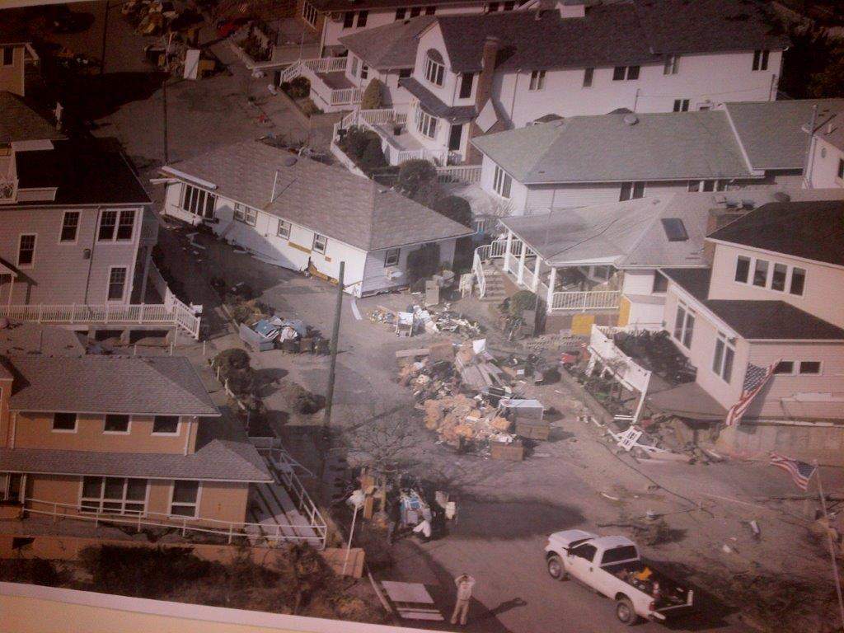
Objective 2
Discuss the decision making process that triggers the activation of the EOC in your community

Slide 21
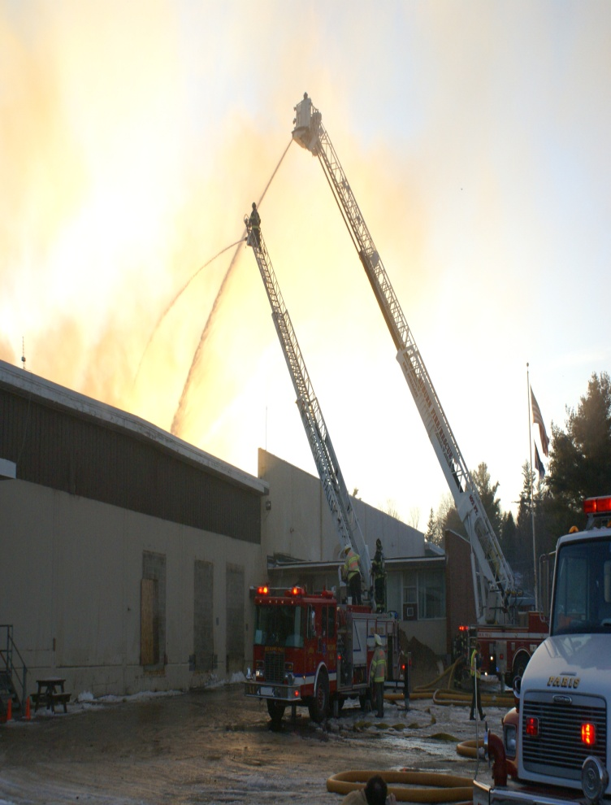
Triggers for activation
IC feels incident could expand rapidly
Establishment of Unified Command
Involvement of multiple jurisdictions
Amount of resources needed
Threshold events
  Described in Emergency Operations Plan

Slide 22
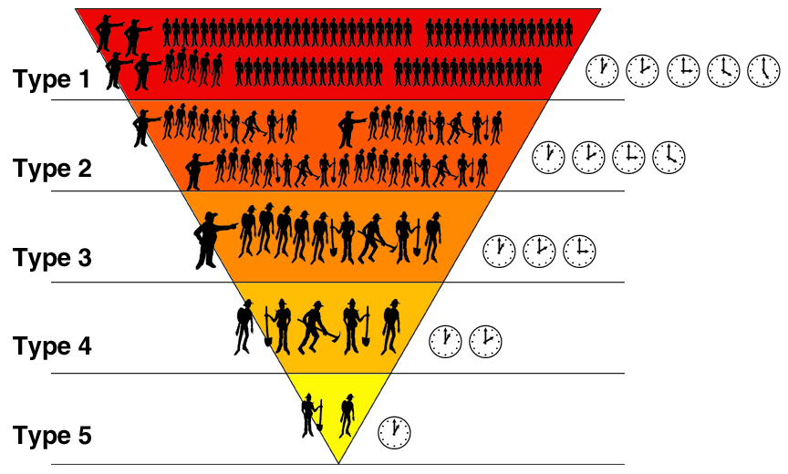
Incident Typing
95% of all incidents

Slide 23
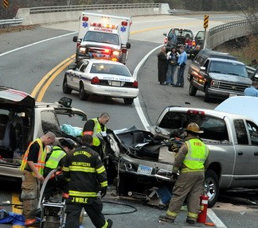
Type 5 incident
Minor in nature
Stabilized quickly
Minimal threat to public safety
EOC generally not activated

Slide 24
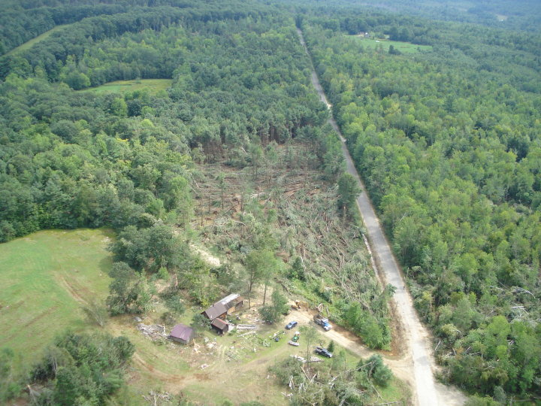
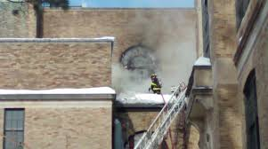
Type 4 incident
Localized incident
  Vapor release
  Accident w/ multiple injuries
Public safety/ environment threatened
Evacuation may be required
EOC may be activated

Slide 25
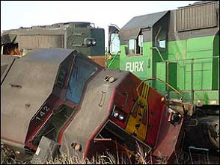
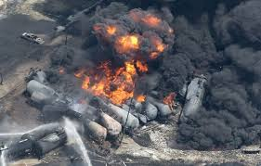
Type 3 Incident
Threatens public health, safety, environment
  Active shooter event
  Toxic chemical accident
Requires local/regional/ state resources
Impacts community or larger area
EOC coordinates with responding agencies
Notes:
.

Slide 26
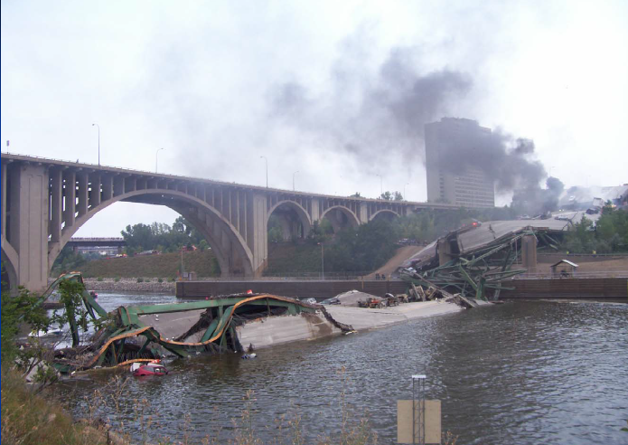
Type 2 Incident
Regional or national response resources required
  Flood
  Earthquake
Long lasting (several days/weeks)
EOC maintains communication with other local & regional EOCs

Slide 27
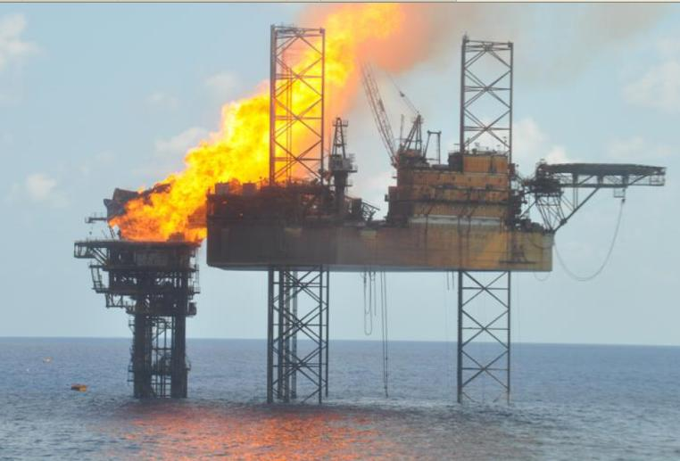
Type 1 Incident
Incident of national significance
  Terrorist attack
  Deep Water Horizon type disaster
Long lasting (weeks/months)
High impact on local jurisdiction
EOC activated throughout incident

Slide 28
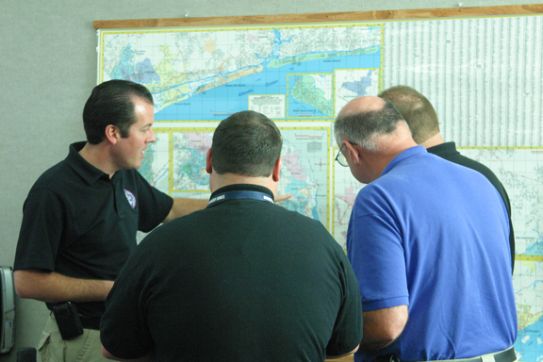
EOC Activation Levels
Level I
  Fully equipped
  Fully Staffed 24/7
  Immediate start-up
Level II
  Some systems & equipment
  Moderate start-up period
  Key personnel
  Request County EMA Staff support
Level III
  Space available but not outfitted
  Longer start-up period
  Notify County EMA

Slide 29
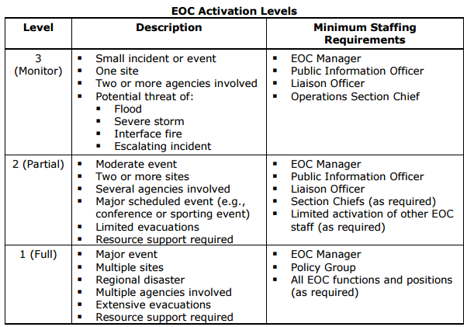
EOC Activation Levels obj 2

Slide 30
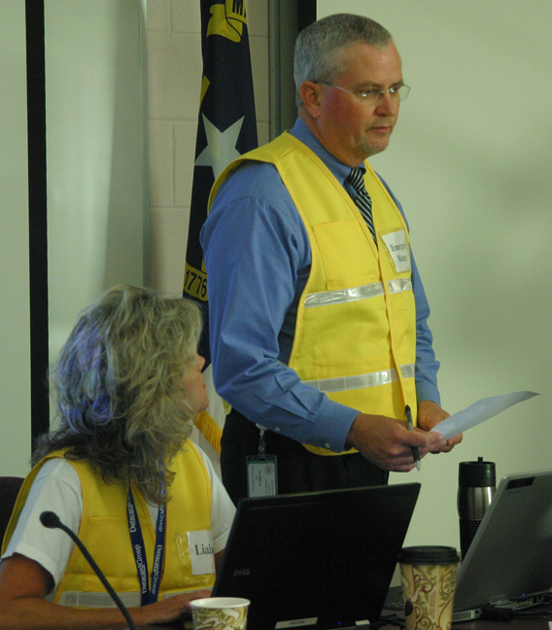
Objective 3
Identify staffing, communication systems, and equipment needs at the EOC.
The structure of the EOC mirrors the structure of Incident Command

Slide 31
EOC Structure
Board/Council Chair
EOC Manager
Liaison Officer
PIO
EOC Command Staff
(as needed)
Safety Officer
Intelligence Officer
Legal Counsel
Medical Advisor
EOC General Staff
Operations
Chief
Planning
Chief
Logistics
Chief
Finance/Admin
Chief

Slide 32
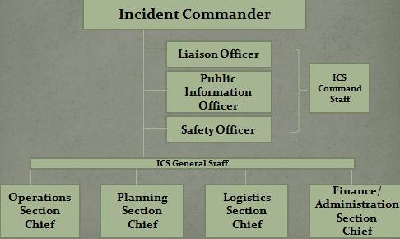
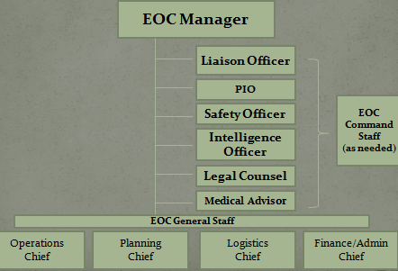
Positions - On scene EOC

Slide 33
EOC Manager
Overall responsibility for EOC
Supports Command
Provides technical expertise
Does not have IC authority or responsibilities

Slide 34
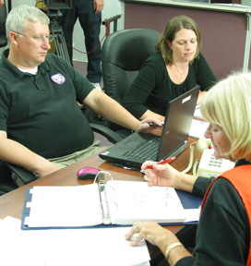
EOC responsibility
Support the requirements needed for incident management
Create communications plan
Establish incident communications center
Utilize procedures to access funds
Implement mutual aid program
Collect & manage information
Damage Assessment
Maintain Incident Log

Slide 35
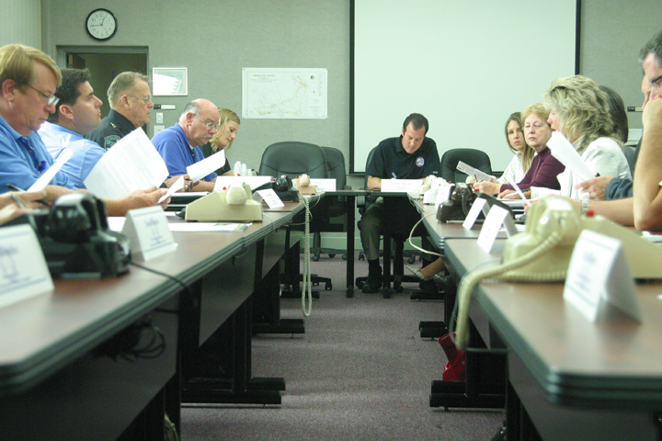
Planning meetings
Attended by Command & General Staffs
Conducted by Planning Section Chief
Situation & resources evaluated
Incident Action Plan prepared

Slide 36
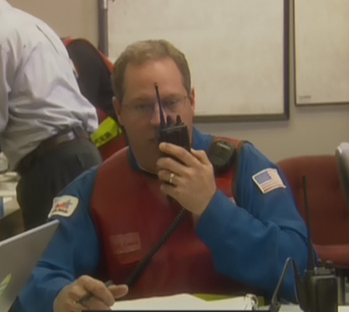
Resources
EOC receives requests from Command & General Staff
EOC orders necessary resources
Prioritizes & assigns resources
Tracks resource use
Arranges payments

Slide 37
Accessing & Ordering Resources
Local – private sector such as contractors, stores, etc
Mutual aid – emergency responders/equipment
State – MEMA response teams
Interstate – border towns
Non-governmental
organization s– Red Cross, Salvation Army
Federal assistance - FEMA

Slide 38
EOC Public Information Officer
Interfaces with the on scene PIO
Provides information to the public
Issues alerts and warnings
Manages the JIC
Manages Social Media

Slide 39
Joint Information Center
Includes representatives from agencies involved in incident management
Co-located with EOC
Primary source for incident information
Disseminates warnings
Communicates operational decisions
Provides status updates
Recommends public information plans

Slide 40
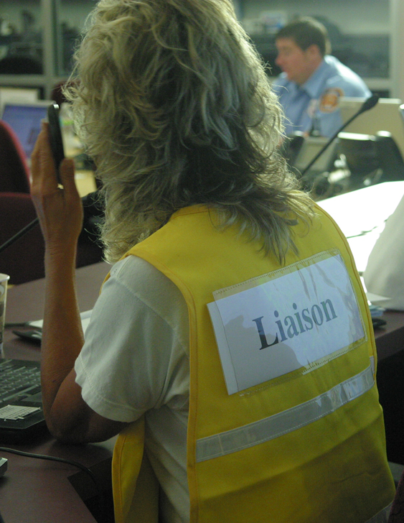
EOC Liaison Officer
Locates and establishes contact with responding agencies
Liaison with on scene LNO
Assists agencies
  Red Cross
  Utilities
  Organizations affected by incident

Slide 41
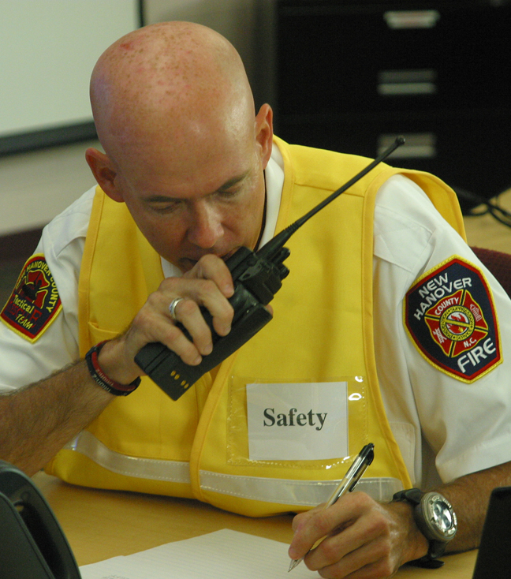
EOC Safety Officer
Interfaces with the on scene Safety Officer
Supplies necessary safety equipment
Provides site safety plans
Interface with ME BLS, OSHA & other government agencies

Slide 42
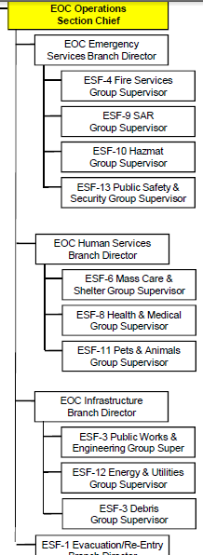
Operations Section
The Operations Section Chief is
responsible for the management of
all operations directly applicable to
the emergency response.
Ensure the activities of the Emergency Support Functions (ESFs) are carried out within the EOC and in accordance with response objectives and priorities
Monitor status of all field operations
Organize, assign, and supervise all tactical and/or response resources

Slide 43
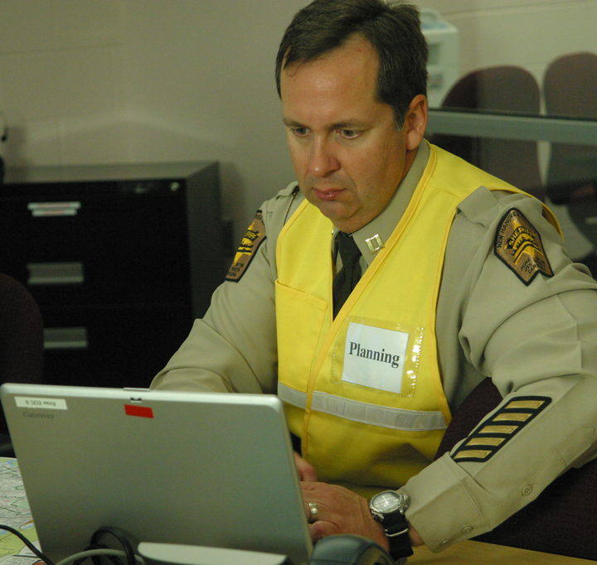
Planning Section
Responsibilities
  Collect & evaluate information
  Create & update IAP
  Conduct Planning Meetings
  Manage Technical Specialists
Units
    Situation Unit
    Resources Unit
    Documentation Unit
    Demobilization Unit

Slide 44

Logistics Section
Responsibilities
  Obtain resources to support response
Units
  Supply Unit
  Facilities Unit
  Ground Support Unit
  Food Unit
  Communications Unit
  Medical Unit

Slide 45
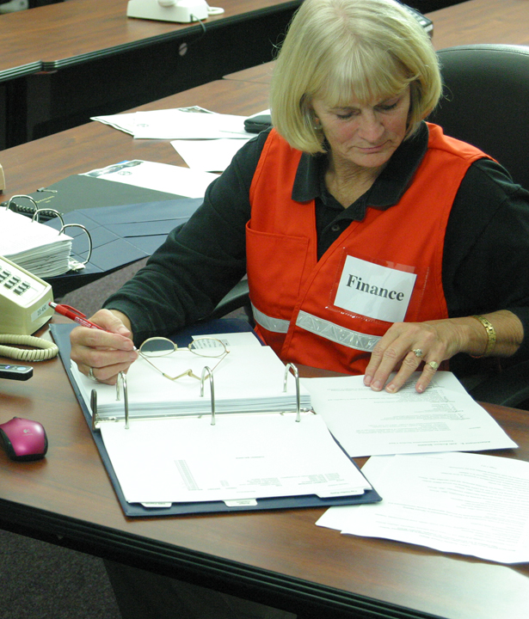
Finance/Administration Section
Established during complex scenarios
Responsibilities
  Approve purchasing (PO#)
  Maintain financial records
  Forecast funding needs
  Reimbursement
Units
  Time Unit
  Procurement Unit
  Compensation & Claims Unit
  Cost Unit

Slide 46
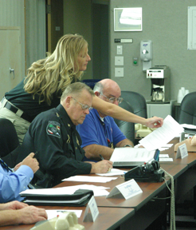

Incident Action Plan
Incident objectives & strategy
Actions to achieve objectives
Work assignments
Resource requirements
Safety Plan

Slide 47
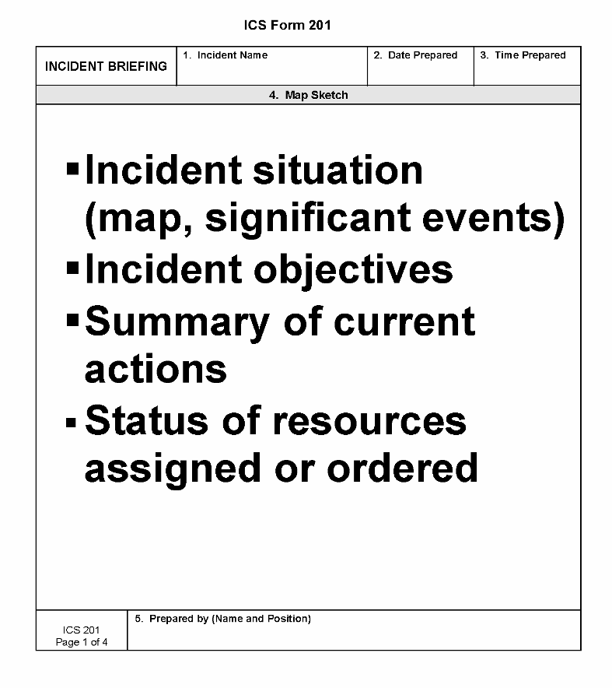
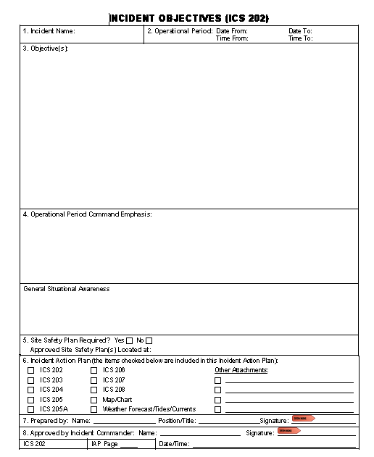
ICS Forms
201 Incident Briefing
202 Incident Objectives

Slide 48
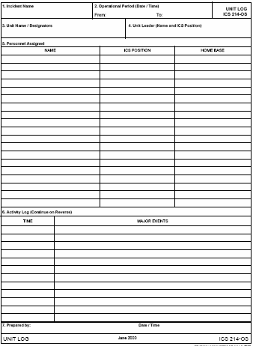
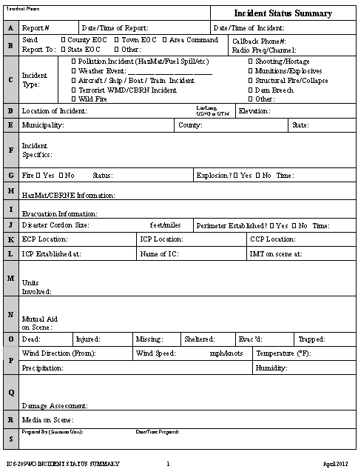
214 Activity Log ME 209 SitRep

Slide 49
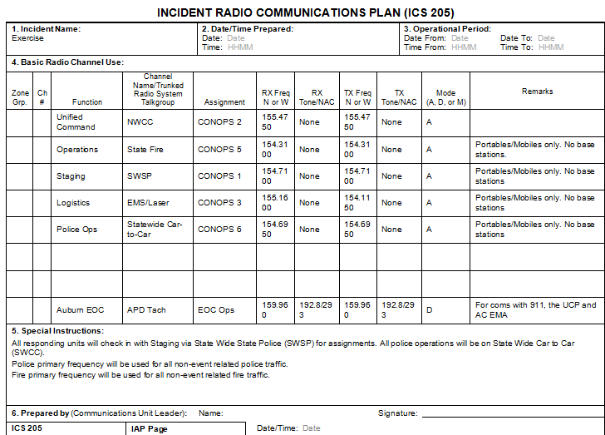
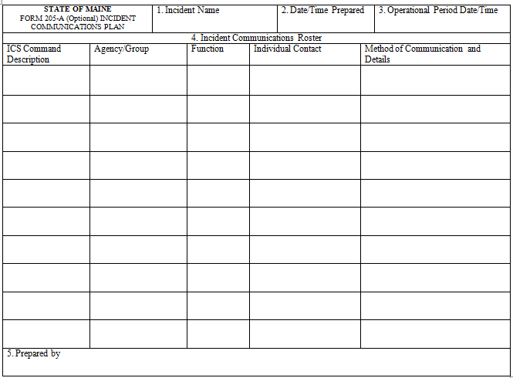
205 Com Plan ME 205A Com Roster

Slide 50
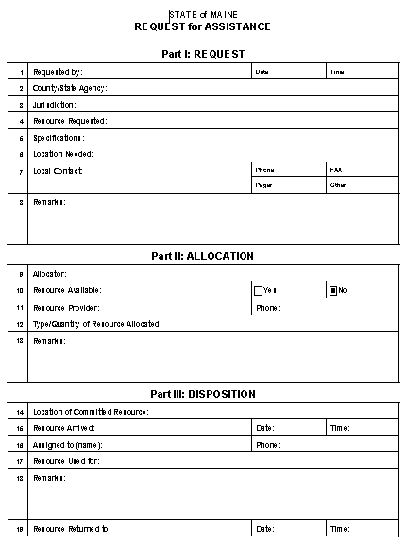
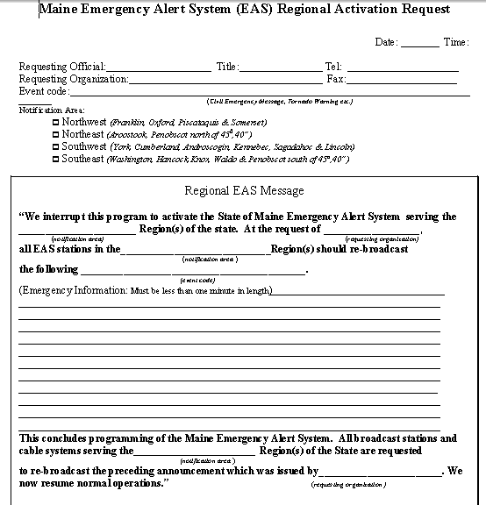
MEMA Forms Link

Slide 51


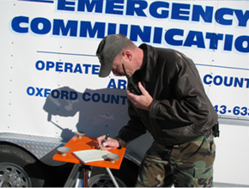
County Resources

Slide 52
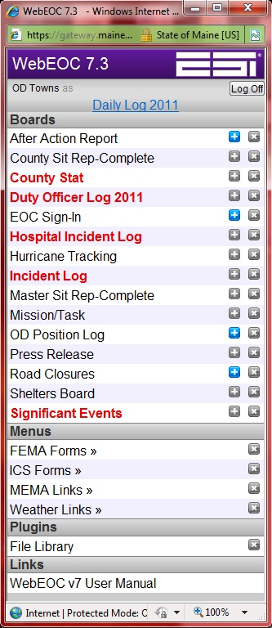

WebEOC

Slide 53


MEMA Resources
Planning, Exercises, Training
IMATs
Hazmat Teams
Communication systems
Private Sector Partners
Support of County Teams – CERT, CART, ARES.
Other State Agencies -

Slide 54

Portable/Mobile EOC’s
portable radio(s)
land line phone(s)
cell phone(s)
white board/flip chart
note pads/pens/markers
computer /printer
basic ICS forms
area maps
local/county resource book

Slide 55



Examples

Slide 56



Closet

Slide 57


Trucks/Trailers

Slide 58



Position Identification obj 3

Slide 59

Objective 4
Participate in a Table Top Exercise
This basic TTX will be a facilitated discussion
Problems are discussed as a group and resolution
is reached

Slide 60

Additional Resources
http://www.training.fema.gov/emiweb/IS/ICSResource

Slide 61

MEMA
Michael F. Grant, State NIMS Coordinator
Maine Emergency Management Agency
Phone: 207-624-4460
Email: michael.f.grant@Maine.gov
Steve Soucy, State Training/Exercise Coordinator
Maine Emergency Management Agency
Phone: 207-624-4460
Email: stephen.soucy@Maine.gov

Slide 62

FINAL
Review Course Expectations

