Slide 1
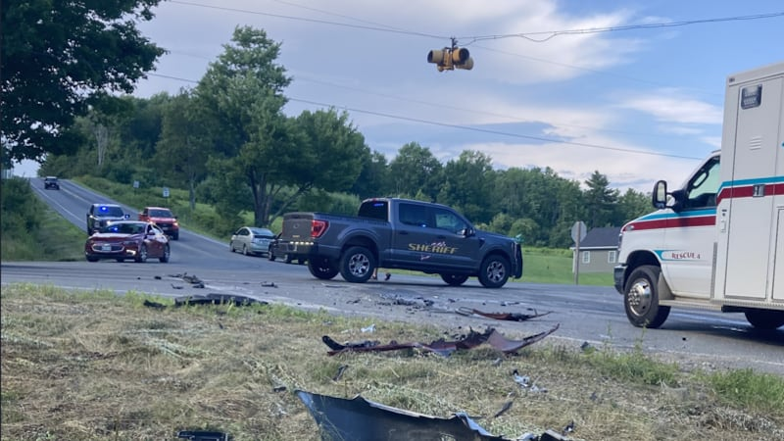
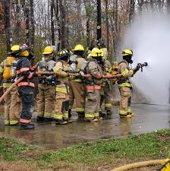
W195T – Overview of the Incident Command System (ICS)
Notes:
5
5

Slide 2
Incident Command System
ICS is an on-scene incident management system
Enables an effective and efficient incident response
Incorporates facilities, equipment, personnel, procedures and communications
Common organizational structure
Used to organize on-scene operations
Used for all levels of emergencies, from small to complex incidents, and both natural and manmade
Notes:
5
5

Slide 3
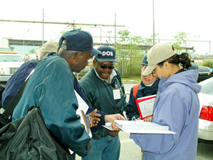
Incident Command System
Purpose
Organizational Format
Incident Facilities
Incident Action Plan
Resource Management
Notes:
5
5

Slide 4
Purpose
To provide a coordinated effort by emergency responders to stabilize the incident in order to protect lives, property and the environment.
Notes:
5
5

Slide 5
The ICS process must
Meet the needs of incident of any kind or size
Provide logistical and administrative support
Allow personnel from a variety of agencies to form rapidly into a single management structure
Notes:
5
5

Slide 6
ICS General Tasks
Establish Incident Command
Identify the Incident Command Post (ICP)
Establish an ICS Organization
Ensure safe work practices
Determine Objectives
Maintain span of control
Manage resources
Coordinate activities
Notes:
5
5

Slide 7
ICS Concepts
Unity of Command: Everyone has one designated supervisor
Chain of Command: Orderly ranking of management positions in line of authority
Incident Named After Location of Incident.
Notes:
5
5

Slide 8
Organizational Format
Incident Commander
Public Information
Officer
Liaison
Officer
Safety
Officer
Operations Section
Planning Section
Logistics Section
Finance/Admin. Section
Resources
Unit
Demob.
Unit
Service
Branch
Support
Branch
Time
Unit
Compensation
Claims Unit
Branches
Air Ops
Branch
Situation
Unit
Doc. Unit
Procurement
Unit
Cost
Unit
Commun.
Unit
Supply
Unit
Divisions
Groups
Medical
Unit
Facilities
Unit
Strike Team
Task Force
Food
Unit
Ground
Support Unit
Single Resource
Notes:
8
10

Slide 9
Organizational Format
Notes:
8
10

Slide 10
Maintain Accountability
Unity of Command used to assure personnel accountability
Supervisors are responsible for knowing who is assigned to them and where they are located
Use a tracking system (logs, tags, etc)
Impacted by geography, number of personnel and difficulty of assignments
Notes:
5
5

Slide 11
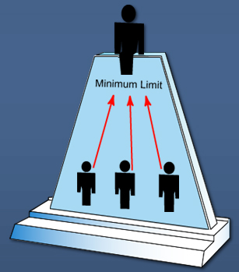
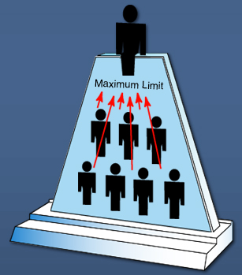
Span of Control
Number of individuals one supervisor can effectively manage
Usually 3 to 7 subordinates; average 5
Notes:
12
13

Slide 12
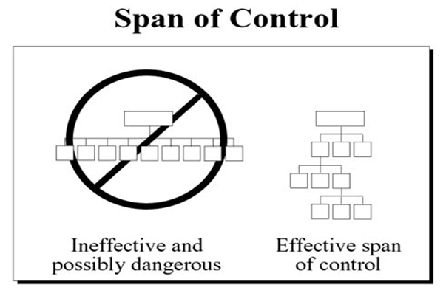

Slide 13

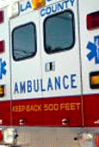
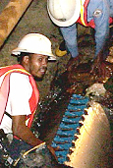
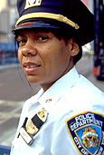
Typical Organizational Structure
In approximately 99% of incidents, the organizational structure consists of
Command
Single Resources
Incident Commander
Notes:
12
13

Slide 14





Expanding Incident Structure
Expanding incidents may add supervisory layers to the organizational structure as needed
Command
Incident Commander
Sections
Operations Section Chief
Branches
Units
Single Resources
Divisions
Groups
Notes:
12
13

Slide 15
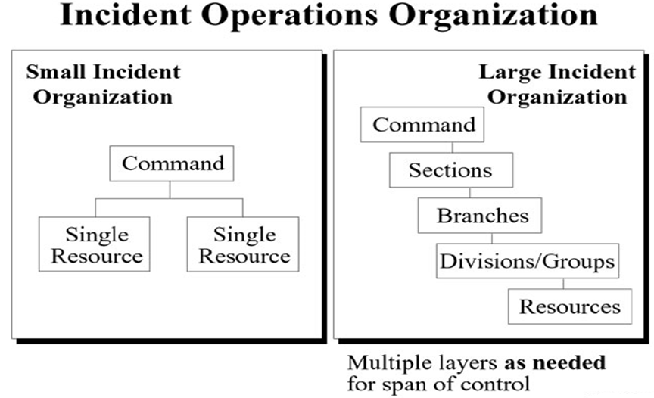

Slide 16
Common Terminology
No “Ten” Codes
Speak in the clear
Think through what you want to say, before keying the mike
Keep messages short and to the point
Notes:
12
13

Slide 17
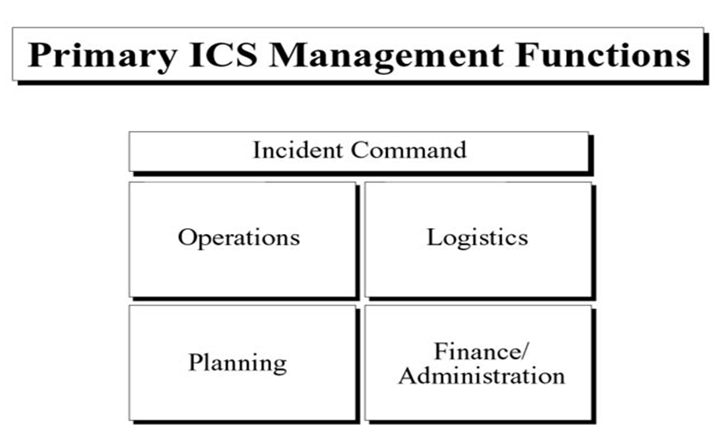

Slide 18
ICS Management Functions
COMMAND: Set objectives and priorities; overall incident responsibility and control
OPERATIONS: Conduct and direct tactical operations
PLANNING: Develop an Incident Action Plan to accomplish objectives; collect information & track resources
LOGISTICS: Provide support
FINANCE: Monitor and pay the costs
Notes:
41
38

Slide 19
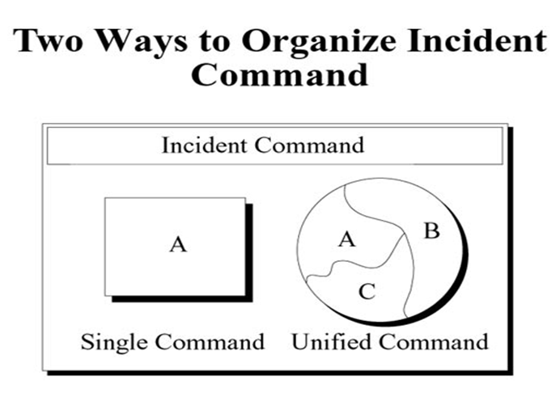

Slide 20
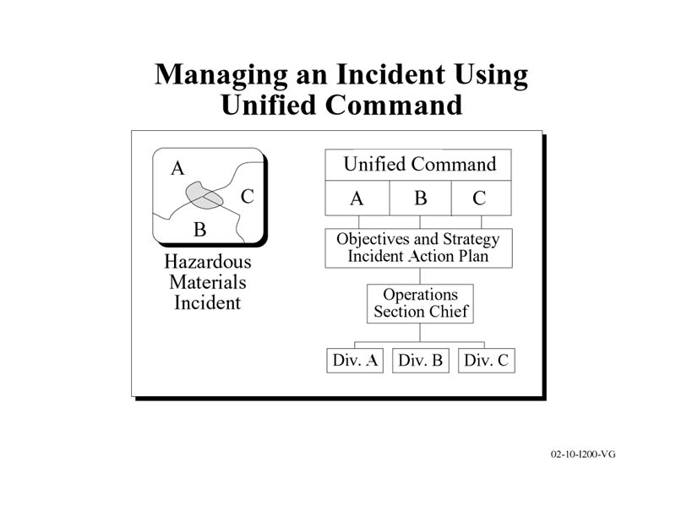
Only one Incident Command Post
Only reps from agencies with jurisdictional or function authority
Only one Operations Section Chief
Only one Incident Action Plan
Jointly develop a common set of incident objectives and strategies

Slide 21
Command & General Staff
Incident
Commander
Public Information
Officer
Liaison
Officer
Command Staff
Safety
Officer
General Staff
Operations
Section
Planning
Section
Logistics
Section
Finance/Admin
Section
Notes:
20
20

Slide 22
Incident Commander
All incidents, regardless of size, must have an Incident Commander to be the final word on decisions
Upon arriving at an incident, the higher-ranking person will either assume command, maintain command as is, or reassign command to another person
May expand the command structure as needed
Shall determine the overall incident objectives
Notes:
44
40

Slide 23
Public Information Officer
Point of Contact for the Media and Public
Develops public warning messages
Develops news releases and briefings
Receives IC’s approval before release of information
Establishes Media Center
Notes:
45
41

Slide 24
Safety Officer
Monitor safety conditions
Develop measures for assuring personnel safety
Review incident action plan for safety implications
Exercise emergency authority to stop life threatening unsafe acts
Conduct safety briefings
Notes:
49
45

Slide 25
Liaison Officer
The primary contact for supporting agencies assigned to the incident.
Is expected to coordinate with assisting or cooperating agencies
Notes:
49
45

Slide 26
Operations Section
Develop tactical objectives
Direct tactical operations
Control staging operations
Determine needs and request additional resources
Notes:
21
21

Slide 27
Operations Section
Operations
Staging
Group
Group
Division
5-7 Groups/Divisions
(Fire, Police, EMS, etc)
1
2
5-7 Resources per Group/Division
(Interior, Exterior, Traffic Control, Ambulance, etc.)
Notes:
22
22

Slide 28
Divisions (Geographic)
Fire Division
Side A
Side B
Side C

Slide 29
Groups
Fire Group
Fire Suppression
Water
Supply
Traffic Control

Slide 30
Staging
Staging is under the Operations Section
Used to locate resources that are on scene but haven’t been assigned a task
Several staging areas may be used
SCBA Firefighters
Ambulances
Operations
Staging

Slide 31
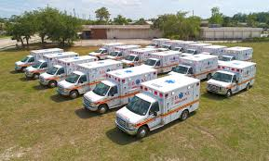
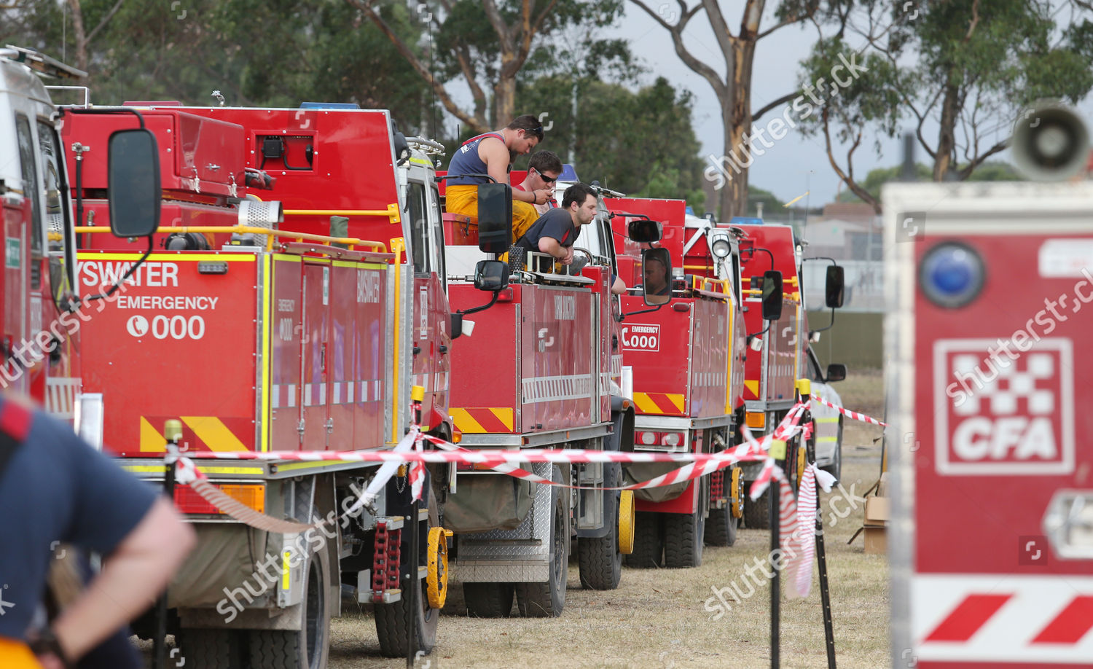
Staging Areas

Slide 32
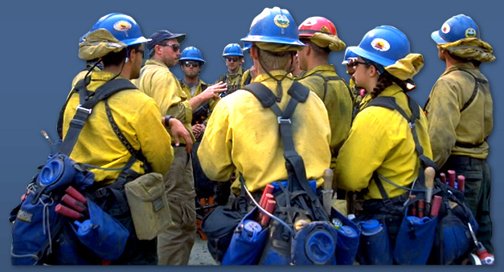
Strike Team
A group of resources of the same size and type
Firefighters on an attack line
Police Officers performing traffic control
Public Works dump trucks hauling debris
Single Leader

Slide 33
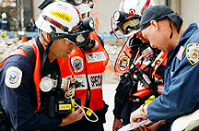
Task Force
Different resources grouped together
Three Firefighters, two police officers, one EMS responder
Assembled for a specific operational task
Single Leader

Slide 34
Single Resource
An individual, a piece of equipment and its personnel complement, or a crew or team of individuals with an identified work supervisor that can be used at an incident.
Examples: patrol car with officer, a bomb disposal technician, a bulldozer, a FD engine company, etc

Slide 35
Planning Section
Resources unit
Identify what resources are needed and track when available
Situation Unit
Constantly assess the incident; perform incident size-up
Documentation Unit: Document all incident activities
Demobilization Unit: Plan and brief demobilization
Technical Specialists: Experts with special knowledge
Planning Section
Resources
Unit
Demobilization
Unit
Situation
Unit
Documentation Unit
Notes:
31
28

Slide 36
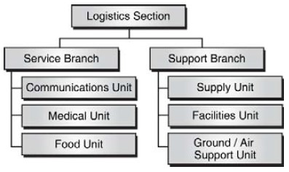
Logistics Section
Communications support
Responder medical support
Feeding responders
Supplies
Facilities
Transportation
Notes:
32
29

Slide 37
Finance/Admin Section
Time Unit (Personnel time)
Procurement Unit (Equipment & rental contracts)
Compensation / Claims Unit
Cost Unit (cost estimates)
Finance/Admin. Section
Time
Unit
Compensation
Claims Unit
Procurement
Unit
Cost
Unit
Notes:
39
36

Slide 38
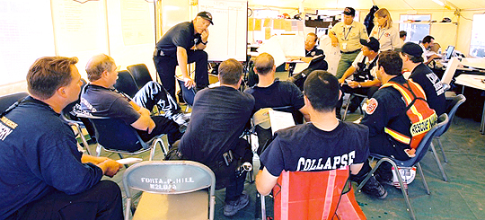
Incident Facilities
Incident Command Post
Base
Emergency Operations Center
Notes:
38
35

Slide 39
Incident Command Post
The location at which the primary command functions take place; there is only one ICP
The Incident Commander is located at the ICP
It is a physical location; should be marked
A building, vehicle or command trailer could be used
Notes:
38
35

Slide 40
Base
The location at which incident logistics functions are coordinated and administered.
The ICP is located at the Base.
Notes:
38
35

Slide 41
Emergency Operations Center
Located in a fixed facility such as a municipal office or fire station
The EOC is organized by the emergency management program.
An EOC is where department heads, government officials and volunteer agencies gather to coordinate their response to an emergency event.
Provide off-site support to one or more incidents.
Notes:
38
35

Slide 42
Incident Action Plan
A written or oral plan of future operations
Assign resources to tactical objectives
Developed for each “operational period” by the Planning Section
Approved by the Incident Commander
Implemented by the Operations Section
Supported by the Logistics and Finance Sections

Slide 43
Management by Objectives
Assess situation
I have 3 people trapped in car
Establish objectives
I need to rescue the 3 people in next 10 minutes
Perform tactical operations
Perform Jaws of Life Extraction (need Jaws crew)
Stabilize and extract victims (need Firefighter/EMS 3-person team)
Load and transport victims (need 3 crewed ambulances)
Determine success of objectives
Done in 8 minutes!

Slide 44
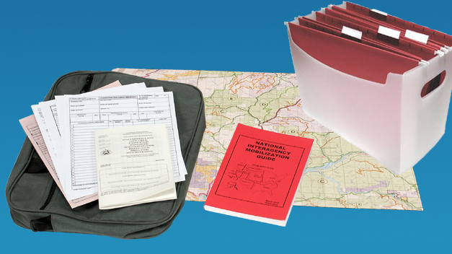
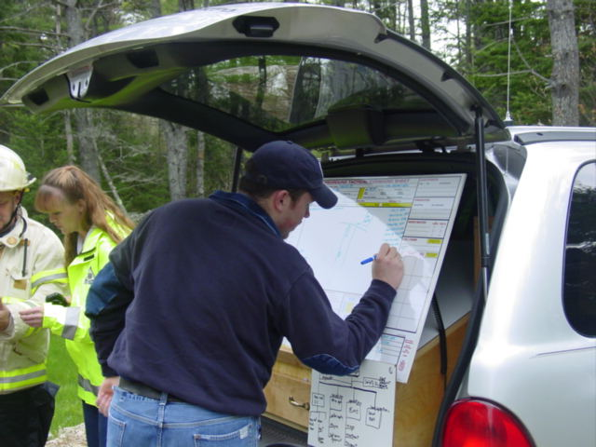
ICS Tools
ICS Forms
Checklists
SOPs
Maps

Slide 45
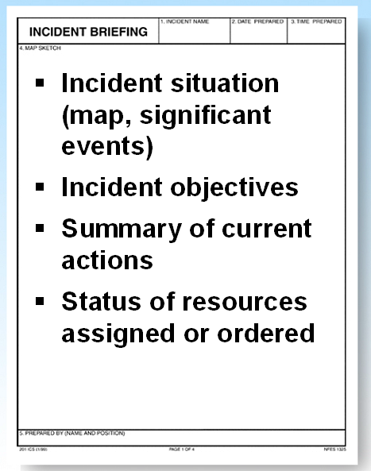
ICS Form 201 Incident Briefing
For small incidents, you can use a ICS Form 201 to create a simple Incident Action Plan
Map, Objectives, Actions to Take, Resources, Comm Plan

Slide 46
Resource Management
Resource Status | AVAILABLE | ASSIGNED | OUT OF SERVICE
Definition | Ready for Deployment | Completing work tasks | No longer able to perform tasks
Location | Staging | Incident Scene | Rehab, Off Scene, etc
Example | SCBA firefighters standing by | SCBA firefighters in house | SCBA firefighters in Rehab
Notes:
16
27

Slide 47
Resource Management
Develop Resource Lists prior to emergency events
Checklists are helpful for tracking resources
Preplan communication assets and frequencies

Slide 48
Checking In (Tagging In)
Officially logs you in at an incident
Ensure personnel accountability
Allow for resources to be tracked
Prepare personnel for assignments
Locate personnel in case of an emergency
After Check-In, locate your supervisor and obtain your assignment

Slide 49
Incident Typing
Incidents are categorized by five types based on complexity
Type 1 is the most complex, requiring national resources to safely and effectively manage and operate
Type 5 is the least complex; handful of local responders
Type 1
Complexity
Type 5

Slide 50
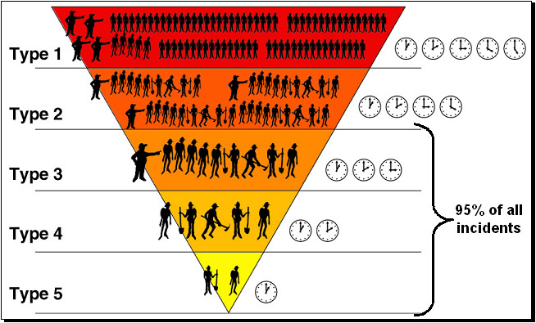
Incident Typing Overview

Slide 51
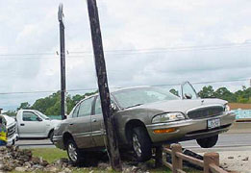
Type “5” Incident
Incident Commander
2-12 responders
1-3 Hours
No written IAP

Slide 52
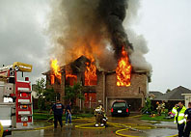
Type “4” Incident
Incident Commander
Some Staff Positions
Safety Officer, Public Info, Check-In,
Planning, Food
10-30 responders
2-6 Hours
Consider a written IAP

Slide 53
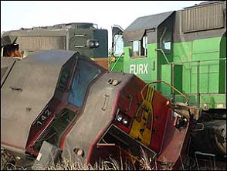
Type “3” Incident
Incident Commander
All General and Command Staff Positions
Branches, Groups, Teams
Many responders
1-7 days
Written IAP
Operational briefings

Slide 54
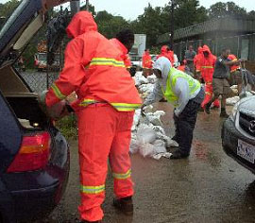
Type “2” Incident
Local, State and/or National resources
200-500 responders
Days or weeks
Written IAP
Operational briefings

Slide 55
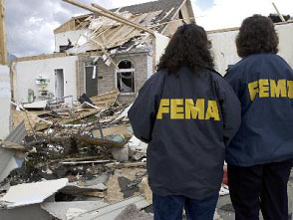
Type “1” Incident
“Incident of National Significance”
Local, State and National resources required
Weeks or months
Written IAP
Operational briefings

Slide 56
Incident Management Assistance Teams (IMATs)
IMATs are used to support an incident with additional incident management personnel.
IMATs include trained and equipped personnel to non-operation positions.
Waldo County IMAT consists of County EMA staff and volunteers

Slide 57
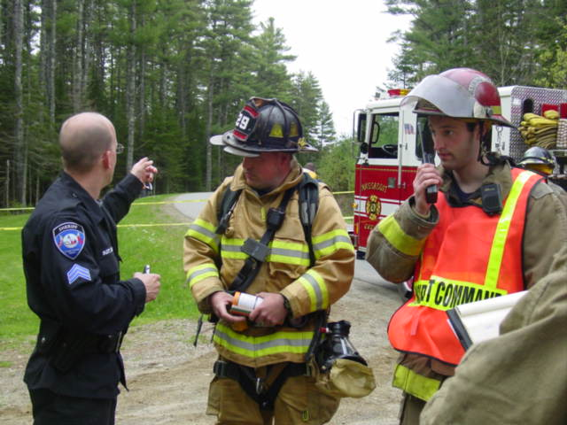
Incident Command System
Discussion Exercise
Notes:
5
5

Slide 58
Dispatch
“_____ Fire Department. There is a 2-car accident located at the intersection of ________ and _____ . Unknown injuries at this time. Time of Page 1700.”
Units Dispatched – 1 Engine, 1 Rescue, 2 ambulances and 1 SO.
Arrival: Fire Chief, Asst Chief, LT and five firefighters. 1 paramedic and 1 AEMT. 1 SO
Notes:
Evaluator will provide ICS booklets, sitemap, matchbox cars, figurines and writing surface (whiteboard or chart paper)
Select Incident Commander. IC should complete size up and track resources (personnel and equipment)

Slide 59
Size Up Completed
Busy road intersection. Traffic backing up.
1st car – 8 passenger van – 2 adults and 6 children – major side impact – on side
2nd car – small box truck – 2 adults – front end crushed – smoke coming from engine
Notes:
List out resources.
Start an ICS organization chart.
Create a radio comm plan.
What are your objectives?
What are the safety concerns and protective actions?
Are you asking for more resources?

Slide 60
Follow-up Information
Rescue started. 3 children are trapped under a crushed bench seat.
One of the box truck adults, with a bloody head runs off into the woods.
BDN Reporter shows up.
Notes:
Have your objectives changed?
Are you asking for more resources?
Update list out resources.
Update the ICS organization chart.
Is radio comm plan sufficient?

Slide 61
Follow-up Information
Triage, treatment and transport underway.
1 child still trapped in van.
The van cargo area was opened to look for fire extension. A damaged Meth Lab lies broken on the floor of the cargo truck.
Notes:
Have your objectives changed?
Are you asking for more resources?
Update list out resources.
Update the ICS organization chart.
Is radio comm plan sufficient?
New safety concerns and protective actions?

Slide 62
Follow-up Information
All the victims have left the scene by ambulance.
The area is now cordoned off with a 1,000-foot cordon.
Waiting on DEP HazMat Team.
MSP on scene with crime investigation crew/truck.
Firefighters performing traffic control and standby fire suppression.
EMS crew and ambulance on standby for responders.
Sun has set.
Notes:
Who is acting as Incident Command?
Have your objectives changed?
Update list out resources.
Update the ICS organization chart.
Is radio comm plan sufficient?
New safety concerns and protective actions?

Slide 63
After-Action Review
What worked well?
What can be improved?
Was objectives, organization, resource mgmt., span of control, unity of command, and communications effective?
Notes:
Who is acting as Incident Command?
Have your objectives changed?
Update list out resources.
Update the ICS organization chart.
Is radio comm plan sufficient?
New safety concerns and protective actions?

