Slide 1

W-402
National Incident Management System (NIMs) and Emergency Management Overview for Executives/
Elected Officials
Notes:
Purpose: The purpose of this course is to provide an orientation to the Incident Command System (ICS) for Executives and Senior Officials (including elected officials, city/county managers, agency administrators, etc.).
Time: 2 hours
Content Outline: This presentation includes the following major topics:
Part 1: What Is ICS?
Part 2: ICS Organization & Features
Part 3: Unified & Area Command
Part 4: Coordination & Incident Management Assessment
Part 5: NIMS Preparedness
Equipment:
Computer and projector
Extension cord and power strip (if needed)
Materials:
Copies of the Briefing Package - Recommend printing 2 slides per page in color. You can use the accompanying PDF file to ensure proper printing.
Handout: Resource Information and Checklists for Executives/Senior Officials (can be found at the end of this document)
Handout: Sample Delegation of Authority
Suggested handout: Local and State laws/policies relevant to incident management (if available)
Suggested handout: Local and State incident management roles and responsibilities (if available)
Suggested handout: Emergency Operations Center procedures
PowerPoint visuals (1 through 72)

Slide 2
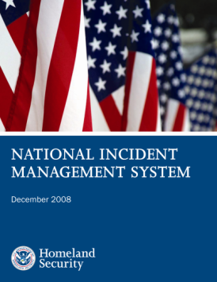
National Incident Management System
  NIMS is a nationwide playbook for responding to emergency and disasters
  Utilized by Federal, State, and local governments, the private sector, and nongovernmental organizations to work together
  To prepare for, respond to, recover from and mitigate the effects of emergencies regardless of cause, size, location, or complexity
  To reduce the loss of life and property, and harm to the environment
Notes:
Transition to this visual by explaining that the National Response Framework provides the broad response doctrine, while the National Incident Management System includes greater detail on the processes used to manage a response.
Explain that NIMS:
Defines what needs to be done to prepare for, prevent, protect against, respond to, and recover from a major event, how it needs to be done, and how well it needs to be done.
Provides a systematic approach for all levels of government, the private sector, and nongovernmental organizations to work seamlessly together.
Applies to all incidents regardless of cause, size, location, or complexity.
Emphasize the following points:
NIMS integrates existing best practices into a consistent, nationwide approach to domestic incident management.
NIMS is applicable at all jurisdictional levels and across functional disciplines in an all-hazards context.
Note that the National Response Framework reinforces that incidents should be managed using NIMS principles and structures.

Slide 3
Incident Management & Coordination
When disasters occur, response happens at two levels:
Incident Command System (ICS) – manages tactical activities that aim to stabilize an incident, save lives, and protect property and the environment
  Led by Incident Commander (IC)
Emergency Operations Center (EOC) – provides incident support activities, including strategic coordination, resource acquisition, and information gathering
  Led by Policy Group
  Managed by EOC manager
Notes:
To provide the best support to disaster survivors, responders work at multiple levels. NIMS describes four main mechanisms that work together to form a comprehensive approach to incident management. Each has its own function and its own team of leaders, who coordinate with one another.
Field personnel (such as firefighters putting out fires or search and rescue personnel searching for missing people) use the ICS for all tactical activities. The IC, who is the most experienced person on scene, leads all field-based tactical efforts.
If an incident is large or complex, EOCs activate to provide incident support activities. Each EOC has its own director.
MAC Groups provide senior-level leadership for incident personnel.
The JIS integrates incident information and public affairs from a variety of organizations to help ensure accurate, coordinated public messaging among all incident personnel, whether they are on scene, in an EOC, or in a MAC Group. The PIO leads this effort. One of the PIO’s functions is to provide senior leaders/elected officials with talking points for communicating with the public. The JIC is the facility that houses JIS operations; this is where public affairs personnel perform their functions.
FEMA can use these four mechanisms for more than responding to disasters—we also use them for special events.

Slide 4
NIMS Components
Preparedness
Communications and
Information Management
Incident Command System
Resource Management
Command and Management
Emergency Operations Centers
Ongoing Management and Maintenance
Public Information
Notes:
ICS is only one facet of NIMS. Following is a synopsis of each major component of NIMS:
Preparedness. Effective incident management and incident response activities begin with a host of preparedness activities conducted on an ongoing basis, in advance of any potential incident. Preparedness involves an integrated combination of planning, procedures and protocols, training and exercises, personnel qualification and certification, and equipment certification.
Communications and Information Management. Emergency management and incident response activities rely on communications and information systems that provide a common operating picture to all command and coordination sites. NIMS describes the requirements necessary for a standardized framework for communications and emphasizes the need for a common operating picture. NIMS is based on the concepts of interoperability, reliability, scalability, portability, and the resiliency and redundancy of communications and information systems.
Resource Management. Resources (such as personnel, equipment, and/or supplies) are needed to support critical incident objectives. The flow of resources must be fluid and adaptable to the requirements of the incident. NIMS defines standardized mechanisms and establishes the resource management process to: identify requirements for, order and acquire, mobilize, track and report, recover and demobilize, reimburse for, and inventory resources.
Command and Management. The Command and Management component within NIMS is designed to enable effective and efficient incident management and coordination by providing flexible, standardized incident management structures. The structure is based on three key organizational constructs: the Incident Command System, Multiagency Coordination Systems, and Public Information.
Ongoing Management and Maintenance. DHS/FEMA manages the development and maintenance of NIMS. This includes developing NIMS programs and processes as well as keeping the NIMS document current.

Slide 5
NIMS & Institutionalizing ICS
To get Preparedness Grants, Governmental officials must:
  Adopt the ICS through executive order or ordinance as the community's official incident response system.
  Direct that emergency managers and public safety organizations train, exercise, and use the ICS.
  Integrate ICS into emergency operations policies, plans, and procedures.
  Conduct ICS training for public safety responders and emergency managers.
  Conduct disaster exercises.
Notes:
Summarize the additional information about the NIMS requirement regarding “Institutionalizing the Use of ICS”:
According to the FEMA National Integration Center, "institutionalizing the use of ICS" means that government officials, incident managers, and emergency response organizations at all jurisdictional levels must adopt the Incident Command System. Actions to institutionalize the use of ICS take place at two levels: policy and organizational/operational.
At the policy level, institutionalizing the ICS means government officials (i.e., agency administrators, governors, mayors, county and city managers, tribal leaders, and others) must:
Adopt the ICS through executive order, proclamation, or legislation as the agency’s/jurisdiction's official incident response system; and
Direct that incident managers and response organizations in their jurisdictions train, exercise, and use the ICS in their response operations.
At the organizational/operational level, evidence that incident managers and emergency response organizations are institutionalizing the ICS would include the following:
ICS is being integrated into functional and system-wide emergency operations policies, plans, and procedures.
ICS training is planned or underway for responders, supervisors, and command-level officers.
Responders at all levels are participating in and/or coordinating ICS-oriented exercises that involve responders from multiple disciplines and jurisdictions.
Additional information about NIMS can be found online at www.fema.gov/nims.

Slide 6
Federalism in Emergency Management
Federal Government is Last Resort!
State Government provides support
Local Government is First Response!
Individuals and Households
Private
Sector
Nongovernmental Organizations
Notes:
Ask the participants: Why it is important that incidents be managed at the lowest level possible? If not mentioned by participants, add the following key points:
Local responders have the most knowledge about the needs of their communities.
Tactical incident command decisions are best made at the incident scene.
Summarize the discussion and review the roles of different levels of Government in response.
Local and Tribal Governments. The responsibility for responding to incidents, both natural and manmade, begins at the local level.
States and Territorial Governments. States and territorial governments have responsibility for the public health and welfare of the people in their jurisdiction. During response, States play a key role coordinating resources and capabilities from across the State and obtaining resources and capabilities from other States.
Federal Government. When an incident occurs that exceeds or is anticipated to exceed State, tribal, or local resources, the Federal Government may provide resources and capabilities to support the State response.
Note that effective response also requires partnerships with:
Individuals and Households. Individuals and households can contribute by reducing hazards in and around their homes, preparing an emergency supply kit and household emergency plan, and monitoring emergency communications carefully.
Private Sector. The private sector plays a key role before, during, and after an incident. First, they must provide for the welfare and protection of their employees in the workplace. Many private-sector organizations are responsible for operating and maintaining portions of the Nation’s critical infrastructure.
Nongovernmental Organizations (NGOs). NGOs play important roles before, during, and after an incident. For example, NGOs provide sheltering, emergency food supplies, counseling services, and other vital support services to support response and promote the recovery of disaster victims. These groups often provide specialized services that help individuals with special needs, including those with disabilities.

Slide 7
What is Emergency Management?
Emergency Management (EM) is the organized effort of managing all types of emergencies and disasters by coordinating the actions of numerous agencies and organizations.
EM includes four phases of disaster activity:
  Mitigation
  Preparedness
  Response
  Recovery
It applies to all risks: attack, man-made, and natural, in a federal-state-local partnership

Slide 8
Emergency Management Program
The Town Emergency Management Program belongs to the jurisdiction’s elected officials.
They appoint someone to serve as Emergency Management Director to run the program for them.
(See Program Review sheet)
Notes:
Identify relevant planning documents. The plans listed here are examples; please refine the list based on your jurisdiction’s situation. Emphasize the senior leader/executive’s role in the planning process and specify whether the leader’s office will need to provide support or resources.
Begin the discussion by describing:
Vision/role of the Office of Emergency Management
Coordination mechanisms and relationships with other departments and agencies
Roles and responsibilities of other departments and agencies in incident response
When introducing the plans, consider the following:
Role of the senior leader/executive in relation to the plan
Primary purpose of each plan; how the plans tie together
Necessity of each plan for legal or grant compliance purposes
How often plans are updated and which are due for revision soon
Plans that may be particularly important for the senior leader/elected official include:
Comprehensive emergency management plan – Describes overarching emergency procedures
Continuity of Operations (COOP)plan/Continuity of Government (COG) plan – Describes procedures that allow essential governmental functions to continue in the event of a catastrophic event; details include designated emergency response group personnel, continuity sites, and so on
Hazard mitigation plan – Identifies high-risk hazards, as well as opportunities to reduce long-term impacts of natural hazards; serves as a foundation for other planning efforts, such as master planning and capital improvements
Recovery plan – Describes plans for economic and social recovery following a disaster (please emphasize the role of the senior leader/executive in this plan)
Example: Liberty City, USA
Liberty City comprehensive emergency management plan
Liberty City EOP
Liberty City COG plan
Liberty County hazard mitigation plan
Liberty City pre-disaster recovery plan

Slide 9
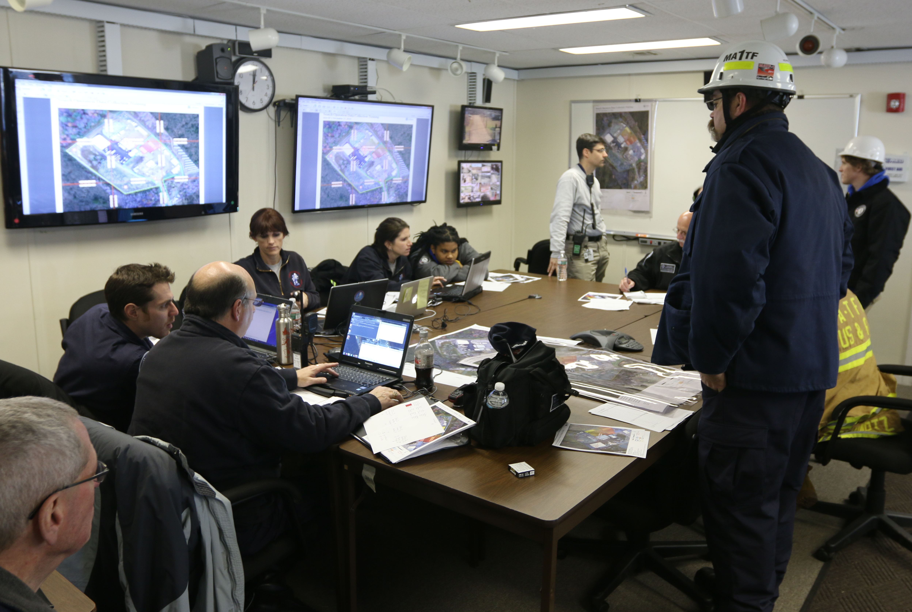
Whole Community Response
Notes:
Explain the Federal, state, and local policies that govern how response responsibilities flow from the local level to the Federal level. The information below shows how the NRF and NIMS define the roles of local, state, tribal, territorial and Federal governments. Note also how private citizens and organizations fit into the overall response.
Summarize the discussion and review the roles of different levels of government:
Local and tribal governments. The responsibility for responding to incidents, both natural and man-made, begins at the local level. The local jurisdiction develops response plans based on local hazards and vulnerabilities.
States and territorial governments. States and territorial governments have responsibility for the public health and welfare of the people in their jurisdiction. During response, states play a key role in coordinating resources and capabilities across the state and obtaining resources and capabilities from other states. The state government develops response plans based on the state’s hazards and vulnerabilities, collaborating with local and regional response plans.
Federal government. When an incident exceeds state, territorial, tribal, or local resources, the Federal government may provide resources and capabilities to support the state response.
Review the roles of private citizens and organizations:
Individuals and households. Individuals and households can contribute by reducing hazards in and around their homes, preparing an emergency supply kit and a household emergency plan, and monitoring emergency communications.
Private sector. The private sector plays a key role before, during, and after an incident. Organizations must provide for the welfare and protection of their employees in the workplace. Many private-sector organizations are responsible for operating and maintaining portions of the nation’s critical infrastructure.
Nongovernmental organizations (NGO). NGOs play important roles before, during, and after an incident. For example, NGOs provide sheltering, emergency food supplies, counseling services, and other vital services to support response and promote recovery. These groups often provide specialized services that help individuals with special needs, including those with disabilities.

Slide 10
Senior Leader Essential Responsibilities
Ensure the continuity of government
Keep the media and public informed
Request assistance from the County Emergency Operations Center (EOC), when needed
Resolve any resource allocation conflicts
Coordinate with other senior officials and whole community partners
Set priorities in coordination with other senior officials
Take steps to ensure the organization follows state and Federal restrictions and requirements
Notes:
NIMS defines general roles and responsibilities for senior leaders/elected officials. For example:
{Position title}’s task is to ensure that the emergency manager is informed and that the Incident Commander (IC) functions responsibly. The emergency manager sets policy, establishes the mission, shapes the overall direction, and authorizes the trained responders to accomplish the incident objectives.
Senior leaders/elected officials are NOT typically at the scene of the incident, but they must be able to communicate and meet with the IC as necessary.
NOTE: Bulleted statements on the slide are suggested items.
Explain senior leader/elected official roles and responsibilities specific to the jurisdiction. Insert jurisdiction-specific roles and responsibilities, such as:
Provide oversight for incident management policies and objectives
Understand the incident’s impact on the continuity of the jurisdiction’s day-to-day activities
Shape the jurisdiction’s overall direction and priorities
Authorize trained responders to establish and accomplish the incident objectives
Help coordinate activities with elected officials and other government representatives
Delegation of Authority
In certain circumstances, the {senior leader/executive} will need to issue a Delegation of Authority to the IC or Incident Management Team (IMT) that is responsible for managing an incident. Delegation of Authority may not be necessary if the IC is acting within existing authorities or is under a pre-established delegation in the Emergency Operations Plan (EOP). Generally, a Delegation of Authority:
Grants authority to carry out specific functions
Comes from the chief elected official, CEO, or agency administrator, either in writing or verbally
Allows the IC to assume command
The Delegation of Authority remains with the IC until one of the following occurs:
The incident concludes
Leadership appoints a relief shift IC
Leadership relieves the IC of his or her duties for just cause
Delegation of Authority does NOT relieve the granting authority of ultimate responsibility for the incident.

Slide 11
Senior Leaders Role
Understand the Emergency Management Mission
Review your Authorities
Learn about your Emergency Team
Review your Plans and Resources
Lead during a Crisis
Promote Community Preparedness
Update your Residents

Slide 12


Leadership
Most importantly, Senior Officials provide leadership.
  Motivating and supporting your emergency manager and emergency responders so that they can accomplish difficult tasks under dangerous, stressful circumstances.
  Instilling confidence in the public that the incident is being managed effectively.
Notes:
Summarize by noting that Executives/Senior Officials have an important leadership role. This leadership role means providing motivation and support to allow the trained, on-scene responders to accomplish difficult tasks under dangerous, stressful circumstances. It also means instilling confidence in the public that the incident is being managed effectively.
Refer the participants to the handout at the end of the briefing package.
Ask the participants if they have any questions. After addressing any questions, thank the group for their participation.

Slide 13
Statutory Requirements
Federal:
  Robert T. Stafford Disaster Relief and Emergency Assistance Act
  Post-Katrina Emergency Management Reform Act
  Homeland Security Act
  Presidential Policy Directive -8 National Preparedness
State:
  Maine Revised Statute Title 37-B, Chapter 13: Maine Emergency Management Agency
Local:
  Civil Preparedness Ordinances
  Local Resident Expectations

Slide 14
Disaster Realities
Every disaster starts at the local level and ends at the local level
A disaster impacts your citizens and even our own families
Your duty as appointed and elected officials is to protect the health and safety of your residents
Your citizens look to you for direction and assurance
You have the responsibility to make key decisions before, during and after a disaster

Slide 15
The Emergency Mgmt Program
Federal Emergency Management Agency (FEMA)
Maine Emergency Management Agency (MEMA)
County Emergency Management Agency
Municipal Emergency Management Director
  The elected officials appoint the EMD
  The EMD works for the elected officials to manage the EM program
  Needs the strong moral support of the elected officials
  The Local EM program is the Foundation of EM in the State.

Slide 16
Maine Title 37-B, Chapter 13
§781. MUNICIPAL, COUNTY AND REGIONAL AGENCIES
Municipal or interjurisdictional agencies.
  Each municipality of the State must be served by a municipal or interjurisdictional agency responsible for emergency management.
Does allow for two or more towns to create a single agency and appoint a single director

Slide 17
Local EM Program
A capable and effective EM program can pay big dividends
  Better prepared (planned, staffed, equipped, trained and exercised) public safety departments
  Federal Funding possible when NIMS Compliant
  Technical Support for EM and 1st Responders
  Disaster Assistance Funds (Public and Individual)
  Better prepared citizenry (Disaster Preparedness)
  More effective and coordinated responses and recovery activities

Slide 18
Maine Title 37-B, Chapter 13
§782. AGENCY DIRECTOR
  A director must be appointed for each municipal emergency management agency
  A director of an emergency management agency may not be at the same time an executive officer or member of the executive body of a municipality
  Notwithstanding, a town manager or administrative assistant may also be appointed to serve as the director of an emergency management agency.
  A director may be removed by the appointing authority for cause

Slide 19
Local EM Director
Appoint a person who wants to do a great job
Don’t appoint a person who already has too much to do in another municipal position
Director should be willing to complete EM training and exercises
Director must be a good organizer and able to work with people
To do a good job, this position can be very involved. They should have help in the forms of:
  A Deputy EM Director
  An EM committee
  A Group of EM volunteers

Slide 20
Maine Title 37-B, Chapter 13
§783. DISASTER EMERGENCY PLAN
Each municipal EMA shall prepare and keep a current disaster emergency plan for the area subject to its jurisdiction. That plan must include:
  Identification of disasters to which the jurisdiction is or may be vulnerable
  Identification of the procedures and operations which will be necessary to prevent or minimize injury and damage
  Identification personnel, equipment and supplies required to implement those procedures and operations
  Recommendations for preparedness measures

Slide 21
Disaster Plan
Also known as the Emergency Operations Plan (EOP)
This is the municipal document which describes who will do what, when, and with what resources, and by what authority--before, during, and immediately after an emergency
It will guide all members of your emergency response team through a disaster event and hopefully lessen the impacts of the disaster on your community and residents

Slide 22
Maine Title 37-B, Chapter 13
Section 784, Mutual Aid Arrangements
  The local EM director has the authority to develop mutual aid agreements for reciprocal EM aid and assistance in case of a disaster too great to be dealt with unassisted.
  In time of emergency each local organization for emergency management shall render assistance in accordance with the mutual aid arrangements.

Slide 23
Mutual Aid
Emergency Management Mutual Aid should include:
  Other EM programs (County and Municipal)
  Other government entities (public works, water, sanitation, general assistance, etc)
  Local public organizations (Vets, ATV clubs, etc)
  Local Businesses and Contractors
  Can provide services, facilities, products, etc
  BIG SAVINGS during a disaster!

Slide 24
Maine Title 37-B, Chapter 13
Section 784-A, Right to Call for and employ assistance
  Local EMA organizations may employ any person considered necessary to assist with emergency management activities.
  All persons called and employed for assistance shall proceed as directed by the EMA Director.
  Any person called and employed for assistance is deemed to be an employee of the State for purposes of immunity from liability and for purposes of workers' compensation insurance

Slide 25
Employing Assistance
The municipal, county and state EM Director’s can accept volunteers to help with the disaster
Will be considered “state employees” for liability and worker’s compensation
Should “credential” the volunteers
  Ensure that they are qualified to do the job
  Collect any licenses or certificates as proof
  Provide a list of names of volunteers to state (through) as soon as possible before or during the disaster

Slide 26
Maine Title 37-B, Chapter 13
Section 824, Appropriations
  Each municipality may make appropriations for the payment of expenses of its local EMA in the same manner as for its other ordinary expenses
  In making those appropriations, the municipality shall specify the amounts and purposes for which the money appropriated may be used by the local EMA

Slide 27
EMA Appropriations
Municipalities may provide for a budget for their EM program
  EM Director Stipend
  Operating Budget
  Disaster Reserves
Not an expensive program
Possible Expenses
EOC Admin Supplies
EOC Phone/Internet
First Aid Supplies
Shelter Supplies
Personal Protective Supplies
Training Costs
Public Education materials
Stockpiled Food and Water
Fuel for equipment
Equipment repairs and maintenance
Capital Expenses
EOC Base Radio + Antenna
EOC Computer and multifunction printer
EOC White Boards + Maps
Portable 2-way Radios

Slide 28
Maine Title 37-B, Chapter 13
Section 831, Utilization of services
  The executive officers or governing bodies of the political subdivisions of the State shall utilize the services and facilities of existing departments, offices and agencies of their political subdivisions to the maximum extent practicable
  The officers and personnel of all departments, offices and agencies shall cooperate with and extend their services and facilities to the emergency management organizations of the State upon request

Slide 29
Utilization of Services
The municipal officers have the authority to require municipal departments and offices to support the response to the disaster event
The municipal departments and offices have the responsibility to assist the emergency management program when requested
Example: Staffing the Town EOC

Slide 30
Local Ordinances
Many towns have local ordinances for civil preparedness or emergency management.
Local officials should be aware of the responsibilities and authorities listed in their local ordinance.
If a town does not have such an ordinance, it might be wise to have one to ensure that the disaster response has fewer conflicts and gaps.

Slide 31
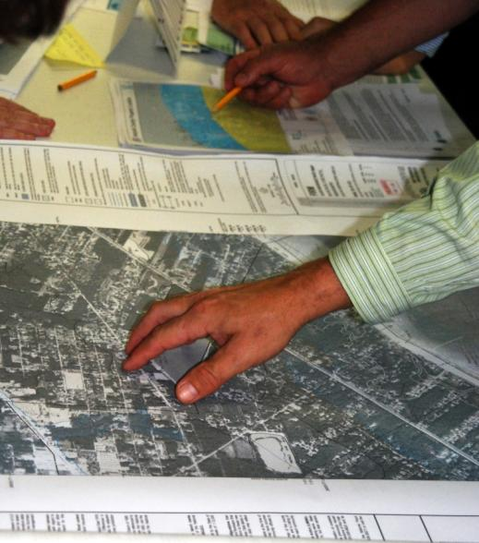
Check Plans, Policies, and Laws
Do your community’s plans, policies, and ordinances:
  Integrate with NIMS?
  Cover all-hazards?
  Include delegations of
  authority?
  Assign Roles and Responsibilities?
Notes:
Note that preparedness plans may take many forms, but the most common include:
Federal, State, or local emergency plans. Note: Emergency plans are developed at the Federal, State, and local levels to provide a uniform response to all hazards that a community may face. Preparedness plans must be consistent with the National Incident Management System (NIMS).
Standard operating guidelines (SOGs).
Standard operating procedures (SOPs).
Jurisdictional or agency policies.
Explain that Executives/Senior Officials should ensure that their jurisdiction’s preparedness plans, policies, and laws:
Comply with NIMS, including ICS.
Cover all hazards and are based on risk assessments.
Include delegations of authority (as appropriate).
Include up-to-date information about:
Resources in the area.
Contact information for agency administrators and response personnel.

Slide 32
Establish Communications and Information Systems
  Do you have procedures for:
    Disseminating warnings to residents?
    Communicating operational decisions?
    Developing and maintaining situation awareness?
  Can responders from different departments (e.g., fire, police, public works) or mutual aid partners communicate with one another?
Notes:
Tell the participants that they should check to see if their jurisdictions have protocols and procedures for:
Formulating and disseminating indications and warnings.
Formulating, executing, and communicating operational decisions.
Preparing for potential requirements and requests supporting incident management activities.
Developing and maintaining situation awareness.
Explain that Executives/Senior Officials should confirm that responders from different agencies (e.g., fire, police, public works) or mutual aid and assistance partners can communicate with one another. They should also ensure that their jurisdiction has a plan and/or budget for maintaining and replacing emergency communication systems.

Slide 33

Training, Credentialing, & Exercising
  Can you verify that personnel meet established professional standards for:
    Training
    Performance
  When was the last tabletop or functional exercise that practiced command and coordination functions? Did you participate in that exercise?
Notes:
Explain that Executives/Senior Officials must ensure that incident responders are well trained and qualified. Tell them they must consider:
If there are sufficient qualified personnel to assume ICS Command and General Staff positions.
Explain that Executives/Senior Officials are responsible for ensuring that a qualified Incident Commander has been designated for the incident. Some agencies and jurisdictions maintain a roster of qualified Incident Commanders based on the complexity of the incident.
Ask the participants to identify the qualities of an effective Incident Commander. If not mentioned by the participants, add any of the following qualities: skilled/experienced in directing tactical response operations; command presence; understanding of ICS; proven management record; strong decisionmaker; calm but quick-thinking; good communication skills; adaptability and flexibility; realistic about personal limitations; and political awareness.
If they can verify that personnel meet established professional standards for:
Training.
Experience.
Performance.
When the last tabletop or functional exercise was conducted to practice command and coordination functions. Note that Executives/Senior Officials should participate in these exercises.

Slide 34
EOC Policy Group
The Policy Group is made up of the Elected Officials:
  Serves as a policy-level body during incidents
  Supports resource prioritization and allocation
  Enables decision-making among elected and appointed officials
Membership includes:
  Town Selectpersons/Councilors
  County Commissioners
Notes:
The MAC Group/Policy Group plays an important role in managing large incidents. Note that not all jurisdictions refer to the group as a MAC Group; other terms include Executive Leadership Group, Policy Group, and Agency Coordination Group.
The {MAC Group/Policy Group}:
Serves as a policy-level body during incidents
Supports resource prioritization and allocation {so, for example, if … }
Enables decision-making among elected and appointed officials
Describe the kinds of decisions that a MAC Group might make in your organization.
Insert an overview of the senior leader/elected official’s role in the MAC Group. Explain MAC Group activation procedures. Review relevant jurisdictional or organizational plans—such as your EOP—that explain the senior leader/elected official’s role.
If the Policy Group has a non-incident role or function, describe it.

Slide 35
Recovery
Recovery focuses on the timely restoration, strengthening, and revitalization of communities affected by a catastrophic incident.
FEMA’s Public Assistance (PA) grants program provides Federal assistance to government organizations and some private nonprofit organizations following a presidential disaster declaration.
The Federal share of assistance is 75 percent of the eligible cost. The State picks up 15% and the Town covers 10%.
Notes:
Discuss recovery and provide examples.

Slide 36
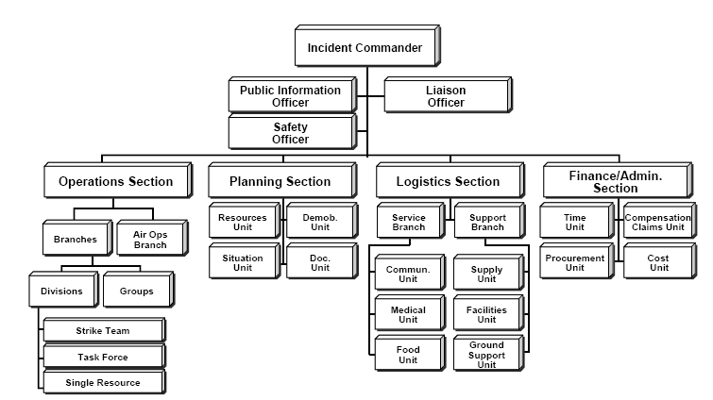
Incident Command System (ICS)
Notes:
Explain that this presentation is divided into the following parts:
Part 1: What Is ICS?
Part 2: ICS Organization & Features
Part 3: Unified & Area Command
Part 4: Coordination & Incident Management Assessment
Part 5: NIMS Preparedness
Note that the first part presents background information on the Incident Command System, or ICS.

Slide 37

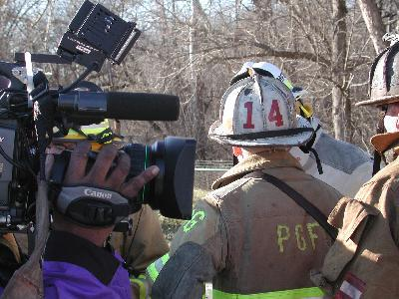
Incident Command System
  Is a standardized, on-scene, all-hazards incident management concept.
  Allows its users to adopt an integrated organizational structure to match the complexities and demands of
  single or multiple incidents
  without being hindered by
  jurisdictional boundaries.
Notes:
Elaborate on the points on the visual using the information below:
The Incident Command System, or ICS, is a standardized, on-scene, all-hazards incident management concept. ICS allows its users to adopt an integrated organizational structure to match the complexities and demands of single or multiple incidents without being hindered by jurisdictional boundaries.
ICS has considerable internal flexibility. It can grow or shrink to meet different needs. This flexibility makes it a very cost-effective and efficient management approach for both small and large situations.
Briefly cover the development of ICS.
ICS was developed in the 1970s following a series of catastrophic fires in California's urban/wildland interface. Property damage ran into the millions, and many people died or were injured. The personnel assigned to determine the causes of this disaster studied the case histories and discovered that response problems could rarely be attributed to lack of resources or failure of tactics.
Surprisingly, studies found that response problems were far more likely to result from inadequate management than from any other single reason. Weaknesses in incident management were often due to:
Lack of accountability, including unclear chains of command and supervision.
Poor communication due to both inefficient uses of available communications systems and conflicting codes and terminology.
Lack of an orderly, systematic planning process.
No common, flexible, predesigned management structure that enables commanders to delegate responsibilities and manage workloads efficiently.
No predefined methods to integrate interagency requirements into the management structure and planning process effectively.
Point out that a poorly managed incident response can be devastating to our economy and our health and safety.

Slide 38
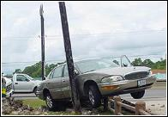
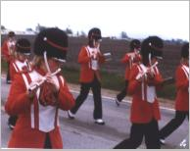
Examples of Incidents Managed Using ICS
  Fire, both structural and wildland
  Natural disasters, such as floods, ice storms, or wind storms.
  Search and rescue missions
  Hazardous materials incidents
  Terrorist incidents, including the use of weapons of mass destruction
  Other planned events, such as parades or demonstrations
Notes:
Refer to the following examples of the types of incidents that have been managed using ICS:
Fire, both structural and wildland
Natural disasters, such as tornadoes, floods, ice storms, or earthquakes
Human and animal disease outbreaks
Search and rescue missions
Hazardous materials incidents
Criminal acts and crime scene investigations
Terrorist incidents, including the use of weapons of mass destruction
National Special Security Events, such as Presidential visits or the Super Bowl
Other planned events, such as parades or demonstrations
Review the following best practice or add an example from your jurisdiction/agency:
The greater Boston area conducts special events as “planned disasters” by employing ICS and integrating portions of the region’s disaster plans into the event’s operations plans. This approach improves coordination during event planning and operations, strengthens relationships between the many agencies and organizations involved in disaster operations, and facilitates the enhancement of regional disaster plans. The Boston area uses ICS to conduct its three regularly occurring events (First Night festivities, the Boston Marathon, and Fourth of July celebrations) and one to two special events (e.g., Super Bowl rallies and Sail Boston) as “planned disasters.” Many of these events can attract crowds of one million or more participants and spectators, providing an optimal environment to test and improve disaster plans.

Slide 39
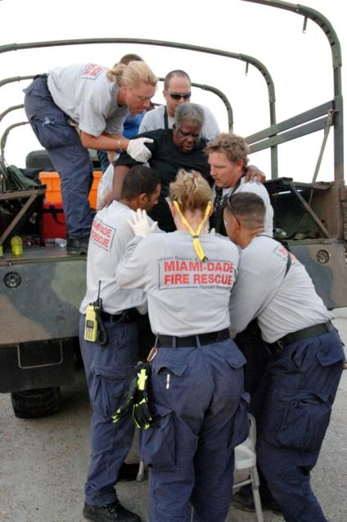
ICS Benefits
  Meets the needs of incidents of any kind or size.
  Allows personnel from a variety of departments to meld rapidly into a common management structure.
  Provides logistical and administrative support.
  Is cost effective by avoiding duplication of efforts.
Notes:
Explain that ICS is designed to be interdisciplinary and organizationally flexible.
Point out that ICS:
Meets the needs of incidents of any kind or size.
Allows personnel from a variety of agencies to meld rapidly into a common management structure.
Provides logistical and administrative support to operational staff.
Is cost effective by avoiding duplication of efforts.
Ask the participants if they can add any benefits to those listed on the visual. Add a personal experience that illustrates the benefits of using ICS.
Summarize by noting that any incident can have a mix of political, economic, social, environmental, and cost implications with potentially serious long-term effects. ICS, as a management system, helps to mitigate the risks by providing accurate information, strict accountability, and planning for any incident.
Emphasize that it is critical that Executives and Senior Officials support ICS planning, preparedness, and training activities.
October 2013
Page 39

Slide 40
Chain of Command
  Chain of command is an orderly line of authority within the ranks of the incident management organization.
  Unity of command means that every individual has a designated supervisor to whom he or she reports at the scene of the incident.
Authority
Notes:
Explain that within the ICS organization, chain of command and unity of command are maintained. Review the following definitions:
Chain of command refers to the orderly line of authority within the ranks of the incident management organization.
Unity of command means that every individual has a designated supervisor to whom he or she reports at the scene of the incident.
These principles clarify reporting relationships and eliminate the confusion caused by multiple, conflicting directives. Incident managers at all levels must be able to control the actions of all personnel under their supervision.
Emphasize that chain of command must be followed at the incident site and by those not deployed to the incident. After being deployed and receiving an incident assignment, personnel may be assigned by someone who is not their day-to-day supervisor. In this situation, the responders must take direction from their on-scene ICS supervisors only. In addition, someone who is a day-to-day supervisor may not be assigned or qualified to serve as an on-scene supervisor.
Ask the participants: What can Executives and Senior Officials do to ensure that chain of command is maintained? If not mentioned by the participants, add the following key points:
Ensure that only qualified supervisors are assigned.
Follow the chain of command by working through the Incident Commander rather than calling personnel within the ranks.

Slide 41
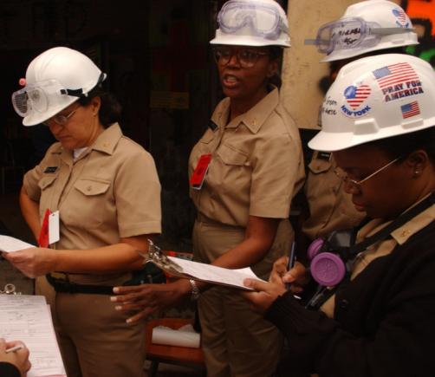
Incident Commander
Upon arriving at an incident, the higher-ranking person will either assume command, maintain command as is, or transfer command to a third party.
The most qualified person at the scene is designated as the Incident Commander.
Notes:
Emphasize that all incident responses begin by establishing command. Explain that upon arriving at an incident, the higher ranking person will either assume command, maintain command as is, or transfer command to a third party. Point out that in some situations, a lower ranking person may be the Incident Commander if he or she is the most qualified person.
Ask the participants the following question: Why is it critical to establish command from the beginning of incident operations? If not mentioned by the participants, add the following key points:
Lack of command becomes a safety hazard for responders.
Size-up and decisionmaking are impossible without a command structure.
It is difficult to expand a disorganized organization if the incident escalates.
Tell the participants that the process of moving responsibility for incident command from one Incident Commander to another is called transfer of command. Explain that a transfer of command occurs when:
A more qualified person assumes command.
The incident situation changes over time, resulting in a legal requirement to change command.
There is normal turnover of personnel on extended incidents.
The incident response is concluded and responsibility is transferred to the responsible agency.
Explain that transfer of command must include a transfer of command briefing – which may be oral, written, or a combination of both.

Slide 42

Incident Commander’s Role
The Incident Commander:
  Provides overall leadership for incident response.
  Takes policy direction from the Elected Officials.
  Delegates authority to others.
  Ensures incident safety.
  Establishes incident objectives.
Notes:
Explain that the Incident Commander:
Provides the overall leadership for incident response. The Incident Commander is in charge of overall management of the incident and must be fully qualified to manage the incident.
Takes policy direction from the Executive/Senior Official.
Delegates authority to others to manage the ICS organization.
Ensures the safety of incident responders and the public.
Provides information to internal and external stakeholders.
Establishes and maintains liaison with other agencies participating in the incident.
Establishes incident objectives.
Directs the development of the Incident Action Plan.
Note that the Incident Command will size up the incident and assess resource needs. If the incident is complex and/or long term, more staff may be needed. In addition, a Deputy Incident Commander may be assigned. Note that if a Deputy is assigned, he or she must be fully qualified to assume the Incident Commander’s position.

Slide 43

Elected Officials’ Role & Responsibilities
  Provide policy guidance on priorities and objectives based
  on the situation and the Emergency Operations Plan (EOP).
  Approve resources and support to the incident command from the Emergency Operations Center (EOC).
Notes:
Present the following key points:
The Executive/Senior Official (elected official, city/county manager, agency administrator, etc.) is responsible for the incident. In most jurisdictions, responsibility for the protection of the citizens rests with the chief elected official. Along with this responsibility, by virtue of their office, these people have the authority to make decisions, commit resources, obligate funds, and command the resources necessary to protect the population, stop the spread of damage, and protect the environment.
Having the responsibility does not mean that the Executive/Senior Official assumes a command role over the on-scene incident operation. Rather, the Executive/Senior Official:
Provides policy guidance on priorities and objectives based on situational needs and the Emergency Plan.
Oversees resource coordination and support to the on-scene command from the Emergency Operations Center or through dispatch.
Typically, the Executive/Senior Official is not at the scene of the incident, but must have the ability to communicate and meet with the Incident Commander as necessary.
Ask the participants to identify reasons why an Executive’s/Senior Official’s presence at the incident scene may be detrimental. If not mentioned by the participants, add the following key points:
A visit from leadership personnel could draw more media and bystanders into a hazardous area.
Response resources may be diverted away from critical tactical operations to attend to a visiting Executive/Senior Official.
The presence of the Executive/Senior Official could cause confusion about the chain of command (who’s in charge of on-scene operations).
Acknowledge that visits to the scene by an Executive/Senior Official may be beneficial to the operation. Tell the participants that those visits must be coordinated with the Incident Commander and not jeopardize the response efforts.

Slide 44
Command vs. Coordination
What is the difference between command and coordination?
Notes:
Ask the participants: What is the difference between command and coordination? If possible, record the participants’ responses on chart paper.

Slide 45
NIMS: Command
Command: The act of directing, ordering, or controlling by virtue of explicit statutory, regulatory, or delegated authority.
Who has the explicit authority for the management of all incident operations?
Notes:
Compare the participants’ response to the following definition:
Command: The act of directing, ordering, or controlling by virtue of explicit statutory, regulatory, or delegated authority. In NIMS, responsibility for this process is delegated to the on-scene Incident Commander by the Executive/Senior Official. Examples of command activities include:
Determining incident objectives.
Establishing operational periods.
Assigning and supervising field resources.

Slide 46
NIMS: Coordination
Coordination is a process that allows all levels of government and all disciplines to work together more efficiently and effectively.
Notes:
Compare the participants’ response to the following definition:
Coordinate: To advance systematically an analysis and exchange of information among principals who have or may have a need to know certain information to carry out specific incident management responsibilities. Coordination includes the activities that ensure that the ICS organization(s) receive the resources and support they need when they need them. Coordination takes place in a number of entities and at all levels of government. Examples of coordination activities include:
Adjusting agency budgets, policies, and work priorities to make funds and resources available.
Facilitating interagency decisionmaking.
Coordinating interagency public information.
Dispatching additional resources.

Slide 47
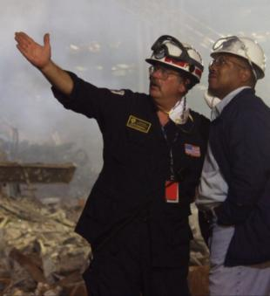
Senior Officials Delegate Command Authority
Executives/Elected Officials delegate authority to the Incident Commander for on-scene operations.
The Incident Commander has direct tactical and operational responsibility for conducting incident management activities.
Notes:
Explain that Executives/Senior Officials delegate authority to the designated Incident Commander for on-scene operations. The Incident Commander is accountable to the Executive/Senior Official but has the complete authority to direct the operation.
Emphasize that direct tactical and operational responsibility for conducting incident management activities rests with the Incident Commander, while the Executive/Senior Official plays a vital coordination role.
Facilitate a discussion of the importance of keeping command and coordination roles clear by asking the following discussion question: Why is it important to keep the command role solely with the Incident Command?
Acknowledge the participants’ input and add any personal experiences that illustrate the teaching points.

Slide 48
Incident Management Roles
Incident Commander’s
Role
Manages the incident at the scene.
Keeps the EOC informed on all important matters pertaining to the incident.
Elected Officials’ Role
These officials provide the following to the Incident Commander:
Policy
Strategic direction
Authority
To maintain unity of command and safety of responders, the chain of command must NOT be bypassed.
Notes:
Use the visual to summarize the different roles assumed by the Executive/Senior Official and Incident Commander. Add the following key points:
The Executive’s/Senior Official’s task is to ensure that you are informed and that your Incident Commander is functioning in a responsible manner. You set policy, establish the mission to be accomplished, shape the overall direction, and give the trained responders the authority to accomplish the incident objectives.
The Incident Commander is the primary person in charge at the incident. In addition to managing the incident scene, he or she is trained to keep you informed and up to date on all important matters pertaining to the incident.
Present the following example or add one from your jurisdiction: The Washington area sniper case was one of the most infamous crimes in recent law enforcement history, instilling fear in thousands of people. According to the after-action report, communication was clearly the most compelling concern in the sniper case. Investigations of this kind succeed or fail based on executives’ ability to effectively manage and communicate information in a timely manner. Incident Commanders must balance the incident needs with the obligations of local executives to be responsive to their citizens. In the words of one police chief, “You cannot expect leaders to stop leading.”
The final responsibility for the resolution of the incident remains with the chief elected official, chief executive officer, or agency administrator. It is imperative then that the chief elected official, chief executive officer, or agency administrator remain an active participant, supporter, supervisor, and evaluator of the Incident Commander.
Summarize the discussion by noting that the ICS hierarchy of command must be maintained. After you have clearly articulated the policy you wish followed and delegated certain authorities, the Incident Commander who reports to you will have the necessary authority and guidance to manage the incident.

Slide 49

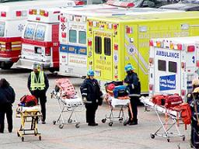
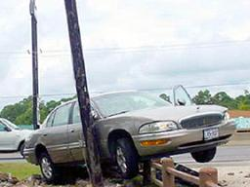
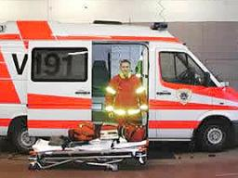
Incident Complexity & Resource Needs
Incident Complexity
Resource Needs
ICS Structure
Complexity
Notes:
Refer the participants to the visual. Note that as demonstrated in the lost child scenario, as complexity increases, resources must increase, requiring an organization with additional levels of supervision.

Slide 50
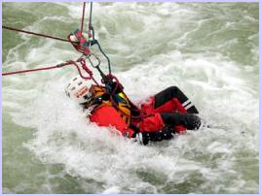
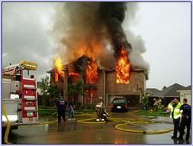
Overall Priorities
Initial decisions and objectives are established based on the following
priorities:
#1: Life Safety
#2: Incident Stabilization
#3: Property/Environmental Protection
Notes:
Explain that the Incident Commander develops incident objectives—the statement of what is to be accomplished on the incident. Not all incident objectives have the same importance.
Incident objectives can be prioritized using the following simple “LIP” mnemonic:
Life Safety: Objectives that deal with immediate threats to the safety of the public and responders are the first priority.
Incident Stabilization: Objectives that contain the incident to keep it from expanding and objectives that control the incident to eliminate or mitigate the cause are the second priority.
Property/Environmental Conservation: Objectives that deal with issues of protecting public and private property and the environment are the third priority.
Explain that incident objectives are not necessarily completed in sequence determined by priority. It may be necessary to complete an objective related to incident stabilization before a life safety objective can be completed. Using the LIP mnemonic helps prioritize incident objectives. This device can also be used to prioritize multiple incidents, with those incidents with significant life safety issues being given a higher priority than those with lesser or no life safety issues.
Ask the participants for examples of each type of priority. Present examples based on your experience.

Slide 51
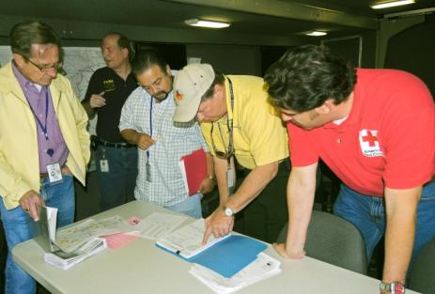
Unified Command
As a team effort, Unified Command allows all agencies with jurisdictional authority or functional responsibility for an incident to jointly provide management direction to the incident.
In Unified Command, no agency’s legal authorities will be compromised or neglected.
Notes:
Introduce this topic by telling participants that:
Early in the development of ICS, it was recognized that many incidents crossed jurisdictional boundaries or the limits of individual agency functional responsibility.
As a team effort, Unified Command allows all agencies with jurisdictional authority or functional responsibility for an incident to jointly provide management direction to the incident.
Emphasize that NIMS encourages the use of Unified Command when appropriate.
Reinforce the points you just covered on Unified Command by referring to the excerpt on the visual. This excerpt is from the following longer quote from the NIMS document:
“Unified Command is an important element in multijurisdictional or multiagency incident management. It provides guidelines to enable agencies with different legal, geographic, and functional responsibilities to coordinate, plan, and interact effectively. As a team effort, Unified Command allows all agencies with jurisdictional authority or functional responsibility for the incident to jointly provide management direction to an incident through a common set of incident objectives and strategies and a single Incident Action Plan. Each participating agency maintains its authority, responsibility, and accountability.”

Slide 52



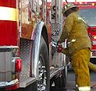


Unified Command
Unified Command
  Establish a common set
  of incident objectives and strategies.
  Allows Incident Commanders to make joint decisions by establishing a single command structure.
  Maintains unity of command. Each employee reports to only one supervisor.
Fire
Law Enforcement
EMS
Operations Section Chief
Resources
Notes:
Explain that Unified Command:
Enables all responsible agencies to manage an incident together by establishing a common set of incident objectives and strategies.
Allows Incident Commanders to make joint decisions by establishing a single command structure.
Maintains unity of command. Each employee only reports to one supervisor.
Summarize the following key points about Unified Command:
Unified Command is an important element in multijurisdictional or multiagency domestic incident management. It provides guidelines to enable agencies with different legal, geographic, and functional responsibilities to coordinate, plan, and interact effectively.
As a team effort, Unified Command overcomes much of the inefficiency and duplication of effort that can occur when agencies from different functional and geographic jurisdictions, or agencies at different levels of government, operate without a common system or organizational framework.
All agencies with jurisdictional authority or functional responsibility for any or all aspects of an incident and those able to provide specific resource support participate in the Unified Command structure and contribute to the process of determining overall incident strategies, selecting objectives, and ensuring that joint tactical planning occurs.
No agency's legal authorities will be compromised or neglected.
Note: Agency is used to describe organizations that have a legal and functional responsibility at an incident. The graphic depicts three Incident Commanders (Incident Commander #1 for firefighting, Incident Commander #2 for the law enforcement investigation, and Incident Commander #3 for search and rescue operations). This graphic is simply a representation of how multiple commanders may be assigned. In another situation, the Incident Commanders could be from different jurisdictions rather than from different departments within the same jurisdiction.

Slide 53
Key Terms
Emergency Operations Center: The physical location at which
the coordination of information and resources to support
incident management takes place.
Elected Officials work at the EOC as the Policy Group.
Emergency
Ops Center
(EOC)
Incident
Commander
#1
Incident
Commander
#2
Incident
Commander
#3
Incident Commander: Performs primary tactical-level, on-scene incident command functions. The Incident Commander is located at an Incident Command Post at the incident scene.
Notes:
Remind the participants that command structures direct on-scene emergency management. Review the following command structures:
Incident Commander: Performs primary tactical-level, on-scene incident command functions. The Incident Commander is located at an Incident Command Post at the incident scene.
Emergency Operations Center (EOC): Coordinates information and resources to support local incident management activities. The EOC is the physical location at which the coordination of information and resources to support incident management (on-scene operations) activities normally takes place. An EOC may be a temporary facility or may be located in a more central or permanently established facility, perhaps at a higher level of organization within a jurisdiction. EOCs may be organized by major functional disciplines (e.g., fire, law enforcement, and medical services), by jurisdiction (e.g., Federal, State, regional, tribal, city, county), or some combination thereof.

Slide 54
Support and Coordination
Provide support and coordination to incident command by:
  Making policy decisions.
  Establishing priorities.
  Resolving resource issues.
  Facilitating logistics support
  and resource tracking.
  Collecting, analyzing,
  and disseminating
  information.
Town
Emergency
Ops Center
(EOC)
County
Emergency
Ops Center
(EOC)
State
Emergency Ops Center (EOC)
Incident
Command
Notes:
Explain that the role of EOCs is often related to the size or complexity of the jurisdiction involved. The most common roles include:
Making policy decisions.
Establishing priorities.
Resolving critical resource issues.
Facilitating logistics support and resource tracking.
Collecting, analyzing, and disseminating information.

Slide 55
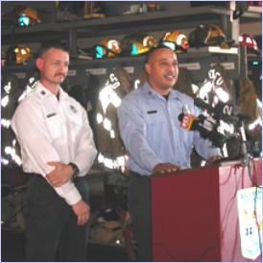
Speaking With One Voice
  Elected Officials and Incident Command must coordinate and integrate messages for the public
Notes:
Emphasize that Executives/Senior Officials must coordinate and integrate messages with on-scene Public Information Officers and other agencies.
Explain that the Joint Information System (JIS):
Integrates incident information and public affairs into a cohesive organization designed to provide consistent, coordinated, timely information during crisis or incident operations.
Provides a structure and system for:
Developing and delivering coordinated interagency messages.
Developing, recommending, and executing public information plans and strategies on behalf of the Incident Commander.
Advising the Incident Commander concerning public affairs issues that could affect a response effort.
Controlling rumors and inaccurate information that could undermine public confidence in the emergency response effort.
Emphasize that the JIS is not a single physical location, but rather is a coordination framework that incorporates the on-scene Public Information Officer with other Public Information Officers who may be located at the JIC, EOC, or other coordination center.
Ask the participants if they understand the differences between a JIC and a JIS. Clarify any misunderstandings before proceeding.

Slide 56

Incident Management Assessment
Assessment is an important leadership responsibility.
Assessment methods include:
  Debriefing those involved
  Develop lessons learned
  Implement corrective actions
Notes:
Present the following key points:
Management is an important leadership responsibility.
Assessments should be conducted after a major activity in order to allow employees and leaders to discover what happened and why.
Common assessment methods include:
Corrective action report/after-action review.
Post-incident analysis.
Debriefing.
Post-incident critique.
Mitigation plans.

Slide 57
W-402
National Incident Management System (NIMs) and Emergency Management Overview for Executives/Elected Officials
Notes:
Purpose: The purpose of this course is to provide an orientation to the Incident Command System (ICS) for Executives and Senior Officials (including elected officials, city/county managers, agency administrators, etc.).
Time: 2 hours
Content Outline: This presentation includes the following major topics:
Part 1: What Is ICS?
Part 2: ICS Organization & Features
Part 3: Unified & Area Command
Part 4: Coordination & Incident Management Assessment
Part 5: NIMS Preparedness
Equipment:
Computer and projector
Extension cord and power strip (if needed)
Materials:
Copies of the Briefing Package - Recommend printing 2 slides per page in color. You can use the accompanying PDF file to ensure proper printing.
Handout: Resource Information and Checklists for Executives/Senior Officials (can be found at the end of this document)
Handout: Sample Delegation of Authority
Suggested handout: Local and State laws/policies relevant to incident management (if available)
Suggested handout: Local and State incident management roles and responsibilities (if available)
Suggested handout: Emergency Operations Center procedures
PowerPoint visuals (1 through 72)

