Slide 1

W-775 County EOC Management and Operations

Slide 2
Program Goal
To provide information regarding the establishment of the Waldo County EOC during an emergency, or planned event.

Slide 3

What is an EOC?
FEMA Definition: A central location from which government – at any level – can provide interagency coordination and executive decision making in support of incidents or disasters.
A location where public officials can coordinate the jurisdiction’s response to a disaster.

Slide 4

Why do we need one?
Some emergency events are too much for the local municipalities to handle without help.
Some natural disasters cause issues in many locations around the county.
Most disasters involve multiple issues, many of which aren’t always managed by Fire or Police.

Slide 5

Why do you need one?
The residents of our county need to be assured that a well coordinated response and recovery process is underway.
An EOC is the location where the county’s efforts are coordinated and where all of the county’s assets can be utilized.

Slide 6
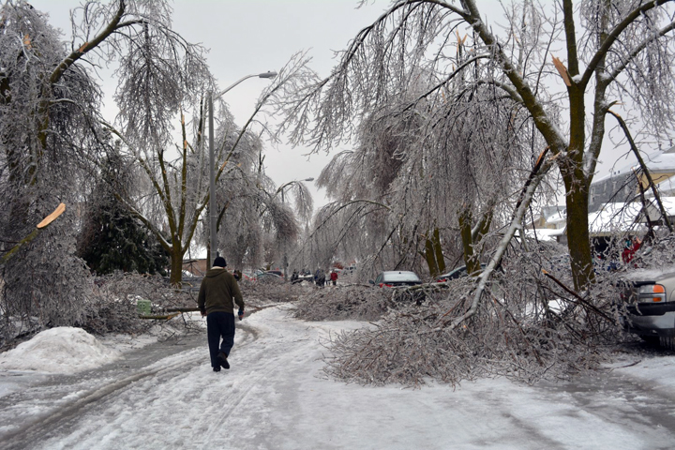

What types of situations warrant an EOC?
Hurricane/Tropical Storm
Major Winter Storm
Long term power outages
Large Forest Fire
Major Flooding
Microburst/Tornado
HazMat Release
Terrorism

Slide 7
EOC Responsibilities
Incident Management/Situational Awareness
Evacuations
Security
Damage Assessment – public & individual
Debris Management
Mass Care – feeding, shelters, assistance
Emergency Public Information

Slide 8
EOC Activities
Situational Awareness
Gaining an understanding of what is happening.
Requires good communications network
Information Management
Collect, evaluate, organize, display and distribute incident information.
Need to have a process in place.
How do we accomplish this?

Slide 9
EOC Activities
Communications
Establish incident communications center
Staff and equip
What types of voice and data comms?
Public Warning
How do you warn our residents to evacuate, or shelter-in-place?
How do you notify our residents of shelters and other available assistance?

Slide 10
EOC Activities
Incident Planning and Coordination
Elected Officials provide policy level support
Emergency Manager facilitates planning
Resource Management
Acquire, assign and track resources
Utilize procedures to access funds
Have a process in place beforehand

Slide 11
EOC Activities
Recovery
Public Road/Property Repairs – where does help come from?
Individual Needs – how can the County help?
Homes
Businesses
Farms
Organizations
Community Morale

Slide 12

EOC Staffing
Resource Manager
Supply Manager
Shelter Program Manager
Commissioners
EOC Manager
Sheriff’s Office
RCC Dispatcher
Radio Communications
Treasurer
Infrastructure Manager
Mass Care Manager
Public Warning Manager

Slide 13
EOC Staffing
Elected Officials/ Commissioners are referred to as the Policy Group
Positions are staffed as needed.

Slide 14

EOC Staffing
Positions aren’t filled if not needed for the disaster event.
Ex. Resource Manager not assigned if there are no resource requests.
However, the County EOC cannot operate with 2 or 3 people – they will be overwhelmed.
We also utilize volunteers and liaisons from other organizations, such as the Red Cross.

Slide 15
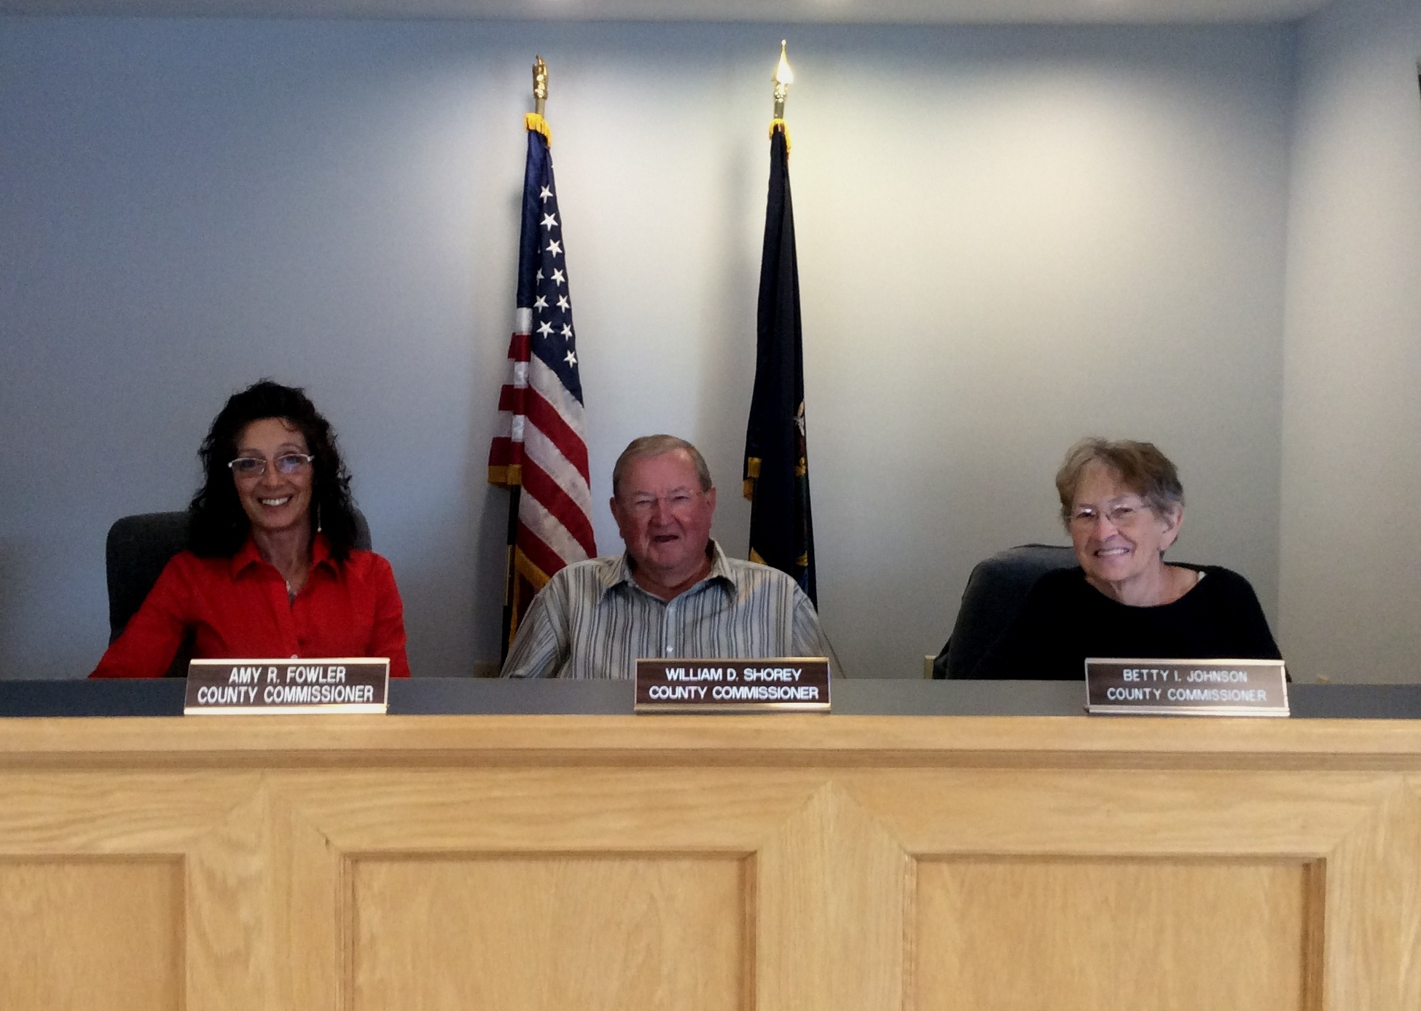
EOC Personnel Tasks
County Commissioners
Assume responsibility for the overall county response and recovery operations.
Make policy decisions relating to the disaster response and recovery.
Approve emergency expenditures.
Approve the EOC manning assignments recommended by the EM Director.
Approve press releases to the media.

Slide 16

EOC Personnel Tasks
Sheriff/Law Enforcement
Oversee all law enforcement resources
Direct law enforcement response operations
Responsible for coordinating emergency evacuations.
Oversee:
Traffic Control
Site/Facility/Scene Security
Rescue

Slide 17
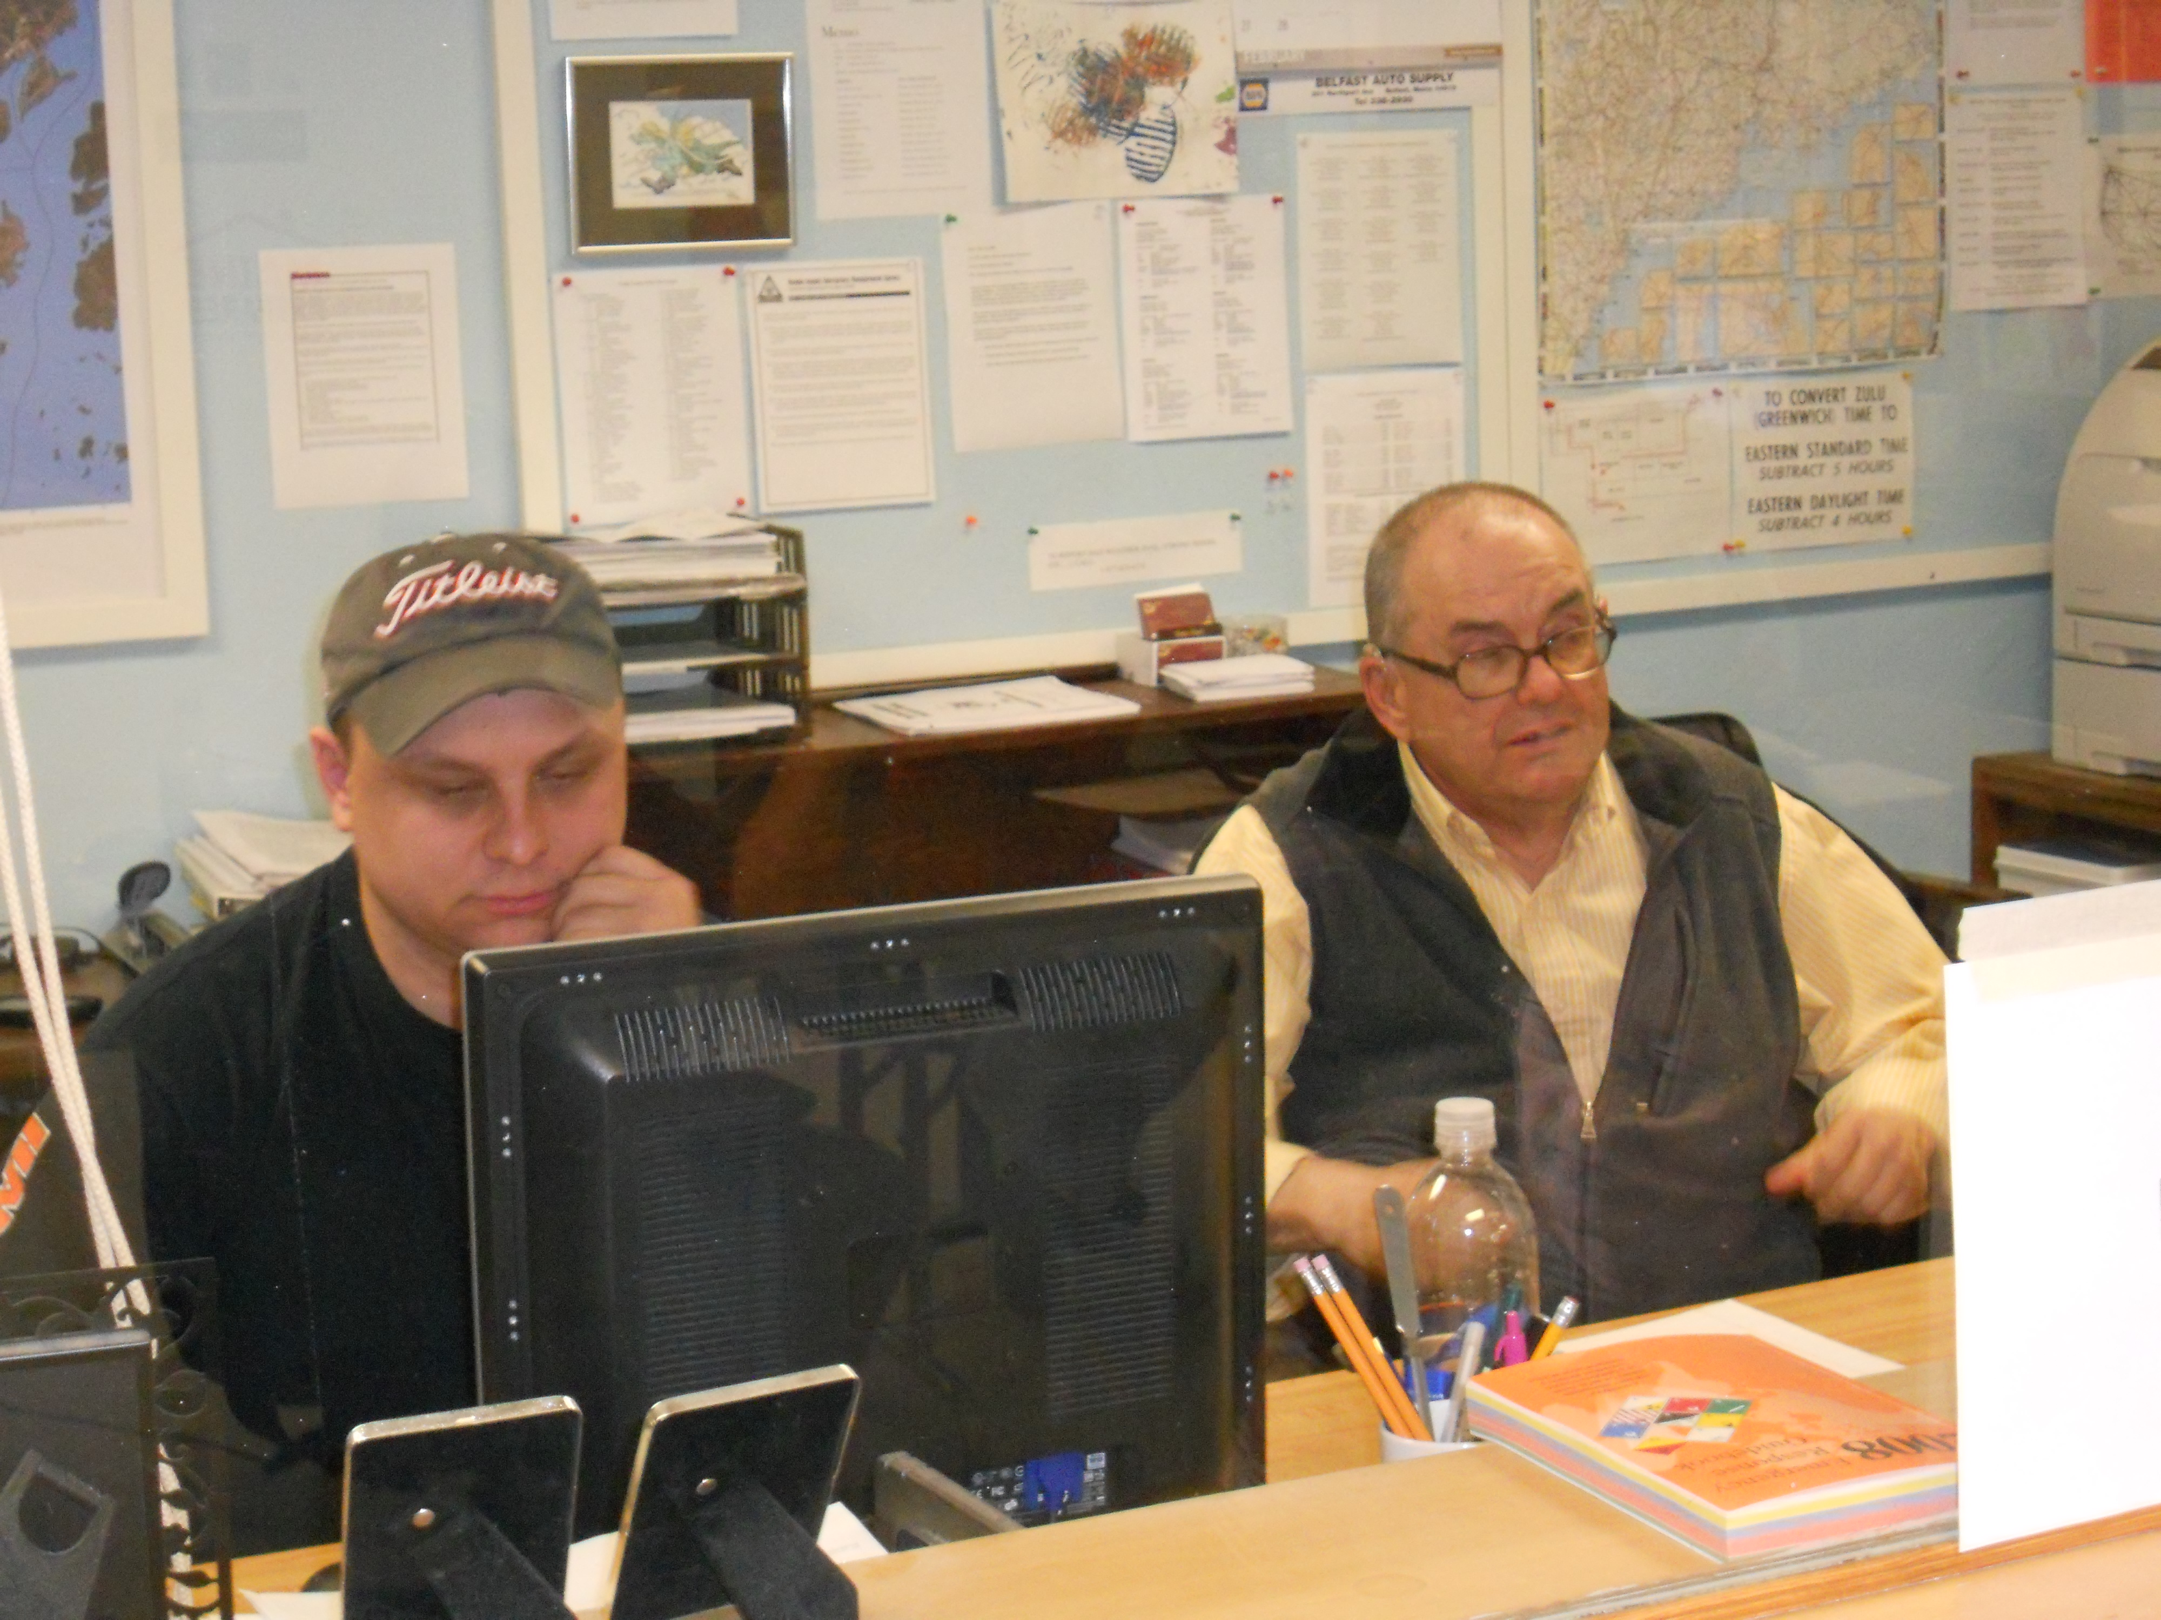
EOC Personnel Tasks
Dispatcher
Answer radio calls from LE, Fire and EMS responders calling the EOC.
Transfer phone calls to the specific EOC staff member who will handle the call.
Update Spillman
Brief EOC on information reported in Spillman.

Slide 18

EOC Personnel Tasks
Finance
Ensure financial records are maintained.
Track all emergency event expenditures.
Gain permission from Commissioners to utilize certain accounts.

Slide 19

EOC Personnel Tasks
Radio Communications
Maintain radio equipment
Operate radio equipment and communicate with responders in field, with volunteers at event locations and with the municipal EOCs.
EMA Frequencies
County Frequencies (Dispatch, County EOC, Sheriff)
MEMA ALL & RegionNet (Maine State Comm Net)
Amateur Radio
Keep a log of message traffic.

Slide 20
EOC Personnel Tasks
Emergency Management Director
Facilitator of the EOC
Knowledgeable of the County Emergency Plans
Activate the EOC with approval of the Policy Group.
Manage the flow of information in the EOC.
Maintain lists of Open Action Items and Completed Action Items.
Develop EOC priorities, objectives and tasks
Facilitate shift change briefings and end of day planning for the next day
Determine the EOC schedule of activities.
Process and distribute situation reports.

Slide 21
EOC Personnel Tasks
Public Warning Manager
Monitor all news media outlet (TV, Radio, Internet, Print)
Monitor and provide updates on Social Media (Facebook and Twitter)
Initiate emergency messages with local TV and Radios stations
Request emergency messages on EAS.
Publicize information on: Shelters, Warming Centers, Evacuations, Shelter-in-place, Areas to avoid and individual assistance.
Provide updated emergency information to 211Maine.

Slide 22
EOC Personnel Tasks
Mass Care Manager
Track information on Mass Feeding events
Track information on Town Warming Centers
Track information on Overnight Shelters
Coordinate with WCAP on transportation of residents to Shelters
Assist mass care activities with finding the resources they need.

Slide 23
EOC Personnel Tasks
Situational Awareness Manager
Collect Form 7 Damage Reports and Situation Reports.
Receive and record detailed damage cost estimates.
Coordinate and record electrical power transmission information with CMP.
Update list of power outages.
Track and record all municipal damage and closure information.
Record information on fuel shortages and gas station status.

Slide 24
EOC Personnel Tasks
Resource Manager
Receive resource requests from municipal EOCs or Incident Commanders
Track down and order necessary resources
Receive resources or oversee their deployment
Keep track of resource status
Assist with resource upkeep (fuel, maintenance, lodging, etc.)
Provide receipts/invoices to Treasurer
Ensure that resources are returned to owners when no longer needed.

Slide 25
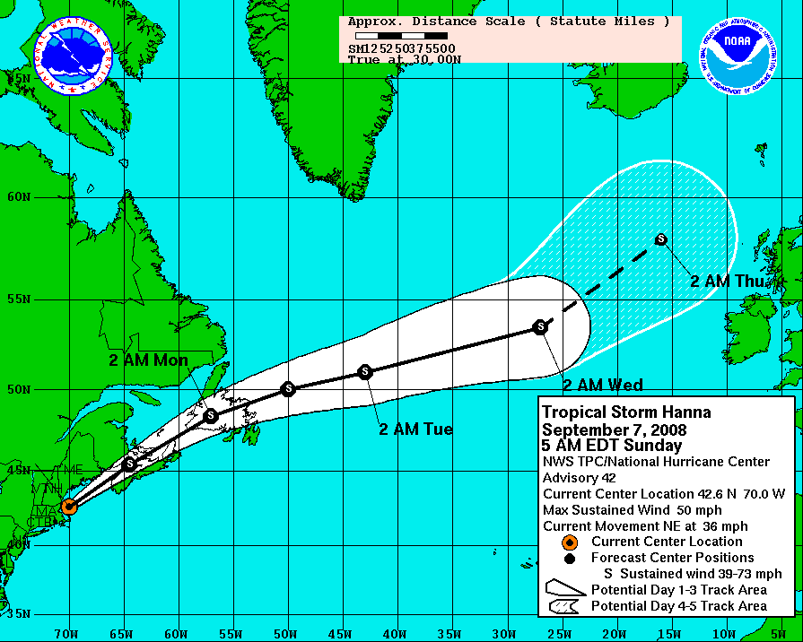
EOC Activation
EM Director monitors potential emergencies, such as Hurricanes and Winter Storms.
Makes recommendation to Elected Officials when to activate, at what level
“Trigger Points” are included in our Emergency Operations Plan for emergencies without warning.
5 acre Forest Fire, HazMat spill which requires evacuations, etc.
Alert the entire EOC staff
Telephone Tree
Paging System
Autodialing system
Text Messaging

Slide 26
EOC Activation Levels
Level 3 – 1-2 day, small event
Staffed by EMA Staff
Preparing for an approaching event or
Working an emergency event
Level 2 – 2-6 day, medium event
Staffed by Key EOC personnel
Working a small disaster event
Level 1– Full Activation
Staffed by all assigned EOC staff
May have Volunteer/Liaison help
Working a Major Disaster
Level 3 EMA Director
Level 2
Partial EOC Staff
Level 1 All EOC Staff

Slide 27
EOC Information Management
Ensure that everyone that might have a need for the information, has the information in a timely manner.
Build an effective way to display incident information
Build an information distribution system
Build a communications system
Build an atmosphere of information sharing
Practice your communications system
Be proactive when communicating

Slide 28
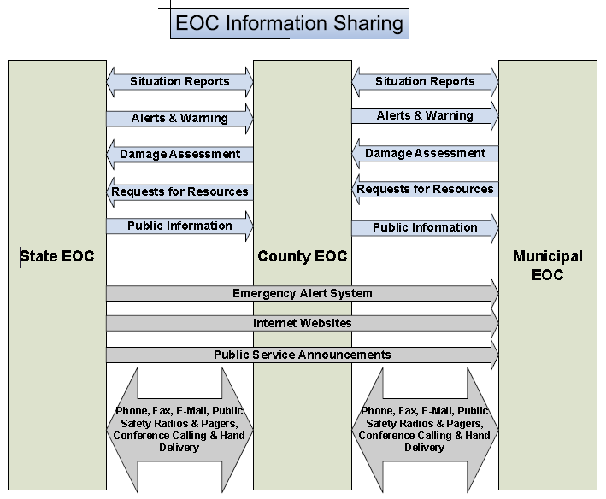
EOC Information Management
In order to build a common operating picture, information must be passed to all that need it.

Slide 29
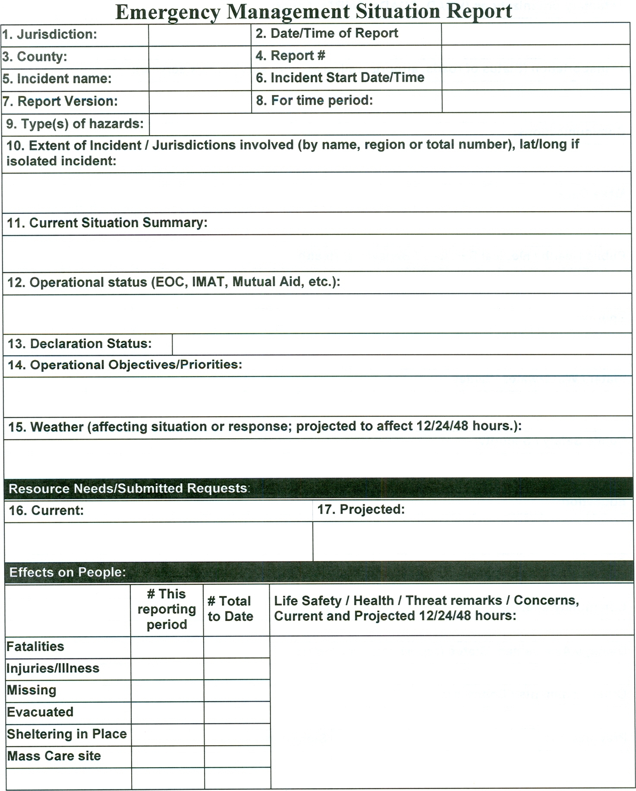
EOC Information Management
Situational Awareness: The ability to identify, process, and comprehend the critical information about an incident. More simply, it is knowing what is going on around you.
Information is submitted to the State EOC on a Situation Report or “SitRep”.

Slide 30
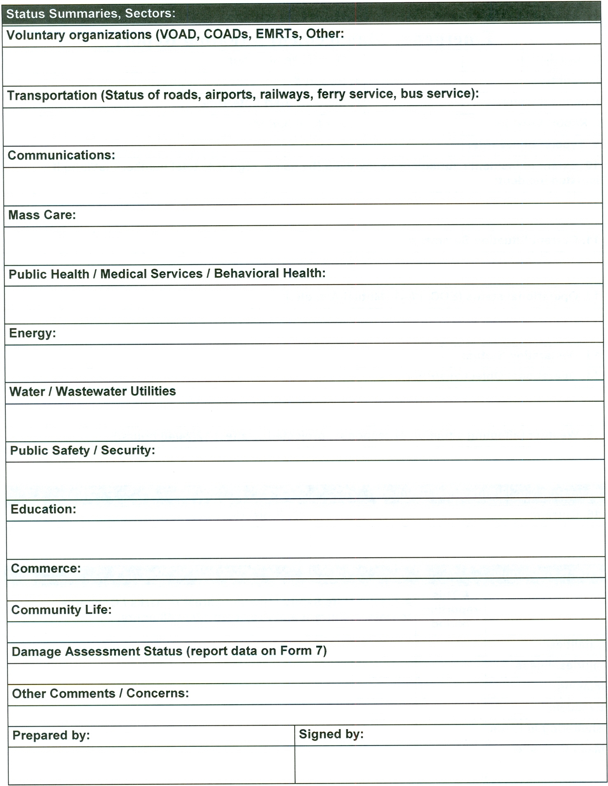
EOC Information Management
Backside shown
A Sitrep may be submitted by
E-mail
Fax
WebEOC
Radio or Phone

Slide 31
EOC Information Management
What information needs to be tracked in the EOC?
Open Action Items
Casualties
Damage Estimates
Roads and Utilities Status
Emergency Facilities (Shelters, Warming Centers, EOCs, etc)
Resource Status
Expenditures
Infrastructure Status
Citizen’s Reports

Slide 32
EOC Information Management
Open Action Items
Action Description | Location | Resource Assigned | Updates | Status
The Airport needs to be closed | Skyway Lane | Airport Manager | Contacted the Fixed Base Operator and FAA. | Open
Evacuate Residents in Flooded Areas | Water Street | 3 Deputies | PD is walking from business to business and informing that the flooding will be getting worse. | Open
Relocate a Nursing Home | Rover Road | 2 School Buses + ADA Bus | School Dept and Clinic staff helped Nursing Home to evacuate. | Closed

Slide 33
EOC Information Management
Casualties
Name | Address | Condition (Dead, Injured, Missing) | Updates
John Doe | 50 Main St | Injured | At County Hospital
Sally Doe | 50 Main St | Injured | At County Hospital
Albert Smith | 135 Water Street | Missing | Warden Service requested

Slide 34
EOC Information Management
Damage Estimates
Municipality | Cat A - Debris | Cat B – Protective Measures | Cat C - Roads | Cat D – Water Control | Cat E - Blds | Cat F – Utilities | Cat G - Parks | Non Profits
Belfast | $20,000 | $8,000 | $80,000 | $0 | $120,000 | $0 | $3,000 | $25,000
Belmont | $5,000 | $2,000 | $25,000 | $0 | $65,000 | $0 | $0 | $3,000
Brooks | $12,000 | $4,000 | $42,000 | $0 | $0 | $0 | $0 | $4,000

Slide 35
EOC Information Management
Roads and Utilities
Description | Status | Town | Address
Pole broken; lines in road | 1 way traffic | Monroe | 20 Swan Lake Ave
Culvert washed out | Road Closed | Troy | 50 Bagley Hill Road
Trees in Road | Road Cleared | Winterport | 100 Monroe Road

Slide 36
EOC Information Management
Emergency Facilities
Type | Location | Address | Phone # | Status | Capacity | Sheltered
ARC Shelter | High School | 177 South St | 123-4567 | Open | 200 | 25
Warming Center | Library | 88 Main St | 123-7654 | Closed | 50 | 15
EOC | Community Center | 12 East Road | 123-4545 | Open

Slide 37
EOC Information Management
Resource Management
Item Description | Requester | Location Needed | Assignment | Status
5kw gas generator | Searsport | Library | Emergency power for Warming Ctr | Delivered at 1300
Traffic Barricades | Belmont | Water Street | Divert Traffic around washout | Waiting on MDOT
200 filled Sandbags | Palermo | Town Garage | Waiting for delivery | Making calls
500 gallons of drinking water | Unity | Community Center | Will hand out to residents | Purchase underway

Slide 38
EOC Information Management
Expenditures
Expenditure | Vendor | Amount | Status
1,000 Sandbags | Traffic Solutions | $150 | Ordered
200 Meals | Walmart | $1,000 | Paid w/ Credit Card
5 Bariatric Cots | Propac | $400 | Waiting on delivery
Rental of Forklift | United Rental | $200 | In Service

Slide 39
EOC Information Management
Infrastructure Status
Name | Town | Nature of Issue | Status
Irving Fuel Depot | Searsport | No Electricity; unable to pump fuel | Open
Natural Gas Pipeline | Searsmont | Damaged, Out of Service | Open
Belfast Water District | Belfast | Main waterline damaged; no water to East Side | Open
Ferry Landing | Islesboro | Ramp Elevator damaged; cannot offload cars | Closed

Slide 40
EOC Information Management
Citizen’s Reports
Name | Town | Nature of Issue | Status
John Adams | Belfast | House Damaged | Open
John Doe | Brooks | Lost Food | Closed
Jack Frost | Winterport | No Heat | Open
Sally Winters | Burnham | Plumbing Frozen and busted | Closed

Slide 41
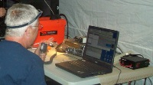
EOC Information Resources
Town & County Emergency Operations Plans
School, Water Dept Emergency Plans
EOC Checklists/Guides
Resource Contact Rosters
Mutual Aid Agreements
EOC Forms (Sitrep, Form 7, Log of Events, etc)
Responder Reference Manuals
Maps
D4H Live

Slide 42
EOC Facility Requirements
Building
Conference/Training Room
Tables & Chairs
Restrooms
Kitchen/Kitchenette
Food, Water, Coffee
Generator
Office Equipment
Computers
Printers
Photocopier/Scanner
Extension Cords/Surge Protectors
Communications
Telephones (hardwired)
Fax Machine
2-Way Base Radio
Internet Connection
TV & AM/FM Radio
NOAA Weather Alert Radio
Amateur Radio a big plus
Admin Supplies (Lots)
Whiteboards/Chalkboards
Tack Boards

Slide 43
EOC Resource Management
Resource Requesting Hierarchy
Local public-private
Mutual Aid
County
County to County
State
State to State
Federal
Federal Agencies
Federal JFO
New Hampshire EOC
Maine State EOC
Knox County EOC
Waldo County EOC
Town EOC
Incident Command

Slide 44
EOC Resource Management
All Disaster are Local.
The first place to look for what you need is Local.
Only after you have used up or don’t have, do you reach out to others.
Federal Government Last Resort!
State Government Provides Support
Local Government First Response!
Individuals and Households
Private Sector
Nongovernmental Organizations
The best place to get a dump truck is from a local contractor, not the State National guard

Slide 45
EOC Resource Management
Interagency Coordination
County EOC
State EOC
Local EOC
Local Dispatch Center
Joint Field
Office (JFO)
Incident
Command
State Dispatch Center
FEMA/DHS
Federal Agency HQ

Slide 46
EOC Resource Management
What needs to be resourced?
People (EOC Staff, Volunteers, Responders, Employees, Teams)
Services (Communications, Feeding, Cleaning, etc.)
Equipment (Vehicles, Generator, Construction Equipment, etc.)
Supplies (Water, Food, Fuel, Ice, Tarps, Personal Sanitation, etc.)

Slide 47
EOC Resource Management
Mutual aid
Should be requested when resources are nearing depletion, or you do not possess.
Agreements should be in place before an incident
Agreements have typically been between Town FDs, but
may also be for Public Works, Animal Control, etc., and,
Can also be with contractors, suppliers, vendors, community organizations, non-profits, etc.

Slide 48
EOC Resource Management
Mutual Aid
Red Cross
City of Belfast Airport
Central Maine Power
Versant Power
Waldo Community Action Partners
Waldo County General Hospital
All Public Schools
Belfast Area Soup Kitchen
Search & Rescue
Other Counties

Slide 49
EOC Resource Requests
Incident/Event name
Date and time of request
Quantity, kind, type or detailed mission description.
Special support needs.
Reporting location.
Requested time of delivery (specific, not ASAP)
Radio frequency to be used
Person/Title placing request
Callback phone number

Slide 50
EOC Resource Examples
Incident Management Assistance Teams (IMAT)
RACES Ham Radio Teams
Hazardous Materials Response Teams
Search and Rescue Teams
Electrical Power Generators
School Buses
Volunteer manpower
Weapons of Mass Destruction Civil Support Team
Civil Air Patrol
American Red Cross
Medical Strike Teams
Mass Casualty Response Trailers

Slide 51
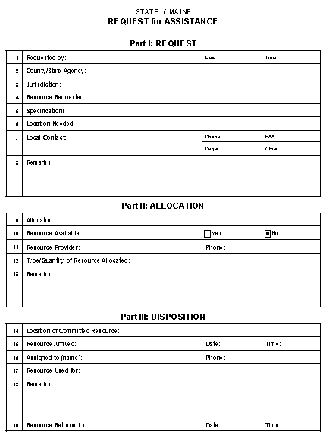
EOC Resource Requests
Example of a Resource Request Form – MEMA
Requester fills in top section
Provider fill in middle section
User fills in bottom section
EOC Resource Manager tracks it at all stages, including demobilization back to the Provider

Slide 52
EOC Resource Requests
Understand that some resources, even government resources, may come with a cost
Example: National Guard forces may charge for salaries and expendables such as fuel
You may need to pay for the lodging and food for Volunteers
There may be reimbursements if:
The incident is a part of a Presidential Declaration
The incident involves the release of HazMat

Slide 53
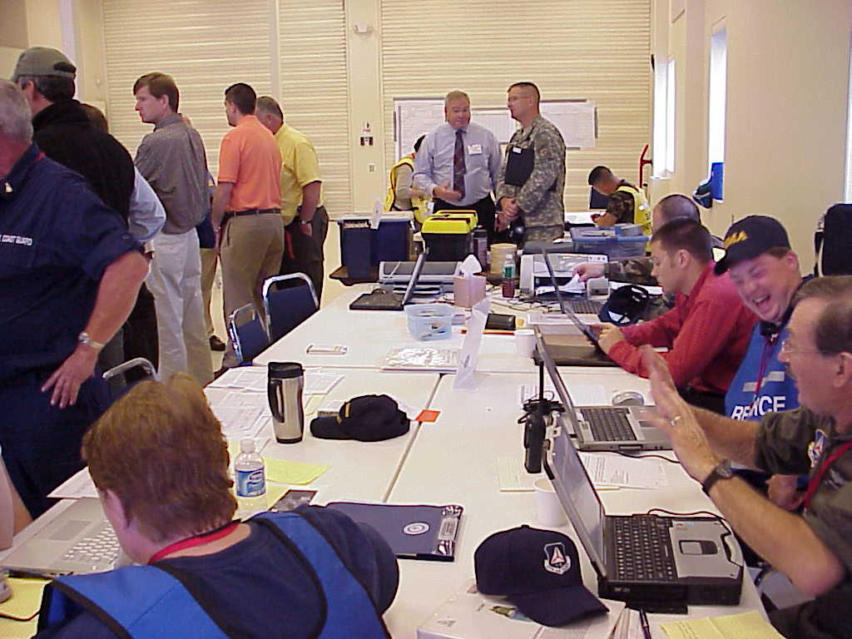
EOC Resource Coordination
When the Dispatch becomes too busy to provide effective logistical support to the incident, the EOC then takes over this task.
A predicted event of the scope and duration requiring multi-agency coordination is imminent (i.e. hurricane).
The County Plan triggers EOC involvement.
A municipal EOC requests assistance.

Slide 54
Disaster Recovery - Definitions
Public Assistance: aid to public entities(and certain private non-profit) for emergency services and the repair or replacement of disaster damaged public facilities
Individual Assistance: aid to individuals and households, including businesses and farms
Disaster Recovery Center: Following a Presidential disaster declaration that includes the Individual Assistance Program, FEMA may open temporary facilities called Disaster Recovery Centers (DRCs). DRC’s may be opened in order to provide direct customer service.

Slide 55
Disaster Recovery
Disaster Declaration Process
Form 7s show sufficient damages to warrant a Disaster Declaration by the Governor
The Governor requests a Declaration by the President
FEMA completes a Preliminary Damage Assessment (PDA)
President issues a Disaster Declaration
FEMA Project Teams meet with local officials

Slide 56
Disaster Recovery – Public Assistance
In order for a County (and its corresponding municipalities) to be eligible for a Public Assistance Declaration, both the County and the State have to reach its PA Damage Threshold
This level of damage is estimated during the Form 7 process and verified during FEMA’s Preliminary Damage Assessment or PDA
The Thresholds for the County and the State are shown on the next slide

Slide 57
Disaster Recovery
Public Assistance Thresholds
Both the County and State Thresholds must be met
A disaster involving only one County would need to meet both thresholds
Otherwise several counties may total to meet the State threshold
Waldo County - $186,946.00
State - $2,574,859.00

Slide 58
The Public Assistance Process
Disaster
Event
Funding
State
Declaration
Applicant
Validation
PDA
of
Small
Projects
Applicant's
Briefing
Complete
Project
Submission
of
Worksheets
Kickoff
Request
Meeting

Slide 59
Disaster Recovery – Public Assistance
Emergency Work
Category A – Debris Removal
Category B – Emergency Protective Measures
Permanent Work
Category C – Roads and Bridges
Category D – Water Control Facilities
Category E – Buildings and Equipment
Category F – Utilities
Category G – Parks, Recreation and Others

Slide 60
Disaster Recovery - Individual Assistance
When the President declares a disaster and authorizes providing Individual Assistance, FEMA’s Individuals and Households Program (IHP) can help homeowners and renters affected by the disaster with housing needs and necessary expenses.
A Disaster Recovery Center may be set up by FEMA for citizens to visit and file for assistance

Slide 61
Disaster Recovery
Individual Assistance
Temporary Housing
Food Stamps
Legal Services
Veteran’s Assistance
Income Tax Counseling
Low Interest Loans
Unemployment payments
Individual & Family grants
Crisis Counseling
Agricultural assistance
Red Cross Services
Medical and Dental Expenses
Funeral and Burial Costs
The municipal involvement will be during the MEMA Form 7 process of collecting individual damage information
Should an Individual Assistance declaration be made, the individual applicants will work directly with FEMA and other Federal entities or with private charities

Slide 62
How do we make this EOC work?
Training
Not just for the County Emergency Management Agency, but all those who staff the EOC
Each EOC staff member should understand their job and how to complete it
Exercising
Workshop – discussion of duties and processes
Tabletop Exercise – scenario-based discussion exercise
Functional Exercise – scenario-based coordination exercise, where you give and receive inputs with other EOCs or with a SimCell
Corrective Action
Assign issues to be resolved to someone and give a deadline for solving!

