Slide 1
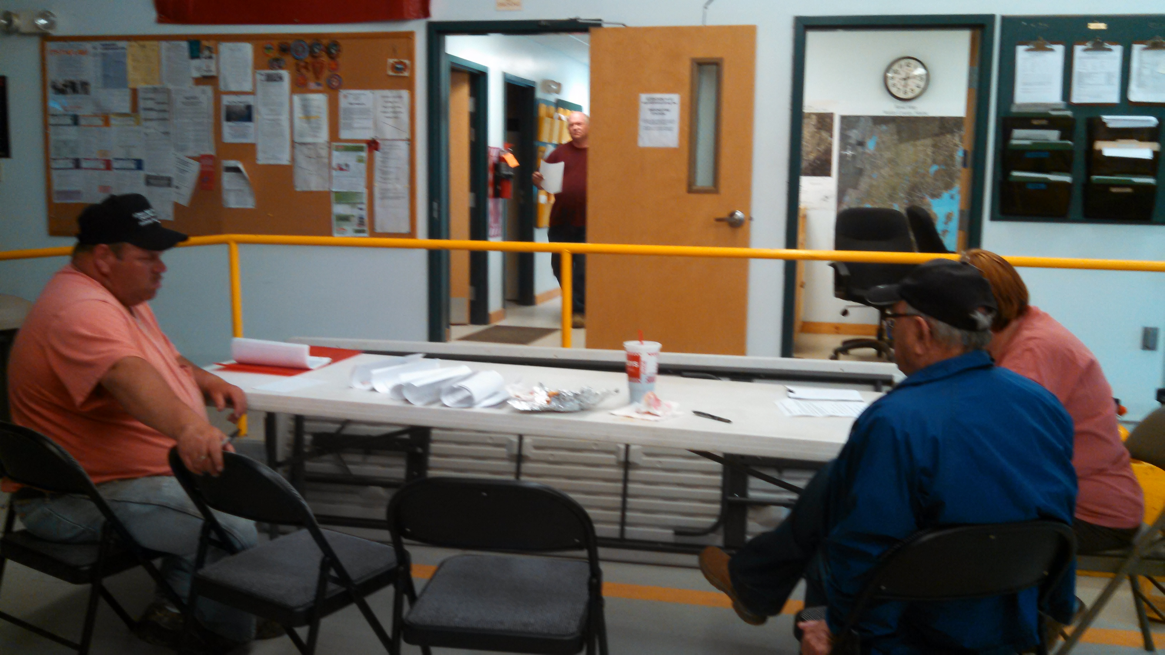


W776
Town EOC
Operations and
Management

Slide 2
Program Goal
To provide information regarding the realistic establishment of a Municipal EOC during an emergency or planned, event.

Slide 3
What is an EOC?
FEMA’s Definition: A central location from which government – at any level – can provide interagency coordination and executive decision making in support of incidents or disasters.
A location where public officials can coordinate the jurisdiction’s response to a disaster.

Slide 4
Why do you need one?
Some emergency events are too much for the Fire or Police Incident Commander to handle without help.
Some natural disasters cause issues in many locations around the community.
Most disasters involve multiple issues, many of which aren’t always managed by Fire or Police.

Slide 5
Why do you need one?
The residents of your community need to be assured that a well coordinated response and recovery process is underway.
An EOC is the location where the community’s efforts are coordinated and where all of the community’s assets can be utilized.

Slide 6
What types of situations warrant an EOC?
Hurricane/Tropical Storm
Major Winter Storm
Large Forest Fire
Major Flooding
Areas damages from a Microburst/Tornado
HazMat Release or Large Industrial Fire
Terrorism or Mass Shooting
Long Term Power Outage
A Planned Community or regional Event
What disaster impacts would happen to the Community?

Slide 7
EOC Responsibilities
Evacuations or Traffic Rerouting
Damage Assessment – public & individual
Debris Clearance
Mass Care – feeding, shelters, warming centers
Road/Bridge Repairs
Emergency Public Information
Event Coordination

Slide 8
EOC Activities
Situational Awareness
  Gaining an understanding of what is happening.
  Requires good communications network
Information Management
  Collect, evaluate, organize, display and distribute incident information.
  Need to have a process in place.
  How do we accomplish this?

Slide 9
EOC Activities
Communications
  Establish incident communications center
  Staff and equip
  What types of voice and data comms?
Public Warning
  How do you warn your residents to evacuate or shelter-in-place?
  How do you notify your residents of shelters and other available assistance?

Slide 10
EOC Activities
Incident Planning and Coordination
  Elected Officials/Chief Executive provide policy level support
  Emergency Manager facilitates planning
Resource Management
  Acquire, assign and track resources
  Utilize procedures to access funds
  Have a process in place beforehand

Slide 11
EOC Activities
Recovery
  Public Road/Property Repairs – where do the funds come from? Who pays?
  Individual Needs – how can the Community help?
    Homes
    Businesses
    Farms
    Organizations
    Community Morale

Slide 12
EOC Staffing
Harbormaster
Health Officer
Fire & Rescue/EMS
Law Enforcement
Mass Care
Public Information
Public Works
Resource Manager
Welfare Services
Volunteer Coordinator
Elected Officials/Manager
Animal Control Officer
Communications – Telephone
Communications - Radio
Damage Assessment
Town Clerk – Documentation
Emergency Management Director
Treasurer – Finance

Slide 13
EOC Staffing
Elected Officials are referred to as the Policy Group
An example Town EOC
Staffing not set in stone
Only assign those positions you need. EM Director to recommend to Policy Group.
Add positions that you do need.

Slide 14
EOC Staffing
This is a comprehensive list
Positions aren’t filled if not needed
  (Inland Towns don’t need a Harbormaster ☺)
  Animal Control not assigned if no animal issues
Depending on size of community – some positions may combined
  One person to answer phone and radio
  Road Commissioner combined with Damage Assessment if roads are the only thing damaged
Don’t try to operate an EOC with 1 or 2 people – they will be overwhelmed.
Look for volunteers (community groups, church, neighbors, etc)

Slide 15
EOC Personnel Tasks
Elected Officials/Municipal Manager
  Assumes responsibility for the overall municipal response and recovery operations.
  Makes policy decisions relating to the disaster response and recovery.
  Approves emergency expenditures.
  Approves the EOC manning assignments recommended by the EM Director.
  Approves press releases to the media.
  Carries out general assistance, if not delegated.

Slide 16
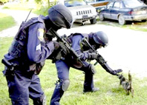
EOC Personnel Tasks
Animal Control Officer
  Point of Contact for dealing with animal issues
    Local Dairy Farm with no electricity
    Farm that needs to be evacuated
    Pet and Evacuated Owner separated
    Pet or Large Animal medical emergency
    Unattended pet

Slide 17

EOC Personnel Tasks
Communications – Telephone
  Someone dedicated to answering the phone
  Keep a log of phone messages
  Transfer calls to the specific EOC staff member who will handle the call
  Keep an eye on the Fax Machine!
  Keep track of telephone numbers that become known during the emergency
  Start telephone alerts to EOC staff and EOC Support Groups

Slide 18

EOC Personnel Tasks
Communications – Radio
  Maintain all radio equipment ensuring that it is functional.
  Operate radio equipment and communicate with responders in field, with volunteers at event locations and with the EOCs in neighboring municipalities and the County.
    Municipal Primary Frequencies (Fire/EMS, Police, Public Works, Harbormaster, etc)
    County Frequencies (Dispatch, County EOC, Sheriff)
    RegionNet (Maine State Comm Net)
    Amateur Radio (if licensed)
  Keeps a log of message traffic.

Slide 19
EOC Personnel Tasks
Damage Assessment
  Collects all information on what is damaged
    Roads, bridges, public buildings
    Home, Business and Farm damages
    Utilities (Water, Sewer, Natural Gas, Electric, Phone)
  Compiles and submits MEMA Form 7
  Coordinates electric transmission issues or information with County EMA or RCC, who resolve with CMP or EmeraMaine.
  Coordinates with FEMA Preliminary Damage Assessment (PDA) personnel during a disaster

Slide 20
EOC Damage Assessment
Rapid Needs Assessment – quickly determine what roads are blocked; where power is out; and what buildings are damaged.
Initial Damage Assessment – initial cost estimates to roads and public infrastructure. Submit on Form 7.
Follow-on Damages Reports – detailed cost estimates using known quantities and estimated unit prices.
FEMA Preliminary Damage Assessment – meet with FEMA officials to discuss and show the damages

Slide 21

EOC Personnel Tasks
Town Clerk – Documentation
  Collects copies of all paperwork and other records relating to the emergency.
  Processes all vital records relating to the emergency (death certificates, etc)
  Assist with logging information.

Slide 22

EOC Personnel Tasks
Emergency Management Director
  Facilitator of the EOC
  Implements multi-agency coordination for the jurisdiction
  Knowledgeable of the Municipal Emergency Plans
  Activates the EOC with approval of the Policy Group.
  Manages the flow of information in the EOC.
  Maintains lists of Open Action Items and Completed Action Items.
  Develops EOC priorities, objectives and tasks
  Facilitates shift change briefings and end of day planning for the next operational day.
  Determines the EOC schedule of activities.

Slide 23

EOC Personnel Tasks
Treasurer
  Ensures financial records are maintained.
  Tracks all emergency event expenditures.

Slide 24

EOC Personnel Tasks
Harbormaster
  Alerts boat owners to approaching hazards
  Evacuates the harbor (hurricanes, tsunamis, etc.)
  Conducts damage assessment of harbor facilities
  Coordinates the use of boating facilities and vessels for emergency response
  Coordinates harbor rescue efforts

Slide 25

EOC Personnel Tasks
Health Officer
  Monitors the health of the residents and visitors
  Reports to and informs the Local Elected Officials on the community’s public health status.
  Reports to Maine CDC on any perceived local public health threats.
  Receives and coordinates public health information
  Requests public health resources and assistance

Slide 26
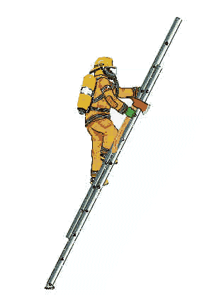
EOC Personnel Tasks
Fire and Rescue/EMS
  Oversees all fire department resources
  Directs fire department response operations.
  Responsible for initiating and implementing emergency evacuations.
  May deliver vital supplies to shut ins.
  May complete community door-to-door welfare checks
  Assist with manpower for:
    Damage Assessment
    Emergency Debris Removal
    Traffic Control

Slide 27

EOC Personnel Tasks
Law Enforcement
  Oversees all law enforcement resources
  Directs law enforcement response operations.
  Responsible for assisting with emergency evacuations.
  May deliver vital supplies to shut ins.
  May complete community door-to-door welfare checks
  Assist with manpower for:
    Traffic Control
    Public Warning

Slide 28
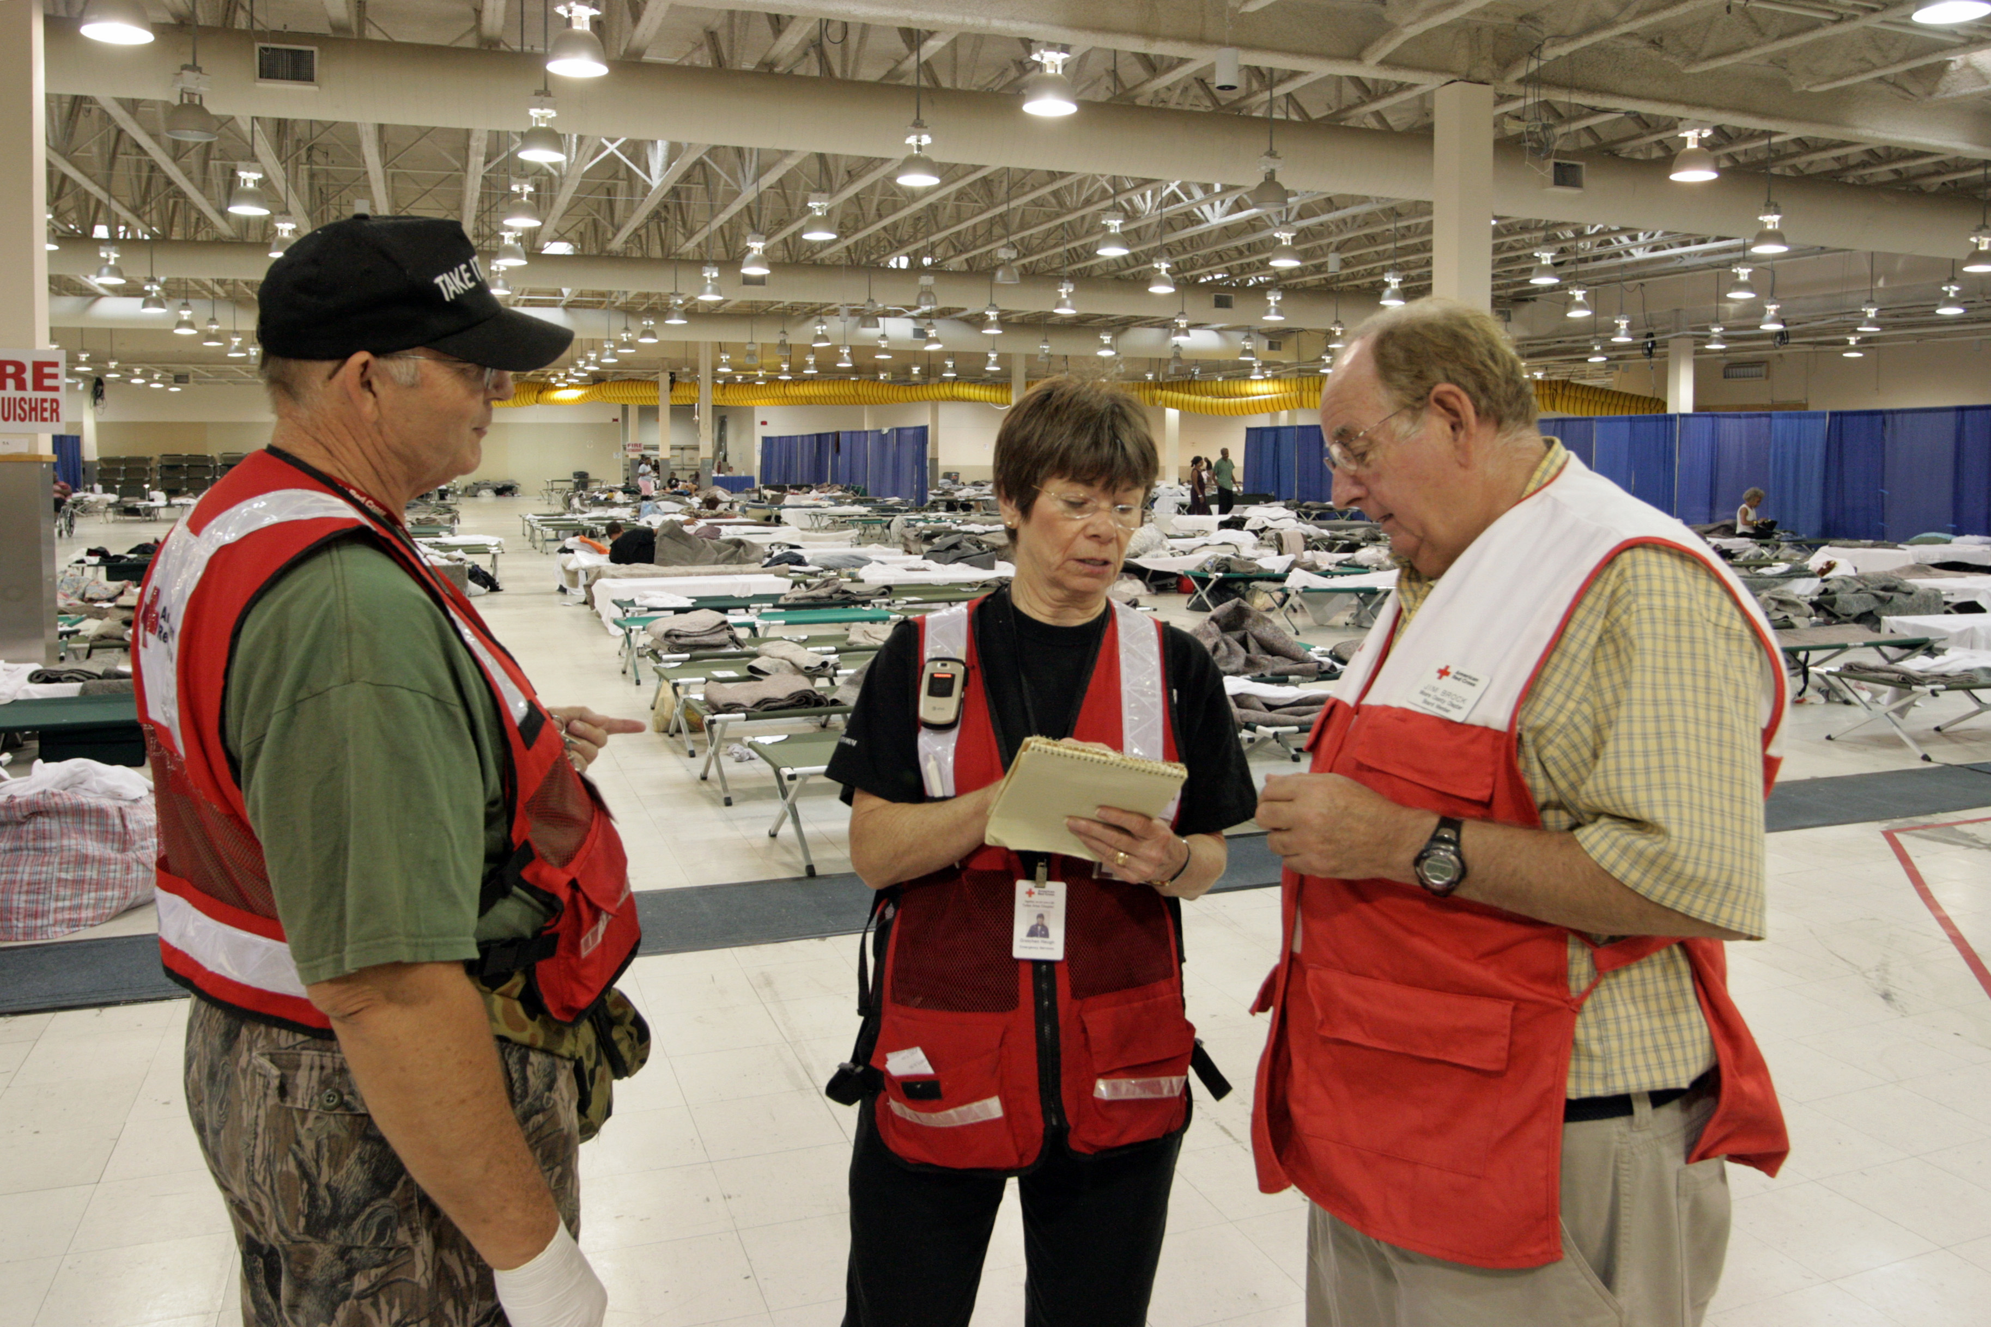
EOC Personnel Tasks
Mass Care
  Coordinate Mass Feeding events
  Activate a Warming Center
  Notify residents of open Red Cross Shelters
  Assist with the Transportation of residents to Shelters
  Coordinate community door-to-door welfare checks
  Use local community groups to help support this role
  Could use a church or civic group with a kitchen facility that conducts public suppers to oversee Mass Feeding, or, a local food pantry that can deploy replacement foods to locals in need.

Slide 29
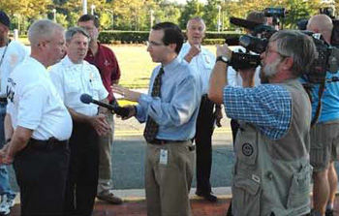
EOC Personnel Tasks
Public Information
  Monitor all news media outlet (TV, Radio, Internet, Print)
  Monitor and provide updates on Social Media (Facebook and Twitter)
  Initiate emergency messages on local access channel.
  Request emergency messages on EAS.
  Publicize information on: Shelters, Warming Centers, Evacuations, Shelter-in-place, Areas to avoid, DRCs, and individual assistance.
  Provide updated emergency information to 211Maine and the RCC.
  Provide briefings to credentialed media.

Slide 30

EOC Personnel Tasks
Public Works/Road Commissioner
  Coordinates road damage assessment.
  Tracks overall road damage and identifies alternate routes
  Installs barricades and barriers.
  Completes road/bridge emergency repairs.
  Develops detailed materials lists and cost estimates.
  Coordinates with FEMA PDA teams to develop Public Assistance Projects.
  Manages the permanent road/bridge repairs.

Slide 31
EOC Personnel Tasks
Resource Manager
  Receives requests from EOC staff or Incident Commanders
  Tracks down and orders necessary resources
  Receives resource or oversees its deployment.
  Keeps track of resource status
  Assists with resource upkeep (fuel, maintenance, lodging, etc.)
  Provides receipts/invoices to Treasurer
  Ensures that resources are returned to owners when no longer needed.

Slide 32

EOC Personnel Tasks
General Assistance
  Identifies those residents in need of assistance.
  Collects and submits data for Individual Assistance Declarations
  Oversees emergency welfare and social service programs
  Coordinates with State social service programs
  Coordinates with local and national charities
  Coordinates location of FEMA Disaster Recovery Centers

Slide 33

EOC Personnel Tasks
Volunteer Coordinator
  Sets up a Volunteer Reception Center
  In processes spontaneous (“walk on”) volunteers
  Credentialing of volunteers
  Provides the EOC with a list of approved volunteers for tasks assignments
  Tracks volunteer work hours
  Coordinates supplies for volunteers

Slide 34
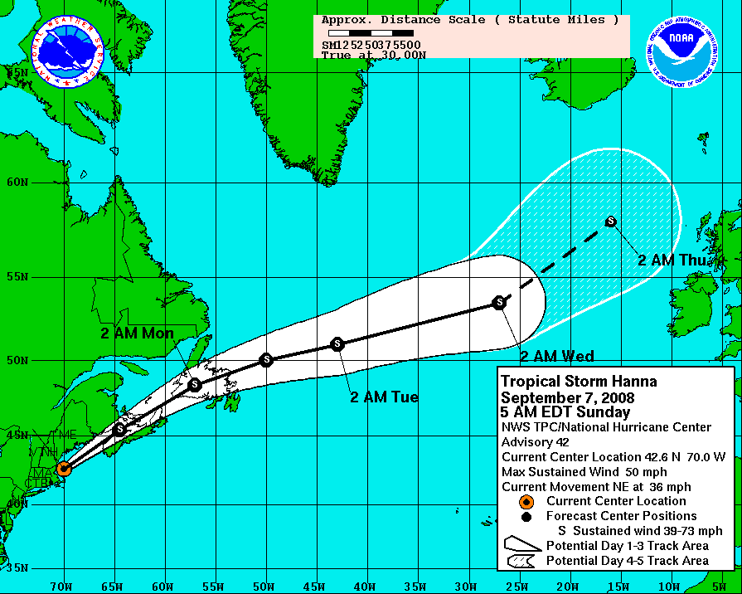
EOC Activation
EM Director monitors potential emergencies, such as Hurricanes and Winter Storms.
  Makes recommendation to Elected Officials when to activate, at what level
Include “Trigger Points” in your Emergency Operations Plan for emergencies without warning.
  5 acre Forest Fire, HazMat spill which requires evacuations, etc.
Develop a way to alert the entire EOC staff
  Telephone Tree
  Paging System
  Autodialing system
  Text Messaging

Slide 35
EOC Activation Levels
Level 3 – Standby
  Staffed by EM Director
  Monitoring the Situation
Level 2 – Increased Readiness
  Staffed by Key EOC Staff
  Preparing for an approaching event or
  Working a small emergency event
Level 1– Full Activation
  Staffed by all assigned EOC staff
  May have Volunteers helping
  Major Emergency/Disaster
Level 3 (Standby):
EMA Director
Level 2
(Increased Readiness):
Partial EOC Staff
Level 1 (Full Activation):
All EOC Staff

Slide 36
EOC Information Management
Ensure that everyone that might have a need for the information, has the information in a timely manner.
Build an effective way to display incident information
Build an information distribution system
Build a communications system
Build an atmosphere of information sharing
Practice your communications system
Be proactive when communicating

Slide 37
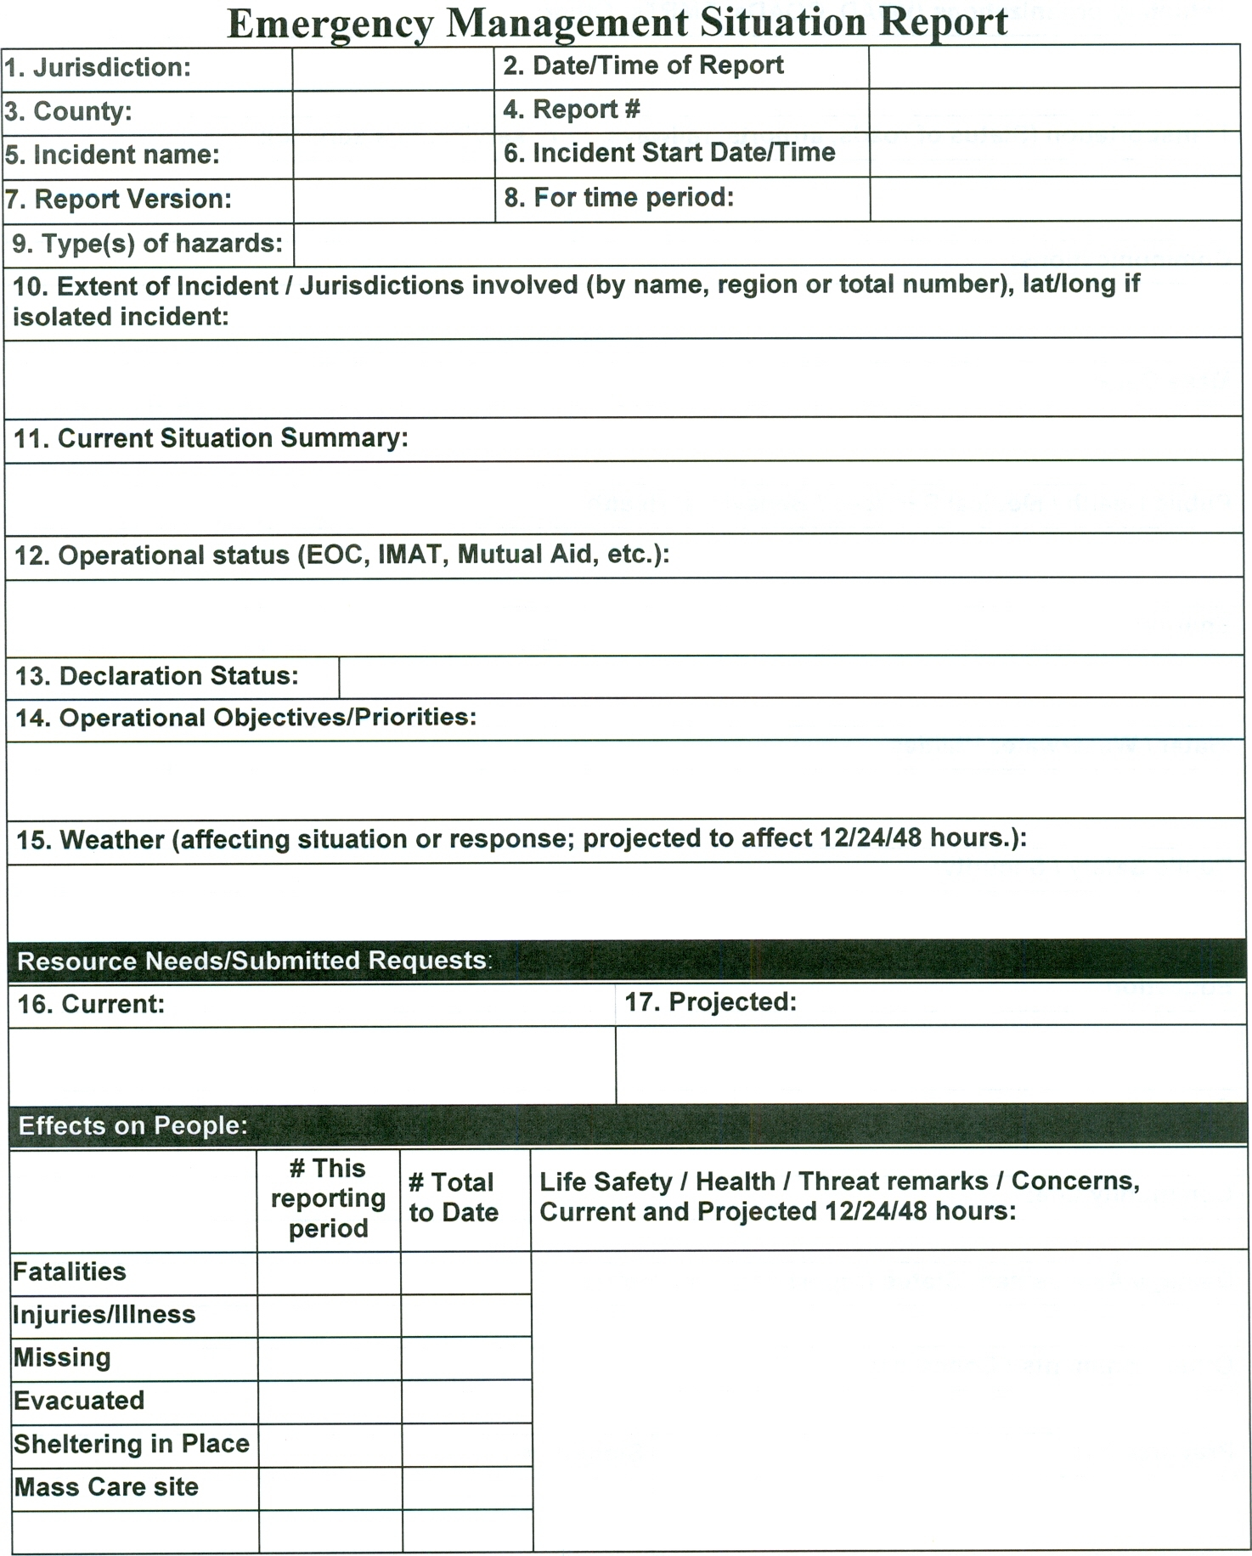
EOC Information Management
Situational Awareness: The ability to identify, process, and comprehend the critical information about an incident. More simply, it is knowing what is going on around you.
Information is submitted to the County EOC on a Situation Report or “SitRep”.

Slide 38
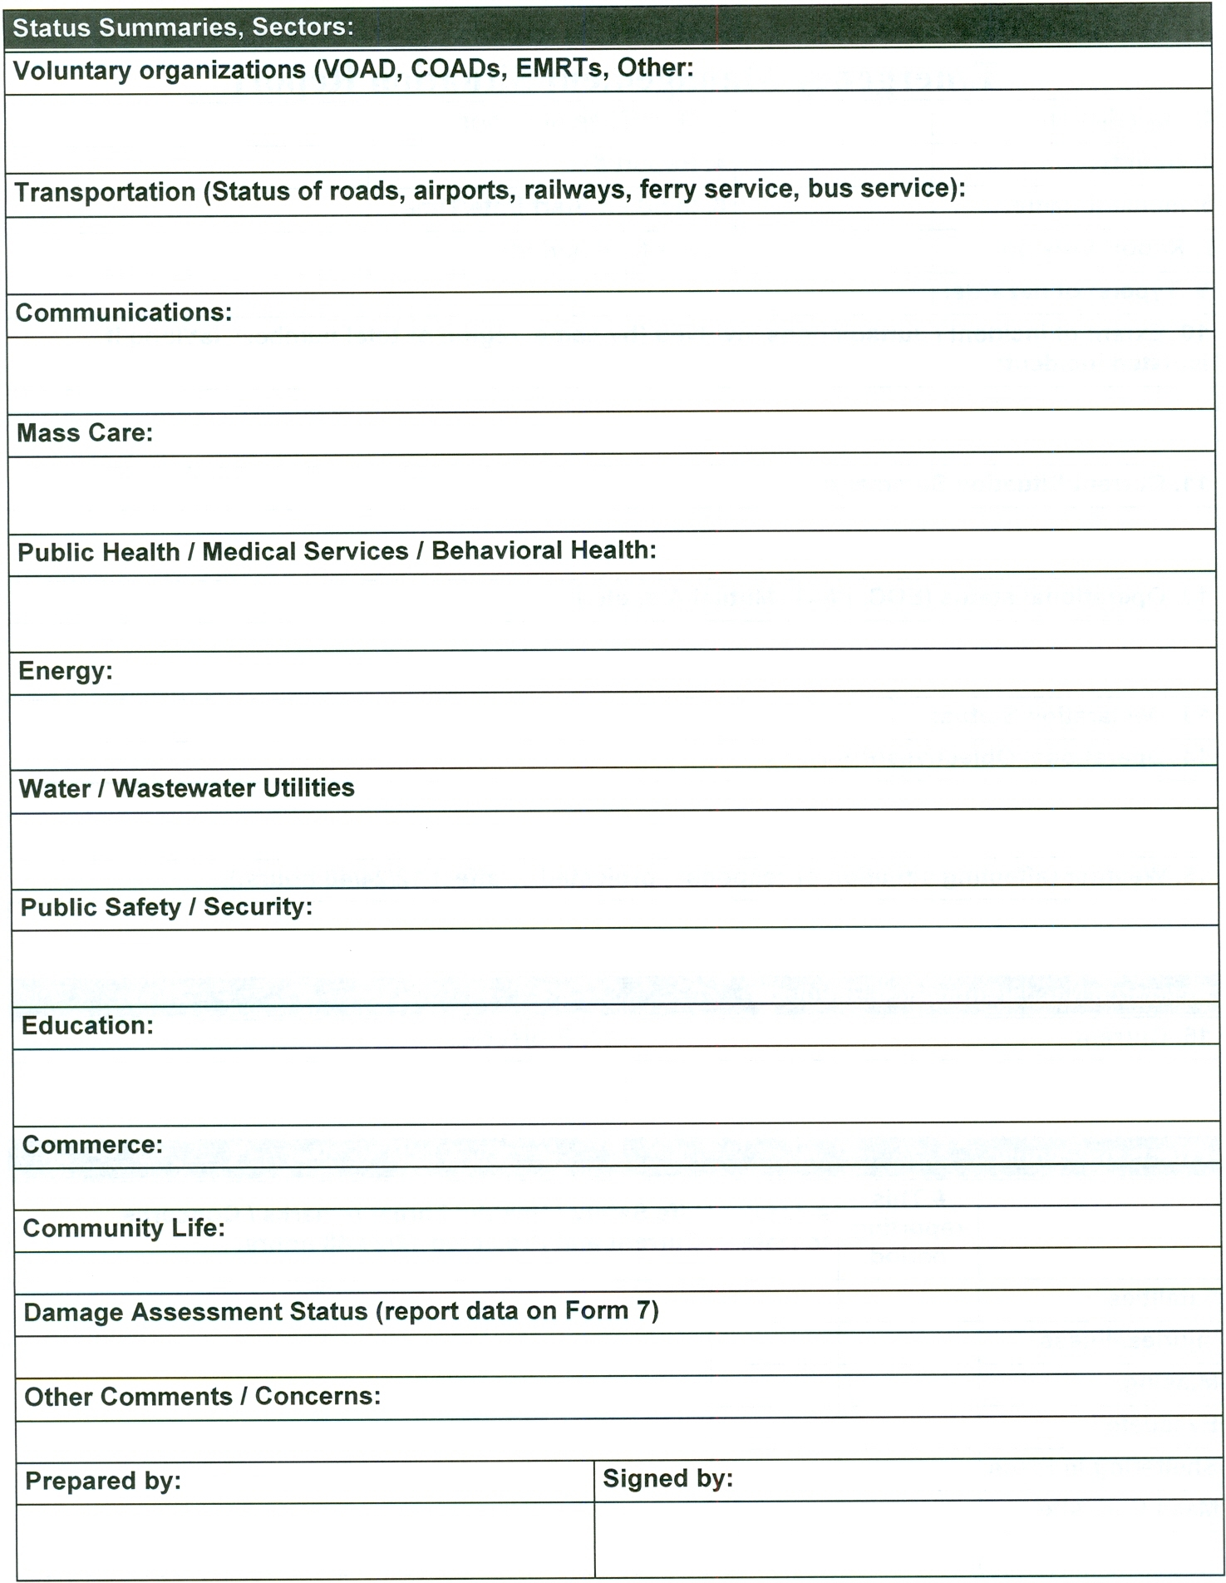
EOC Information Management
Backside shown
A Sitrep may be submitted by
  E-mail
  Fax
  WebEOC
  Radio or Phone
  Hand delivered

Slide 39
EOC Information Management
What information needs to be tracked in the EOC?
  Casualties
  Damages (Roads, Buildings, etc)
  Utility Status
  Shelters/Warming Centers
  Resources
  Action Items

Slide 40
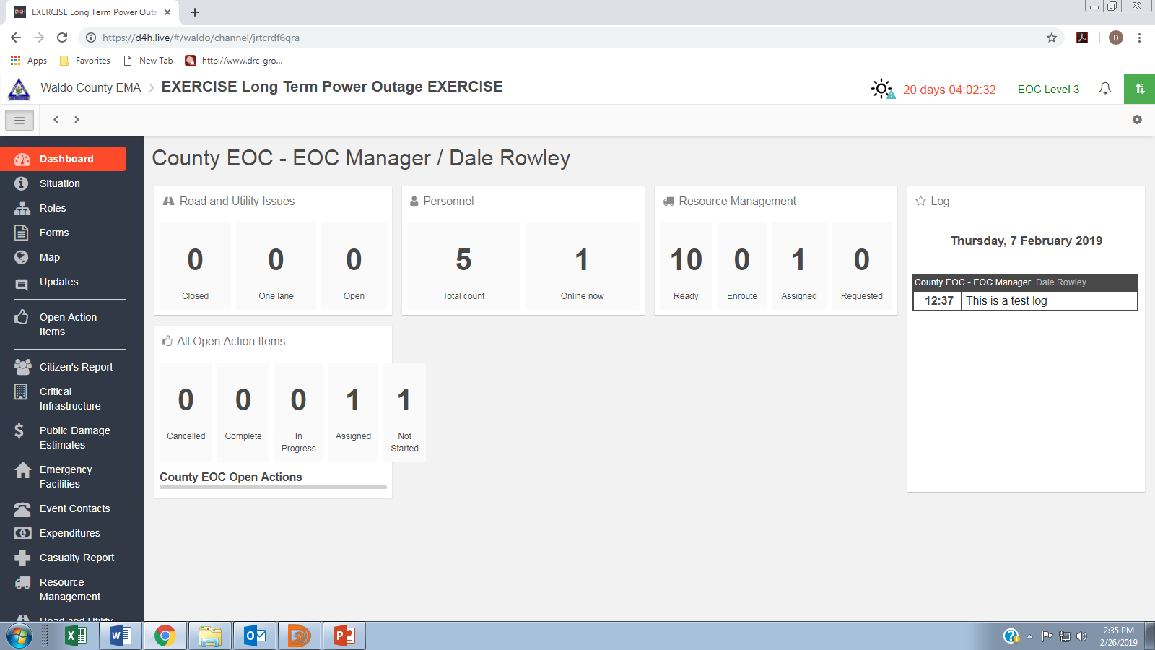
EOC Information Management

Slide 41
EOC Information Management
Casualties
Name | Address | Condition (Dead, Injured, Missing) | Updates
John Doe | 50 Main St | Injured | At County Hospital
Sally Doe | 50 Main St | Injured | At County Hospital
Albert Smith | 135 Water Street | Missing | Warden Service requested

Slide 42
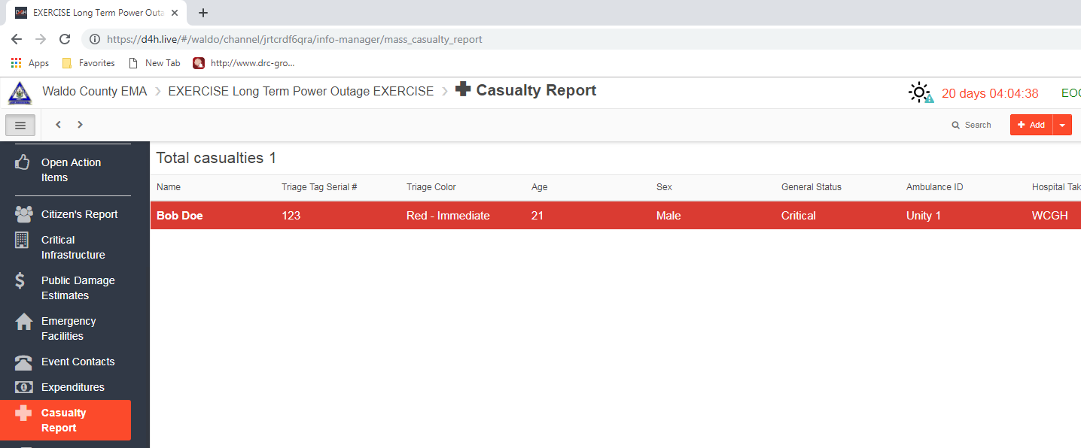
EOC Information Management
Casualties

Slide 43
EOC Information Management
Damages
Location | Type | Description | Resources Assigned | Status
Town Office | Building | Shingles Damaged; roof leaking | Roofing Contractor | Repairs In progress
Water Street | Road | Culvert Washed out; road flooded | Public Works | Repairs In progress
112 North Road | Farm Business | Hay Storage Barn collapsed | USDA | Called USDA Office

Slide 44
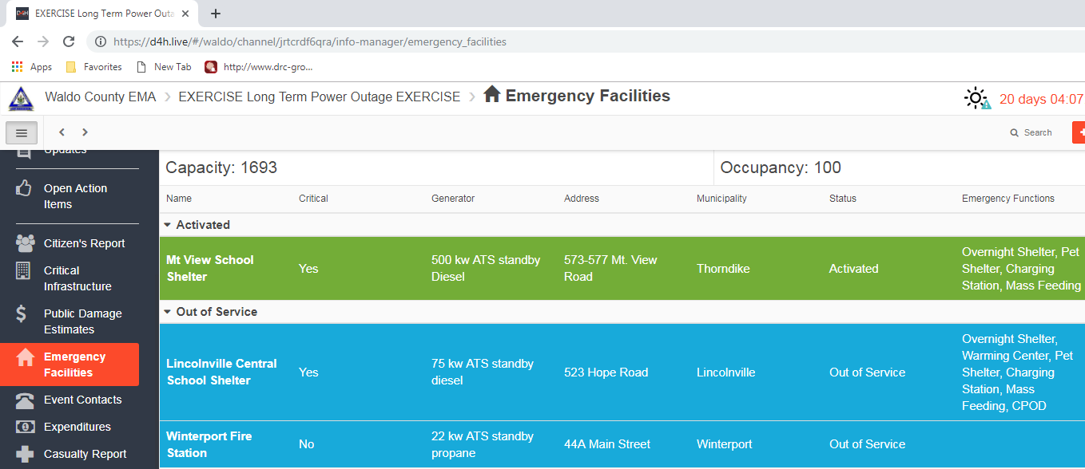
EOC Information Management
Damages

Slide 45
EOC Information Management
Utilities
Location | Type | Description | Resources Assigned | Status
West Road | Powerline | Pole broken; lines in road | 2 Firefighters + 1 Engine | Traffic Control; waiting on CMP
Water Street | Road | Broken water line | Water Department | Repairs In progress
North Road | Transformer | Transformer Station exploded | 1 Patrol Officer/Car | Scene Security while CMP repairs

Slide 46
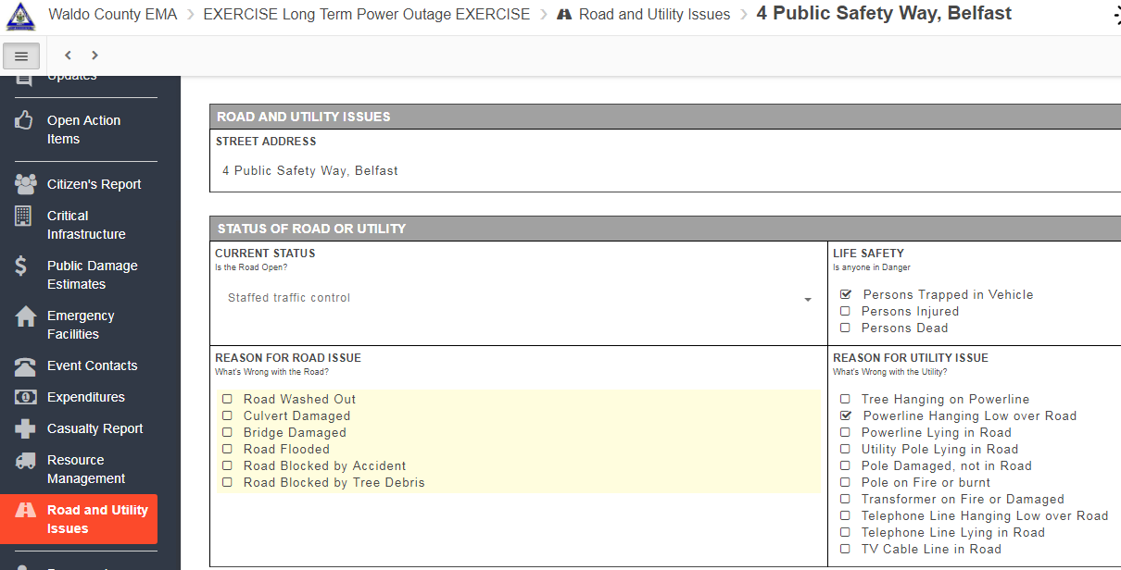
EOC Information Management
Utilities

Slide 47
EOC Information Management
Shelters/Warming Centers
Type | Location | Address | Phone # | Status | Capacity | Sheltered
ARC Shelter | High School | 177 South St | 123-4567 | Open | 200 | 25
Warming Center | Library | 88 Main St | 123-7654 | Open | 50 | 15
Warming Center | Community Center | 12 East Road | 123-4545 | Closed | 100 | 0

Slide 48
EOC Information Management
Resource Management
Item Description | Requester | Location Needed | Assignment | Status
5kw gas generator | Mass Care Mgr | Library | Emergency power for Warming Ctr | Delivered at 1300
Traffic Barricades | Public Works | Water Street | Divert Traffic around washout | Waiting on MDOT
ATV Club | Fire Dept | Warden's CP | Assist with Search | Making calls
500 gallons of drinking water | Water Dept | Community Center | Will hand out to residents | Purchase underway

Slide 49
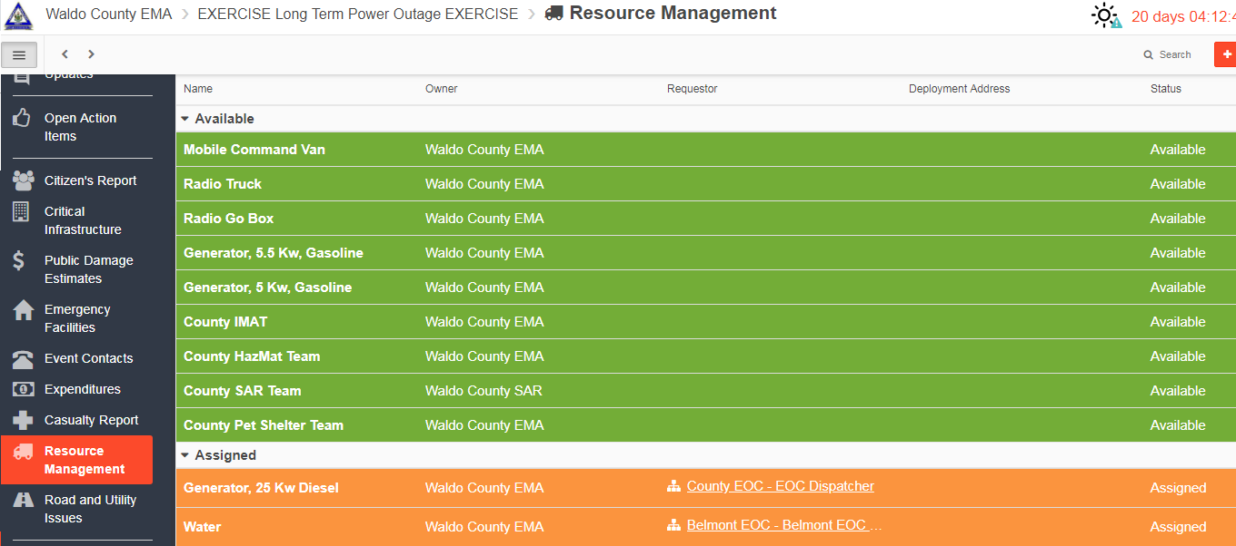
EOC Information Management
Resource Management

Slide 50
EOC Information Management
Action Items
Action Description | Location | Resource Assigned | Updates | Status
The Town Airport needs to be closed | Skyway Lane | Town Manager | Contacted the Fixed Base Operator and FAA. | Open
Evacuate Downtown | Water Street | 3 Patrol Officers | PD is walking from business to business and informing that the flooding will be getting worse. | Open
Relocate a Nursing Home | Rover Road | 2 School Buses + ADA Bus | School Dept and Clinic staff helped Nursing Home to evacuate. | Closed

Slide 51
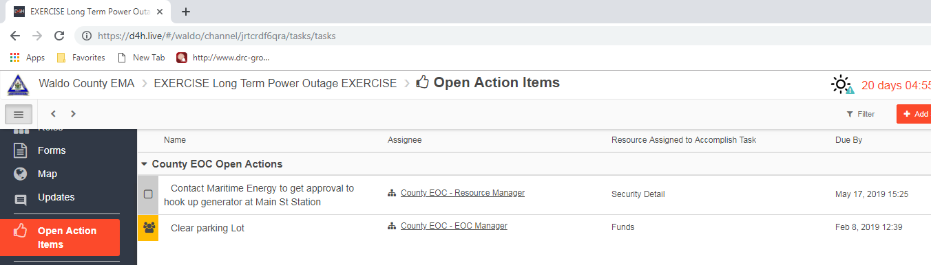
EOC Information Management
Action Items

Slide 52
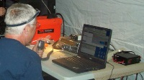
EOC Information Resources
Town & County Emergency Operations Plans
School, Water Dept, Emergency Plans
EOC Checklists/SOPs
Resource Contact Rosters
Mutual Aid Agreements
EOC Forms (Sitrep, Form 7, Log of Events, etc)
Responder Reference Manuals
Maps

Slide 53
EOC Facility Requirements
Building
  Conference/Training Room
  Tables & Chairs
  Restrooms
  Kitchen/Kitchenette
  Food, Water, Coffee
  Generator
Office Equipment
  Computers
  Printers
  Photocopier/Scanner
  Extension Cords/Surge Protectors
Communications
  Telephones (hardwired)
  Fax Machine
  2-Way Base Radio
  Internet Connection
  TV & AM/FM Radio
  NOAA Weather Alert Radio
  Amateur Radio a big plus
Admin Supplies (Lots)
Whiteboards/Chalkboards
Tack Boards

Slide 54
EOC Resource Management
Resource Requesting Hierarchy
  Local public-private
  Mutual Aid
  County
  County to County
  State
  State to State
  Federal
Federal Agencies
Federal JFO
New Hampshire EOC
Maine State EOC
Knox County EOC
Waldo County EOC
Town EOC
Incident Command

Slide 55
EOC Resource Management
  All Disaster are Local.
  The first place to look for what you need is Local.
  Only after you have used up or don’t have, do you reach out to others.
Federal Government Last Resort!
State Government Provides Support
Local Government First Response!
Individuals and Households
Private
Sector
Nongovernmental Organizations
The best place to get a dump truck is from a local contractor, not the State National guard

Slide 56
EOC Resource Management
Interagency Coordination
County EOC
State EOC
Local EOC
Local Dispatch Center
Joint Field
Office (JFO)
Incident
Command
State Dispatch Center
FEMA/DHS
Federal Agency HQ

Slide 57
EOC Resource Management
What needs to be resourced?
  People (EOC Staff, Volunteers, Responders, Employees, Teams)
  Services (Communications, Feeding, Cleaning, etc.)
  Equipment (Vehicles, Generator, Construction Equipment, etc.)
  Supplies (Water, Food, Fuel, Ice, Tarps, Personal Sanitation, etc.)

Slide 58
EOC Resource Management
Mutual aid
  Should be requested when resources are nearing depletion, or you do not possess.
  Agreements should be in place before an incident
  Agreements have typically been between Town FDs, but
  may also be for Public Works, Animal Control, etc., and,
  Can also be with contractors, suppliers, vendors, community organizations, non-profits, etc.

Slide 59
EOC Resource Requests
Incident/Event name
Date and time of request
Quantity, kind, type or detailed mission description.
Special support needs.
Reporting location.
Requested time of delivery (specific, not ASAP)
Radio frequency to be used
Person/Title placing request
Callback phone number

Slide 60


EOC Resource Examples
Incident Management Assistance Teams (IMAT)
RACES Ham Radio Teams
Hazardous Materials Response Teams
Search and Rescue Teams
Electrical Power Generators
School Buses
Volunteer manpower
Weapons of Mass Destruction Civil Support Team
Civil Air Patrol
American Red Cross
Medical Strike Teams
Mass Casualty Response Trailers

Slide 61
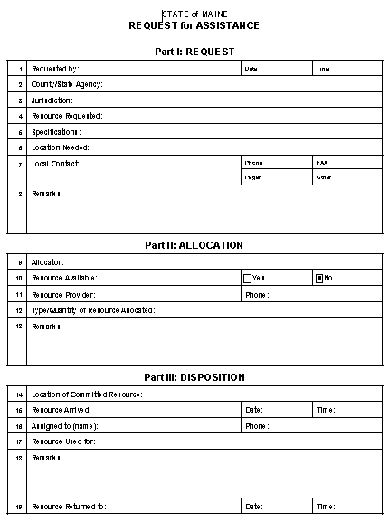
EOC Resource Requests
Example of a Resource Request Form – MEMA
  Requester fills in top section
  Provider fill in middle section
  User fills in bottom section
  EOC Resource Manager tracks it at all stages, including demobilization back to the Provider

Slide 62
EOC Resource Requests
Understand that some resources, even government resources, may come with a cost
  Example: National Guard forces may charge for salaries, lodging and expendables such as fuel
  You may need to pay for the lodging and food for Volunteers
There may be reimbursements if:
  The incident is a part of a Presidential Declaration
  The incident involves the release of HazMat

Slide 63
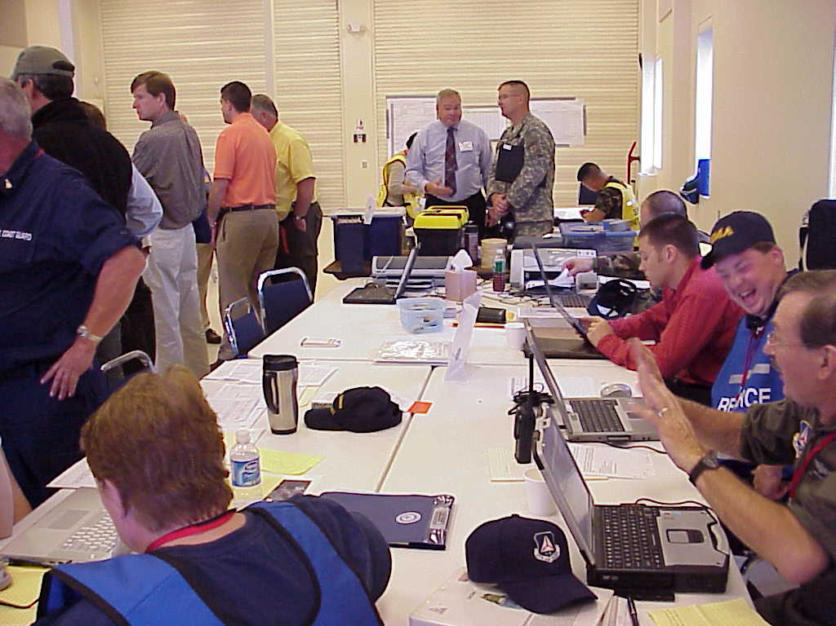
EOC Resource Coordination
Dispatch becomes to busy to provide effective logistical support to the incident. The EOC then takes over this task.
A predicted event of the scope and duration requiring multi-agency coordination is imminent (i.e. hurricane).
The jurisdiction’s policy dictates EOC involvement.
The Incident Commander exceeds his or her legal authority for the resources requested.

Slide 64
How do we make this EOC work?
Staffing
  Sufficient staffing to handle the work and the right positions
Training
  Not just for the Municipal EM Director, but all those who staff the EOC
  Each EOC staff member should understand their job and how to complete it
Exercising
  Workshop – discussion of duties and processes
  Tabletop Exercise – scenario-based discussion exercise
  Functional Exercise – scenario-based coordination exercise, where you give and receive inputs with other EOCs or with a SimCell
Corrective Action
  Assign issues to be resolved to someone and give a deadline for solving!

Slide 65
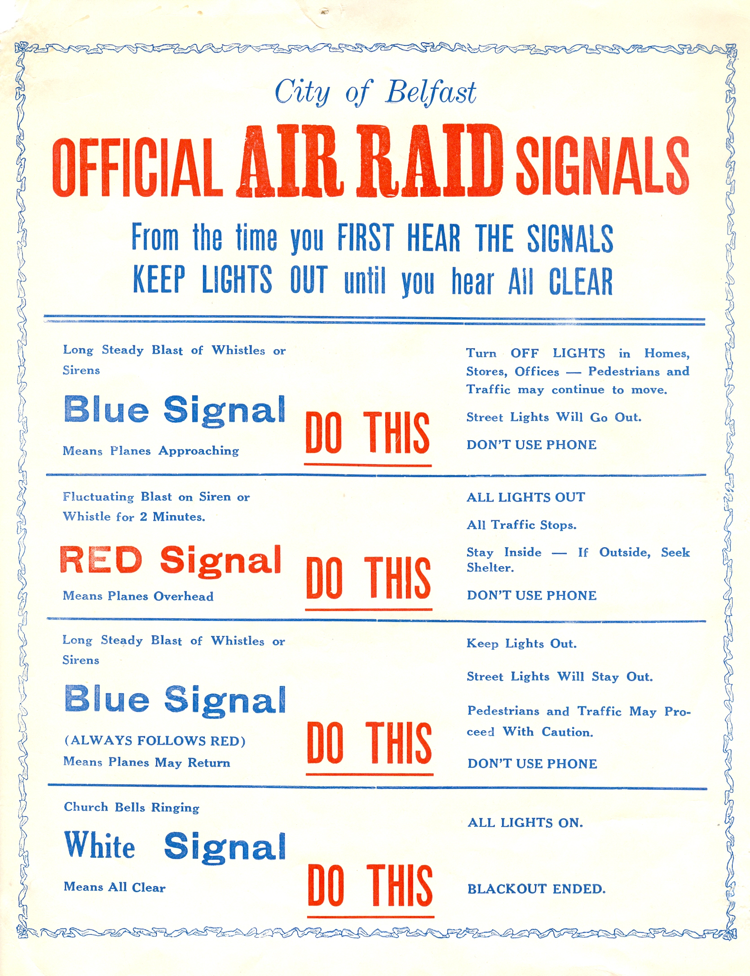
Thank You
You should have a better understanding of how your community can better respond and recover from a major emergency or disaster through the use of an EOC.
Good Luck!

