Slide 1
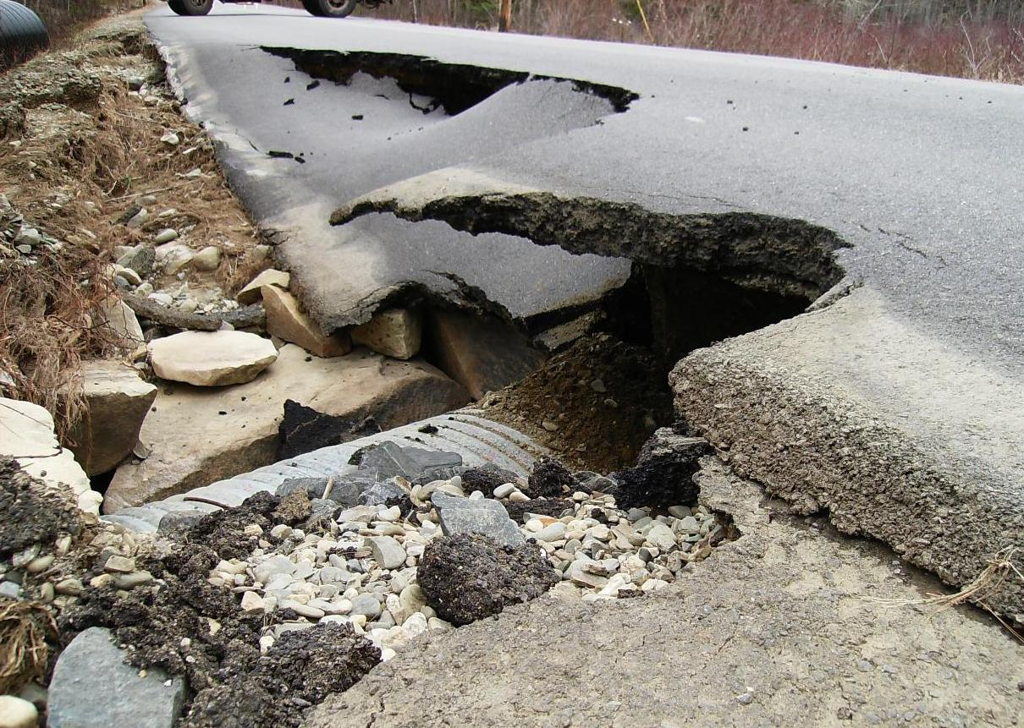
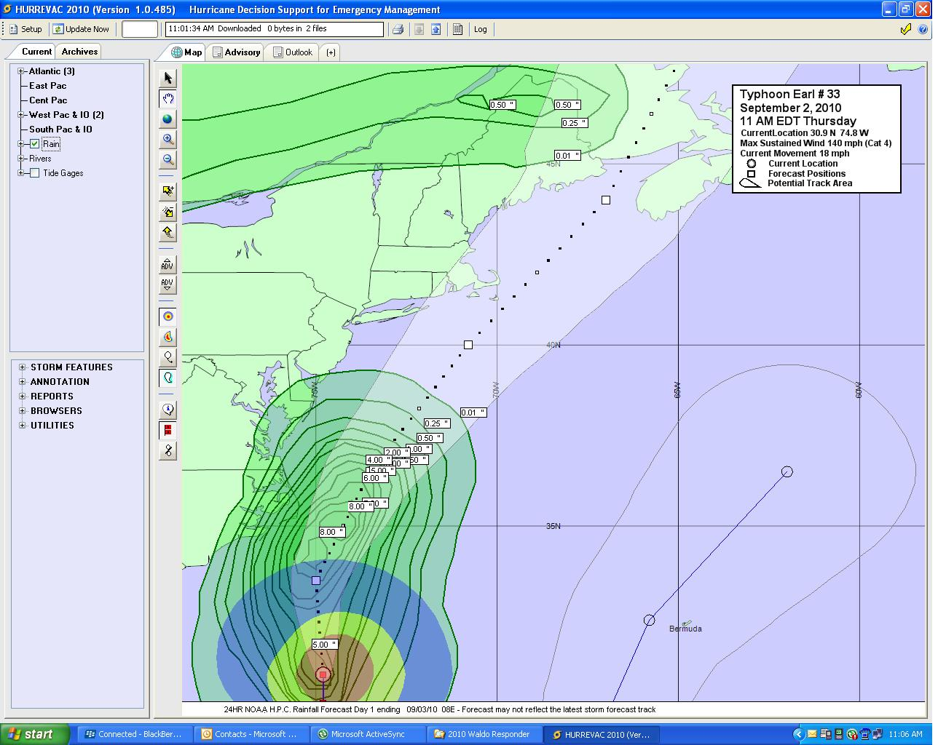
Workshop in Emergency Management Damage Assessment & Reporting
Comprehending Disaster Response
Updated: June 25, 2026
Notes:
The Damage Assessment and Reporting course is one of the Workshop in Emergency Management or WEM series of topics recommended for the Basic Emergency Manager training certification.
This course curriculum was developed by the Waldo County Emergency Management Agency for the municipal emergency management directors in Waldo County.
The purpose of this course is the educate the local emergency managers in how best to assess and report any public and private damages that result from a major storm or other hazard.
Waldo County can experience damages to roadway systems, public utilities, government property and private property. Damages may be caused by severe summer and winter storms, wildfire, hazardous material releases and hostile attacks.

Slide 2
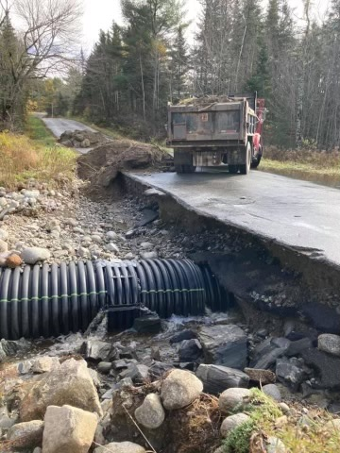
Damage Assessment & Reporting
Damage Assessment (DA) Definition
Phases of DA
Documentation for the State EMA
Preparing for FEMA
Notes:
This course in Damage assessment and Reporting will cover the following topics:
The definition of Damage Assessment and how it relates to your community.
The four phases of damage assessment in Waldo County.
The documentation that is required by the State of Maine to build situational awareness, to decide whether to declare a state of emergency or not, and to decided whether to request a presidential declaration for the federal government.
And finally, the course will identify a few actions that will need to be accomplished to prepare for the arrival of FEMA when they come to town to complete a Stafford Act Preliminary Damage Assessment.

Slide 3
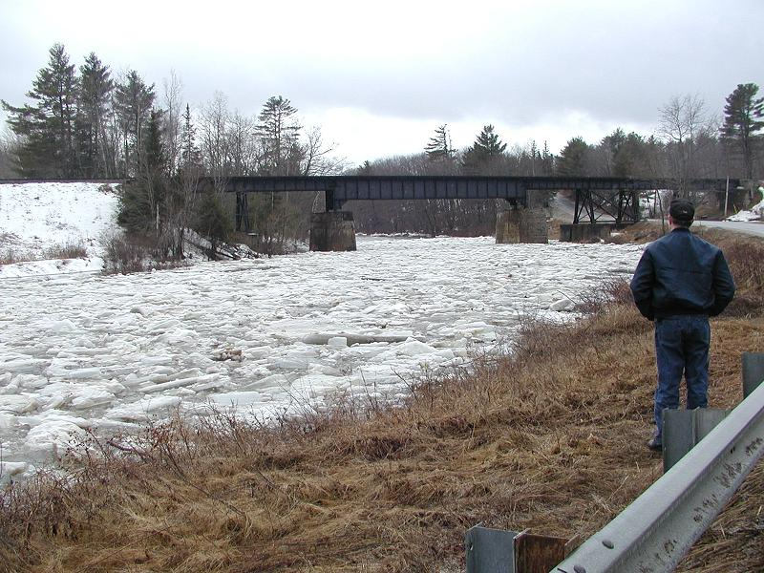
Damage Assessment Definition
What is Damage Assessment?
The process used to appraise or determine the number of injuries and deaths, damage to property, and the status of key facilities and infrastructure.
Facility, utility and road damages are usually measured in repair costs.
Notes:
So, what is damage assessment?
Following a disaster event such as flooding, wildfire, or a severe rain and wind event, important infrastructure in your community may have been damaged. This could include public buildings, roads and bridges, docks and breakwaters, dams, water supply systems and sewer systems. It may also include damage to private property such as homes, farms and businesses.
To be effective, the municipality should form a Damage Assessment Team that will collect information on what is damaged in your community. Members of the Damage Assessment Team should travel around the community to find and record what was damaged. This information will collected by the municipal Emergency operations Center or EOC.
The first priority will be to simply identify what is damaged, the location and a simple description of the level of damage or what is impacted. Examples would be identifying a section of road that washed out, the street address or map coordinate of the damage and that the road is now closed to all traffic.
Later damage assessment should be performed by whomever is responsible for the repairs. This phase will require developing cost estimates of the repairs.

Slide 4
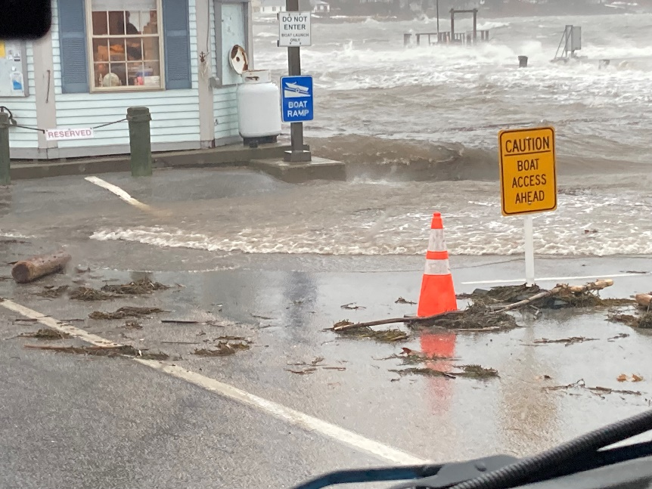
Phases of Damage Assessment
Initial Information
Initial Damage Assessment
Damage Cost Estimating
Preliminary Damage Assessment (PDA)
Notes:
There are four basic phases of Damage Assessment that the municipality will be involved in, should there be an interest by the municipal leadership in applying for public assistance from the federal government.
Phase 1 is Initial Information. This will typically happen before damage assessment teams are deployed.
Phase 2 is Initial Damage Assessment. This is when the Damage Assessment Team is deployed to collect information and report it back to the EOC.
Phase 3 is Damage Cost Estimating. This will involve whomever will be responsible for the damage repairs. For roads and bridges, this will be the Road Commissioner or Public Works Director.
Phase 4 is the Preliminary Damage Assessment. This will occur when representatives from the State EMA office and FEMA arrive to assess the damage for potential federal and state assistance. Someone from the municipality will need to guide the PDA team to the damage locations and describe what happened.

Slide 5
Damage Assessment Phase 1
Initial Information
Received from residents by phone, email, social media or in person
Received from 1st responder eyewitness
Received from Dispatch Center when Fire dept called out
Received from County EOC by radio, phone, email or D4HIM
Should be plotted on a map in Town EOC
Record data in the EOC Log of Events
Notes:
The first phase of damage assessment is collection and processing of Initial Information.
This information may be reported to the municipal officials by residents by phone, email, social media or in person. Be aware that this information will need to be verified. Sometimes people reporting are not sure of their exact location or spent the time to truly assess the level of damage. They will probably not know the difference between a power line, telephoner line or cable line.
The municipal officials may also receive reports from first responders who came upon the damage or were initially dispatched.
The County dispatch center or EOC may also have information on the damages.
As this initial information comes into the municipal EOC, it should be recorded in a log of event, plotted on a map and posted into D4H Incident Management. Updates to the assessment should be made or posted as new information comes in.

Slide 6
Damage Assessment Phase 2
Initial Damage Assessment
The purpose is to find out what is “broken”
Town staff and/or volunteers assigned a route to follow – the EOC needs to know where the team members are located at all times.
Travel in groups of two, if possible
Need comms back to the Town EOC (phone/radio)
Town EOC should update information collected in field on EOC map, log of events and/or D4HIM
Notes:
The Municipal EOC should recall or form a Damage Assessment Team to deploy into the field to collect precise and detailed information of what actually occurred in the community. The purpose is to find everything that was “broken”.
Before deploying the Damage Assessment Team, identify the priority locations or routes for the assessment. Each set of team members should be given a specific route so that the EOC staff will know approximately where they are. This is important for accountability.
The damage assessment team should travel in groups of at least two personnel. Safety is a big concern and everyone needs to have a “buddy”.
If possible, have communications for the deployed personnel so that they can keep in touch with the EOC. This will allow the team members to report their findings quicker and to keep the EOC updated on their location and status.
As the assessment reports come into the EOC, the EOC staff should plot and record the information on hard copy maps, whiteboards and D4H Incident Management.

Slide 7
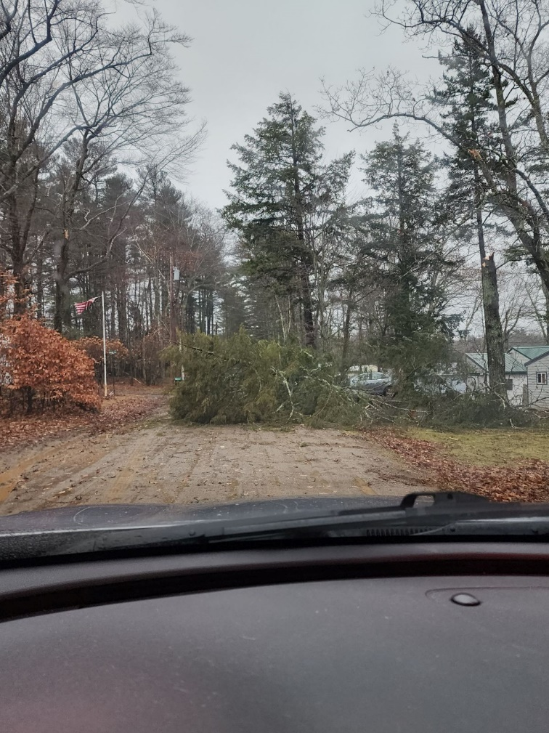
Damage Assessment Phase 2
Initial Damage Assessment of:
Roads, culverts, bridges
Road and powerline debris
Pollution and hazmat spills
Flooded locations
Fire locations
Status of dams
Homes and farms
Businesses
Government facilities
Notes:
As the Damage Assessment Team members travel along their assigned routes, they will be on the lock out for damages to the following infrastructure and property:
Road, culverts and bridges washed out or damaged
Tree and powerline debris blocking the roads or endangering the traveling public
Pollution and/or hazardous materials being released onto the ground, into the waters or into the air. Also report if people are contaminated or in danger by the actual or potential release.
Locations of any out of control fires or damaged dams.
Locations and descriptions of damaged homes, farms or businesses.
And the locations and descriptions of damaged government buildings or utilities.

Slide 8
Damage Assessment Phase 2
Why complete initial damage assessment?
Need to know what’s wrong before you can fix it.
Need to have a full picture before you can prioritize your response and recovery actions.
If you need help from other towns, the county, or the state, you need to identify what is broken.
The town EOC collects all damages in town from the damage assessment personnel in the field.
Notes:
So why do we need to complete an initial damage assessment?
First of all, you need to know what it broken before we can fix it. Is it endangering the public or responders? Is it getting worse? If we do nothing, will it get worse?
Secondly, you need to have a detailed understanding of what has happened, so that you can prioritize the response and recovery. An initial report will probably not have an accurate picture and limited resources may end up getting used up at a less important location.
Once you have a better understanding of the issues and your resource limitations, you may want to request help from other municipalities, or the county or state. They will want to know the details of the incident to know if they can help and with what resources.
This better understanding of what has happened will only come from those you have deployed into the field as a damage assessment team.

Slide 9
Damage Assessment Phase 2
Damage Assessment activities
Start documenting during the storm – as early as you can (taking safety into account).
Take pictures of everything broken!
Record location info (gps/map coordinate or street address)
Report back what is happening (water is undercutting the road, I think the road is going to washout soon)
Report back needs (this location needs traffic barricades)
May need to periodically recheck some areas as conditions and status changes
Notes:
There are several activities that should be completed by the EOC and the Damage Assessment Team.
The EOC staff will start collecting and recording every piece of information they can, even during the storm, taking safety into account. As mentioned earlier this initial information may be coming from the public who are witnessing the damages occurring in real time.
The Damage Assessment Team personnel should take pictures of everything that was broken, from several angles if possible and safe. If cell phones are working, this can be emailed or texted to the EOC. The Team members shall record and report the location of the damages by street address or map coordinates, a description of what is happening and if there are any needs. Throughout the day or days, the team should revisit these locations to report on any changes.

Slide 10
Damage Assessment Phase 2
Who completes the Initial Damage Assessment?
Usually, the Fire Dept gets this job.
Might be accomplished by Public Works staff.
However, consider forming a volunteer EM Damage Assessment Team (DAT) before a disaster event occurs.
This way the Fire Dept isn’t tied up with assessing
PW and FD can clear or barricade roads instead
Little training needed; inexpensive to set up – so other volunteers can accomplish easily
Notes:
So who makes up the staffing of this Damage Assessment Team, also know as a DAT?
Usually, the fire department responders get this job by default. If your municipality hasn’t assigned another group of people ,the Fire Department gets it by default. However, is this a wise use of your limited emergency resource? The fire department needs to be ready to respond to structure fires, hazardous materials releases and accidents. They will be delayed if the firefighters are scattered around town and blocked by road debris.
If your municipality has a public works department they may be assigned this task, but they may be overwhelmed by road repairs and unable to complete community-wide assessments.
The best option would be to recruit and train a volunteer Damage Assessment Team. It could be staffed with residents experienced in construction, code enforcement, building inspections, emergency management, community planning, search and rescue, or just able-bodied and motivated.
There are no major expenses involved such as expensive response gear, vehicles, or personal protection equipment. Costs may involve fuel reimbursements, providing a 2-way radio and simple PPE like a construction helmet and work gloves.

Slide 11
Damage Assessment Phase 2
Damage Assessment items
Digital Camera or Smart Phone
GPS app on a Smart Phone
Paper, pencils, and a clipboard
Blank Initial Damage Assessment Team forms
2-way portable or mobile radio or Smart Phone
Personal protective gear
Class 2 Hi-Vis Traffic Safety Vest
Foul weather clothes and boots
Notes:
Your volunteer Damage Assessment Team should be equipped with a few items that will allow them to better complete their tasks. This could include:
A digital camera or their personal smart phone.
A handheld GPS receiver or a GPS app on their personal smart phone.
Paper, pencils and a clipboard along with blank damage assessment forms.
If cell phone service is still up, the volunteers can call in on their cell phones. If service is not up or not reliable, consider issuing them an inexpensive VHF 2-way radio. These will cost around $140.
Determine what personal protective gear is needed for the job. It might include a reflective safety vest, helmet, gloves, boots and foul weather clothes. The volunteer will probably already have their own boots and clothes for the job.

Slide 12
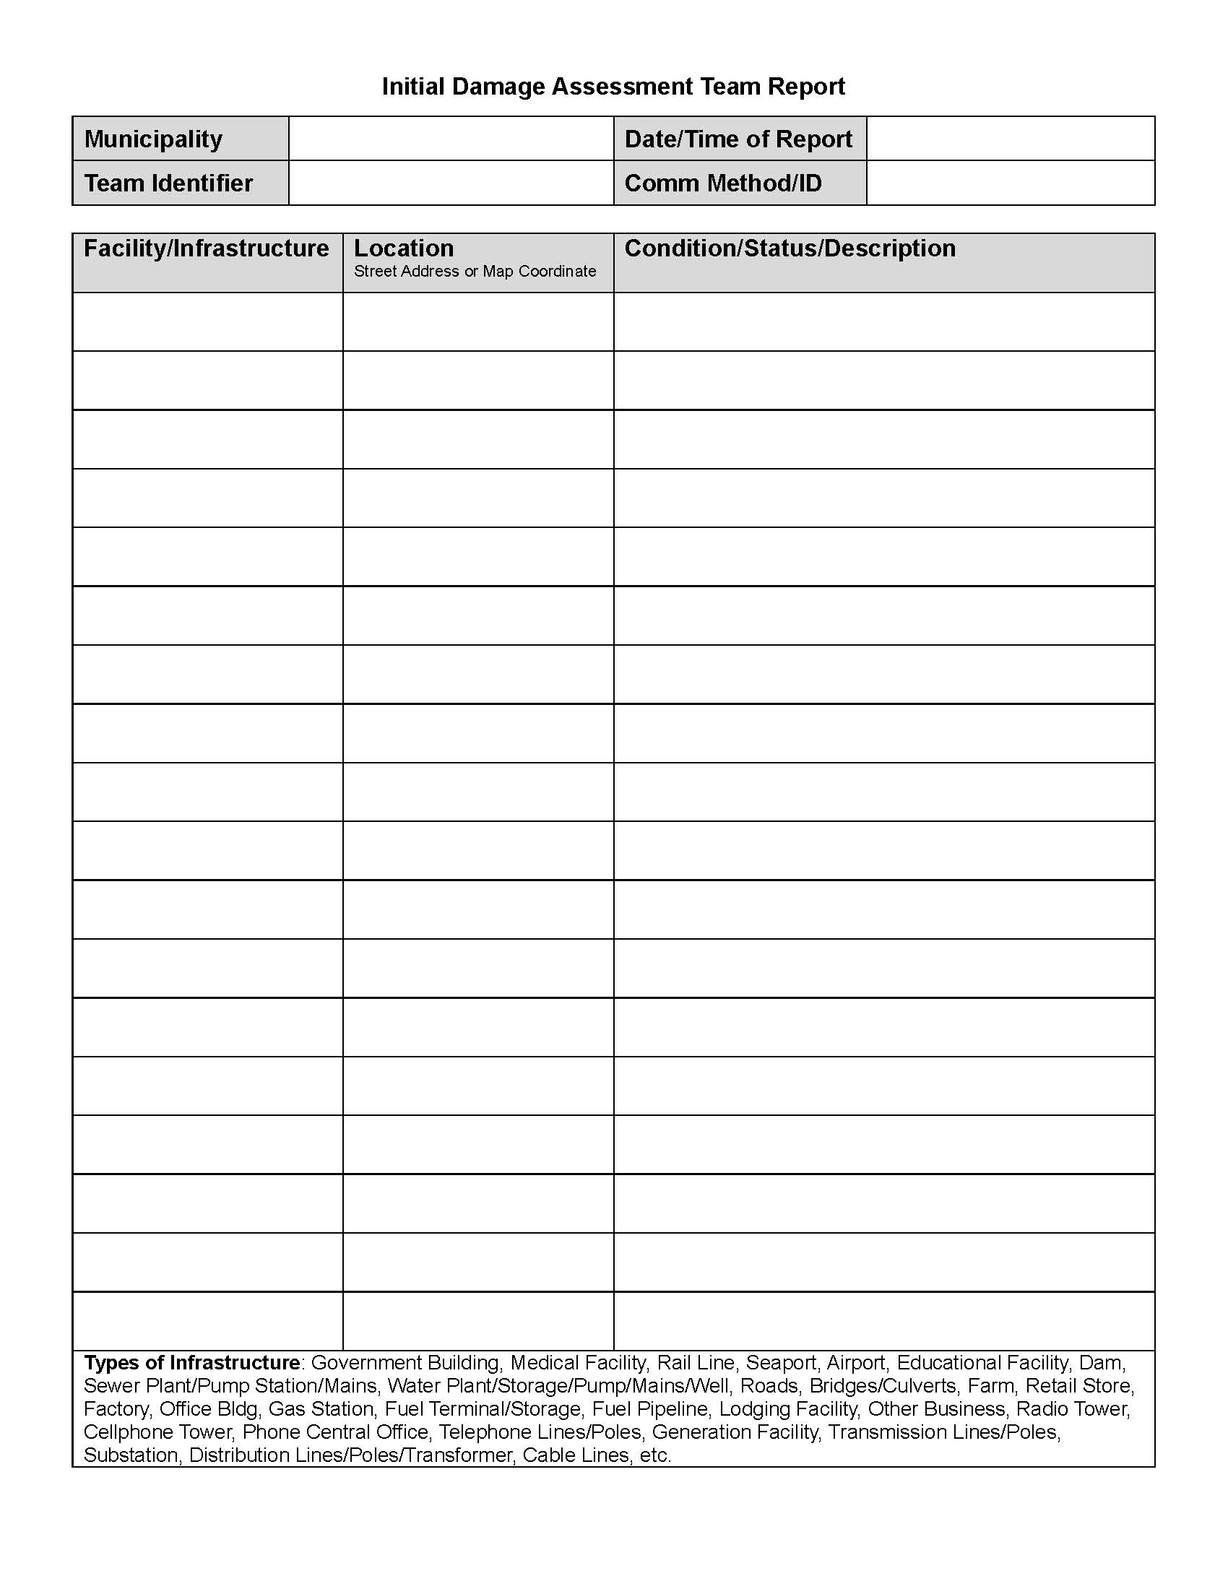
Damage Assessment Phase 2
Initial Damage Assessment Team Report
Completed by Initial DA Team
Info provided to Town EOC
Facility Name, location and status
Notes:
An initial damage assessment team or DAT report is a simple blank form that allows your team to collect the necessary information on the correct infrastructure and property. An example of this form is found on the County EMA website.
Your DAT form should be printed in multiple hard copies before an incident occurs in case your computer, printer or photocopier is not functioning during the emergency event.
This report is completed by the DAT personnel in the field at the location of the damages. The information on this report can be called in to the EOC by phone or radio. It could be texted or emailed. It will include the facility or utility name, location and current status.

Slide 13
Damage Assessment Phase 2
Initial Damage Assessment Team training
Using the Initial DAT Report
Specifics of Road Closure reporting
Understanding a map of the town and familiarity with the roads
Understanding map/gps coordinates
Familiarity with the issued two-way radio
Safety Briefing
Notes:
The training required to be a member of the municipal damage assessment team is simple and short.
Team members will be trained on how to fill in the DAT report form and any specifics on road closure reporting. They should be given a map of the town roads and become familiar with where all the roads are. They should be trained on how to collect and report grid coordinates and trained ion the type of radio they will be issued. This will take between 30 and 60 minutes. This information should be reviewed every year.
Finally, before they deploy, they should be given a safety briefing on the possible hazards they may encounter in the field and how to protect themselves.

Slide 14
Damage Assessment Phase 3
Damage Cost Estimating
Purpose is to determine the cost of repairing what is broken
This will be needed by insurance and for FEMA if the event is declared
It will also be needed for writing bid contracts
This is accomplished by the Town staff a few hours or days later
If roadwork, usually done by Road commissioner
If buildings, may be performed by the CEO, a building contractor, or an engineer
Notes:
Phase 3 of the damage assessment process will involve the collection and development of a detailed cost estimate of the repair of the infrastructure and property damages.
Both the insurance companies and the Federal government will need this information before they can provide reimbursement. You will also need the cost estimate before you write any contracts and go out to bid.
The cost estimate phase will begin a few hours or days after the disaster event occurred. This is usually accomplished by the road commissioner, public works director, code enforcement office, in-house or contracted engineer, town administrator or elected officials.

Slide 15
Damage Assessment Phase 3
Damage Cost Estimating
Record position (Lat/Long or Street Address)
Take notes for each damage location.
Take pictures! From every angle. Before repairs are made.
Estimate the amount of repair materials needed
Sub-base & base gravel, culverts, geotextile, asphalt
Use FEMA, MeDOT or town unit pricing to estimate costs
Notes:
During the cost estimate phase, it is vitally important to accurately record the location of the damage. This may be a long stretch of road, in which case you would identify the location of both ends of the damaged road.
Take notes of the damage levels and specifics. Most importantly, take lots of pictures from every angle of the damage BEFORE making any repairs. The state and federal government may not show up for days, weeks or months after the repairs are made. They will not see the damages and will want verification that the damages actually existed.
Your cost estimate will include all the materials and labor that were needed to make the repairs. Use either FEMA equipment rates, MeDOT unit pricing and well established municipal unit pricing in your damage assessment.
The federal government has very stringent regulations on how repair work can be accomplished and what can be reimbursed. This class will not go into details on the repair process.

Slide 16
Damage Assessment Phase 4
Preliminary Damage Assessment (PDA)
This is the formal process for determining if the state and county can be awarded a federal disaster declaration.
You will be filling out State of Maine PDA forms
These forms are only used by the State of Maine – not the Feds
However, the information on the forms are used to bring FEMA into the picture
Notes:
There are two stages to the Preliminary Damage Assessment or PDA process. There is a state process and a federal process.
The first stage involves the state process of determined if there is enough damages to meet a certain level of cost threshold to request a federal disaster declaration.
This will involve the completion of State of Maine preliminary damage assessment forms that record the repair cost estimates for public damages and the level of damages to private property. These forms are not used by the Federal government.
Instead the information on these forms are used by the state EMA office to determine if the federal government will be asked to get involved.

Slide 17
PDA Documentation
MEMA Preliminary Damage Assessment (PDA) Forms
Public Assistance (PA)
Individual Assistance (IA)
Use forms to record all public and private damages
Must be completed and reported soon after disaster occurs
Notes:
There are two State PDA forms – one for public damages and one for provide property damages.
Public damages fall under the federal Public Assistance or PA program.
Private damages fall under the federal Individual Assistance or IA program.
These forms should be completed within a few days of the disaster event occurring.
The municipality or an associated quasi-municipal entity such as a water district or school district will provide the information on the PA form.
Have the private property owner complete the IA form and provide it to the town office or EOC.

Slide 18
PDA Documentation
Public Assistance (PA) Form
Records the detailed cost estimates of public damages (town, school, utilities, etc)
Total cost of PA damages may result in a Gubernatorial state of emergency order, which could then initiate a FEMA Preliminary Damage Assessment (PDA)
Notes:
The Public Assistance or PA form will record the detailed cost estimates of the public damages, such as roads, buildings or utilities.
The damage estimates will be compiled at the State EMA office to determine if certain cost thresholds were met by the sate and counties in order to get federal assistance.

Slide 19
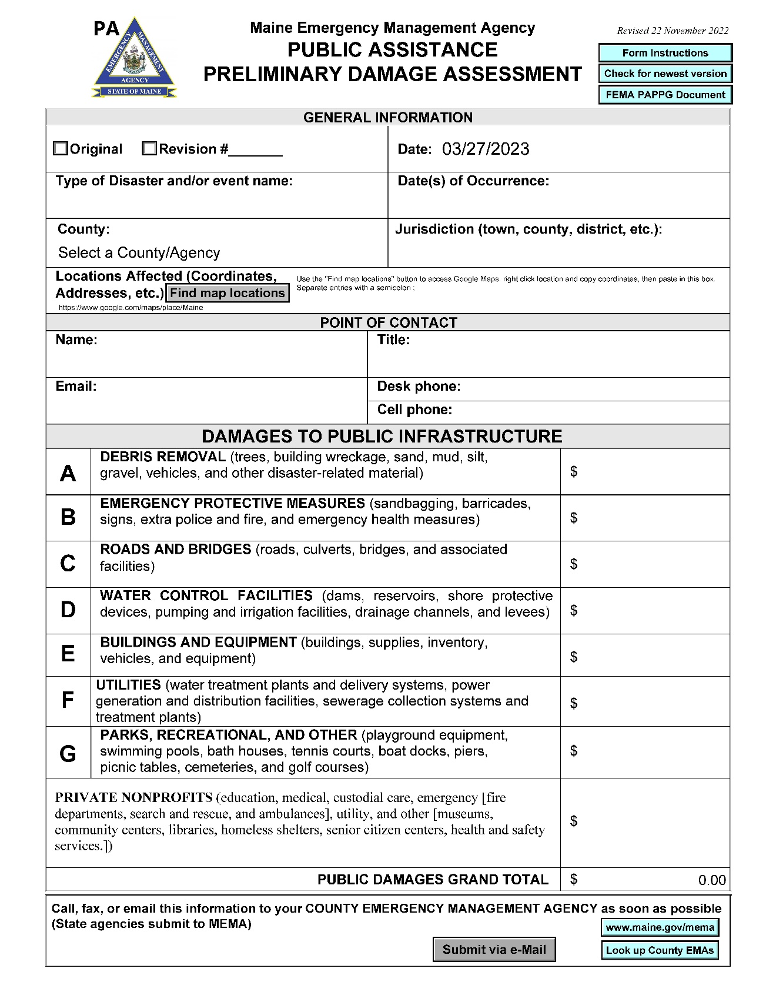
Public Assistance Preliminary Damage Assessment form
Page 1
Summary Page
Contact Information
Total $ per Category
Notes:
This is page 1 of the state public assistance preliminary damage assessment form. This includes the municipal contact information and damage cost estimates by Public Assistance statutory categories. This class will not go into the category definitions.

Slide 20
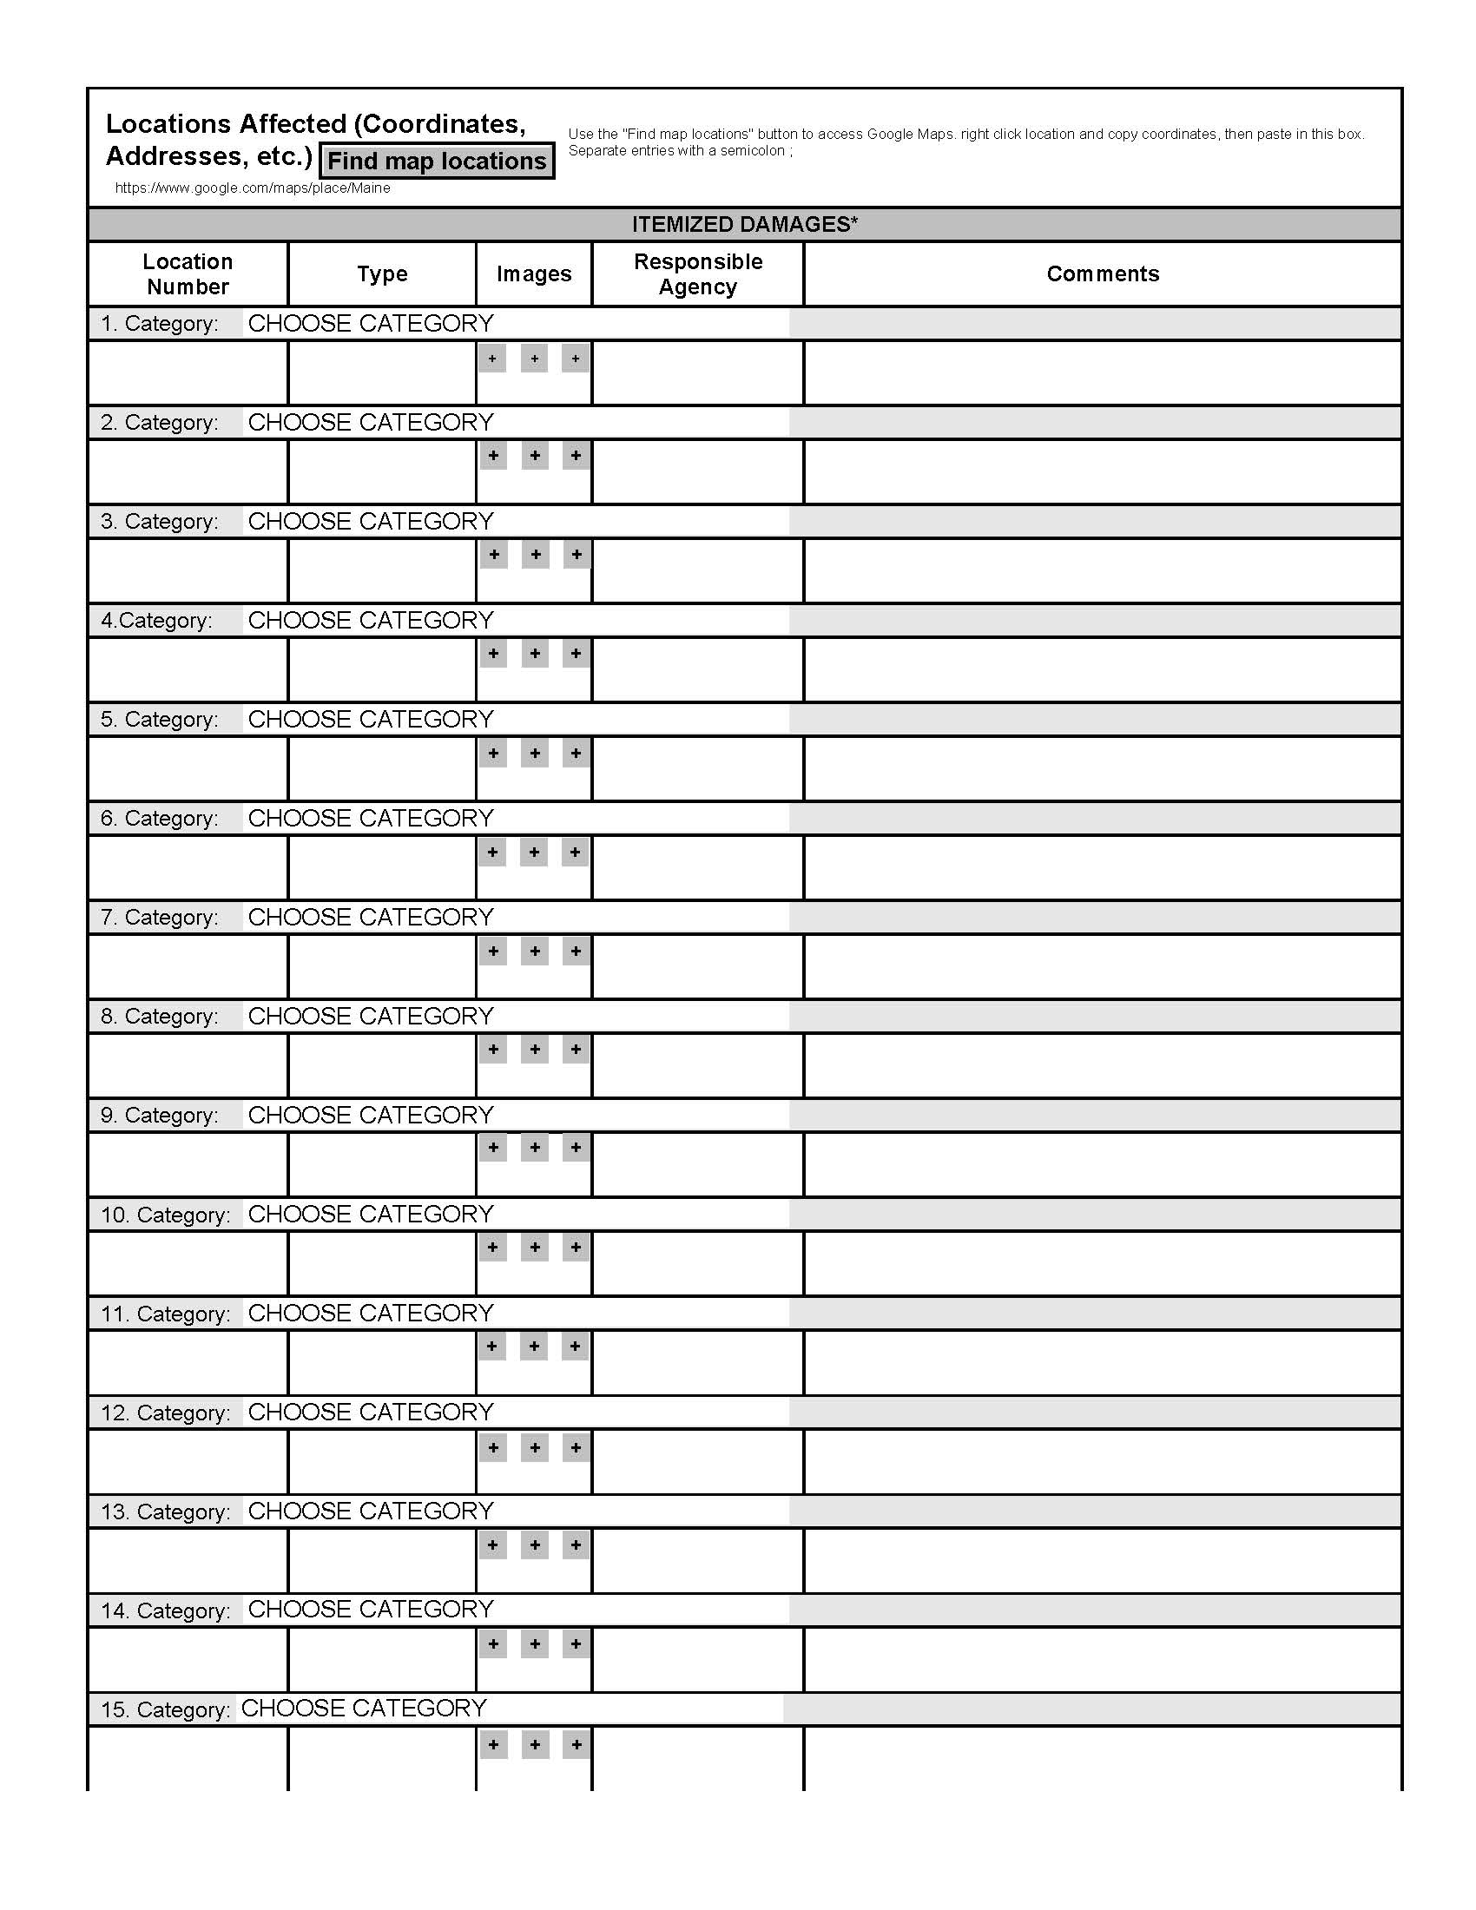
Public Assistance Preliminary Damage Assessment form
Page 2
Description of each Project Location
Notes:
Page 2 of the PA PDA form collects specific information on each location of public damage. You will need grid coordinates, pictures, contact information, category type and notes listed on each damaged area.

Slide 21
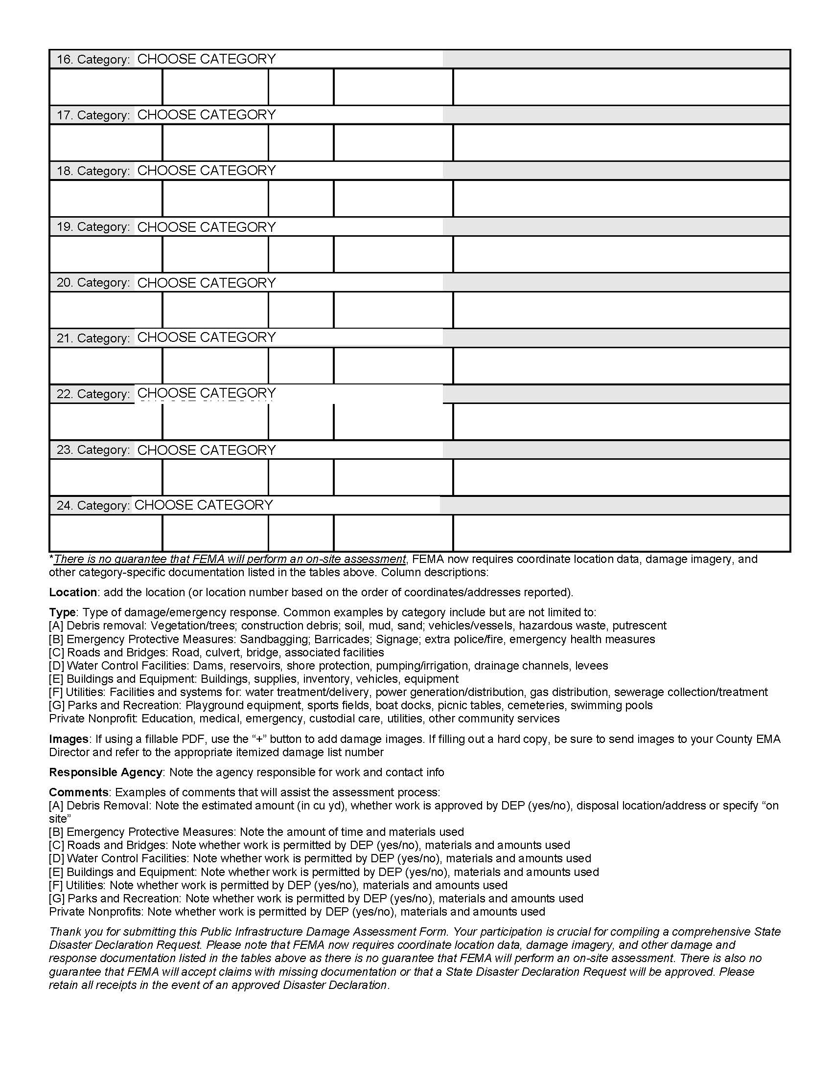
Public Assistance Preliminary Damage Assessment form
Page 3
Continuation of the Description of each Project Location
Description for each column
Notes:
Page 3 of the PA PDA includes additional space for recording damaged areas. It also includes the instructions for filling out the form.

Slide 22
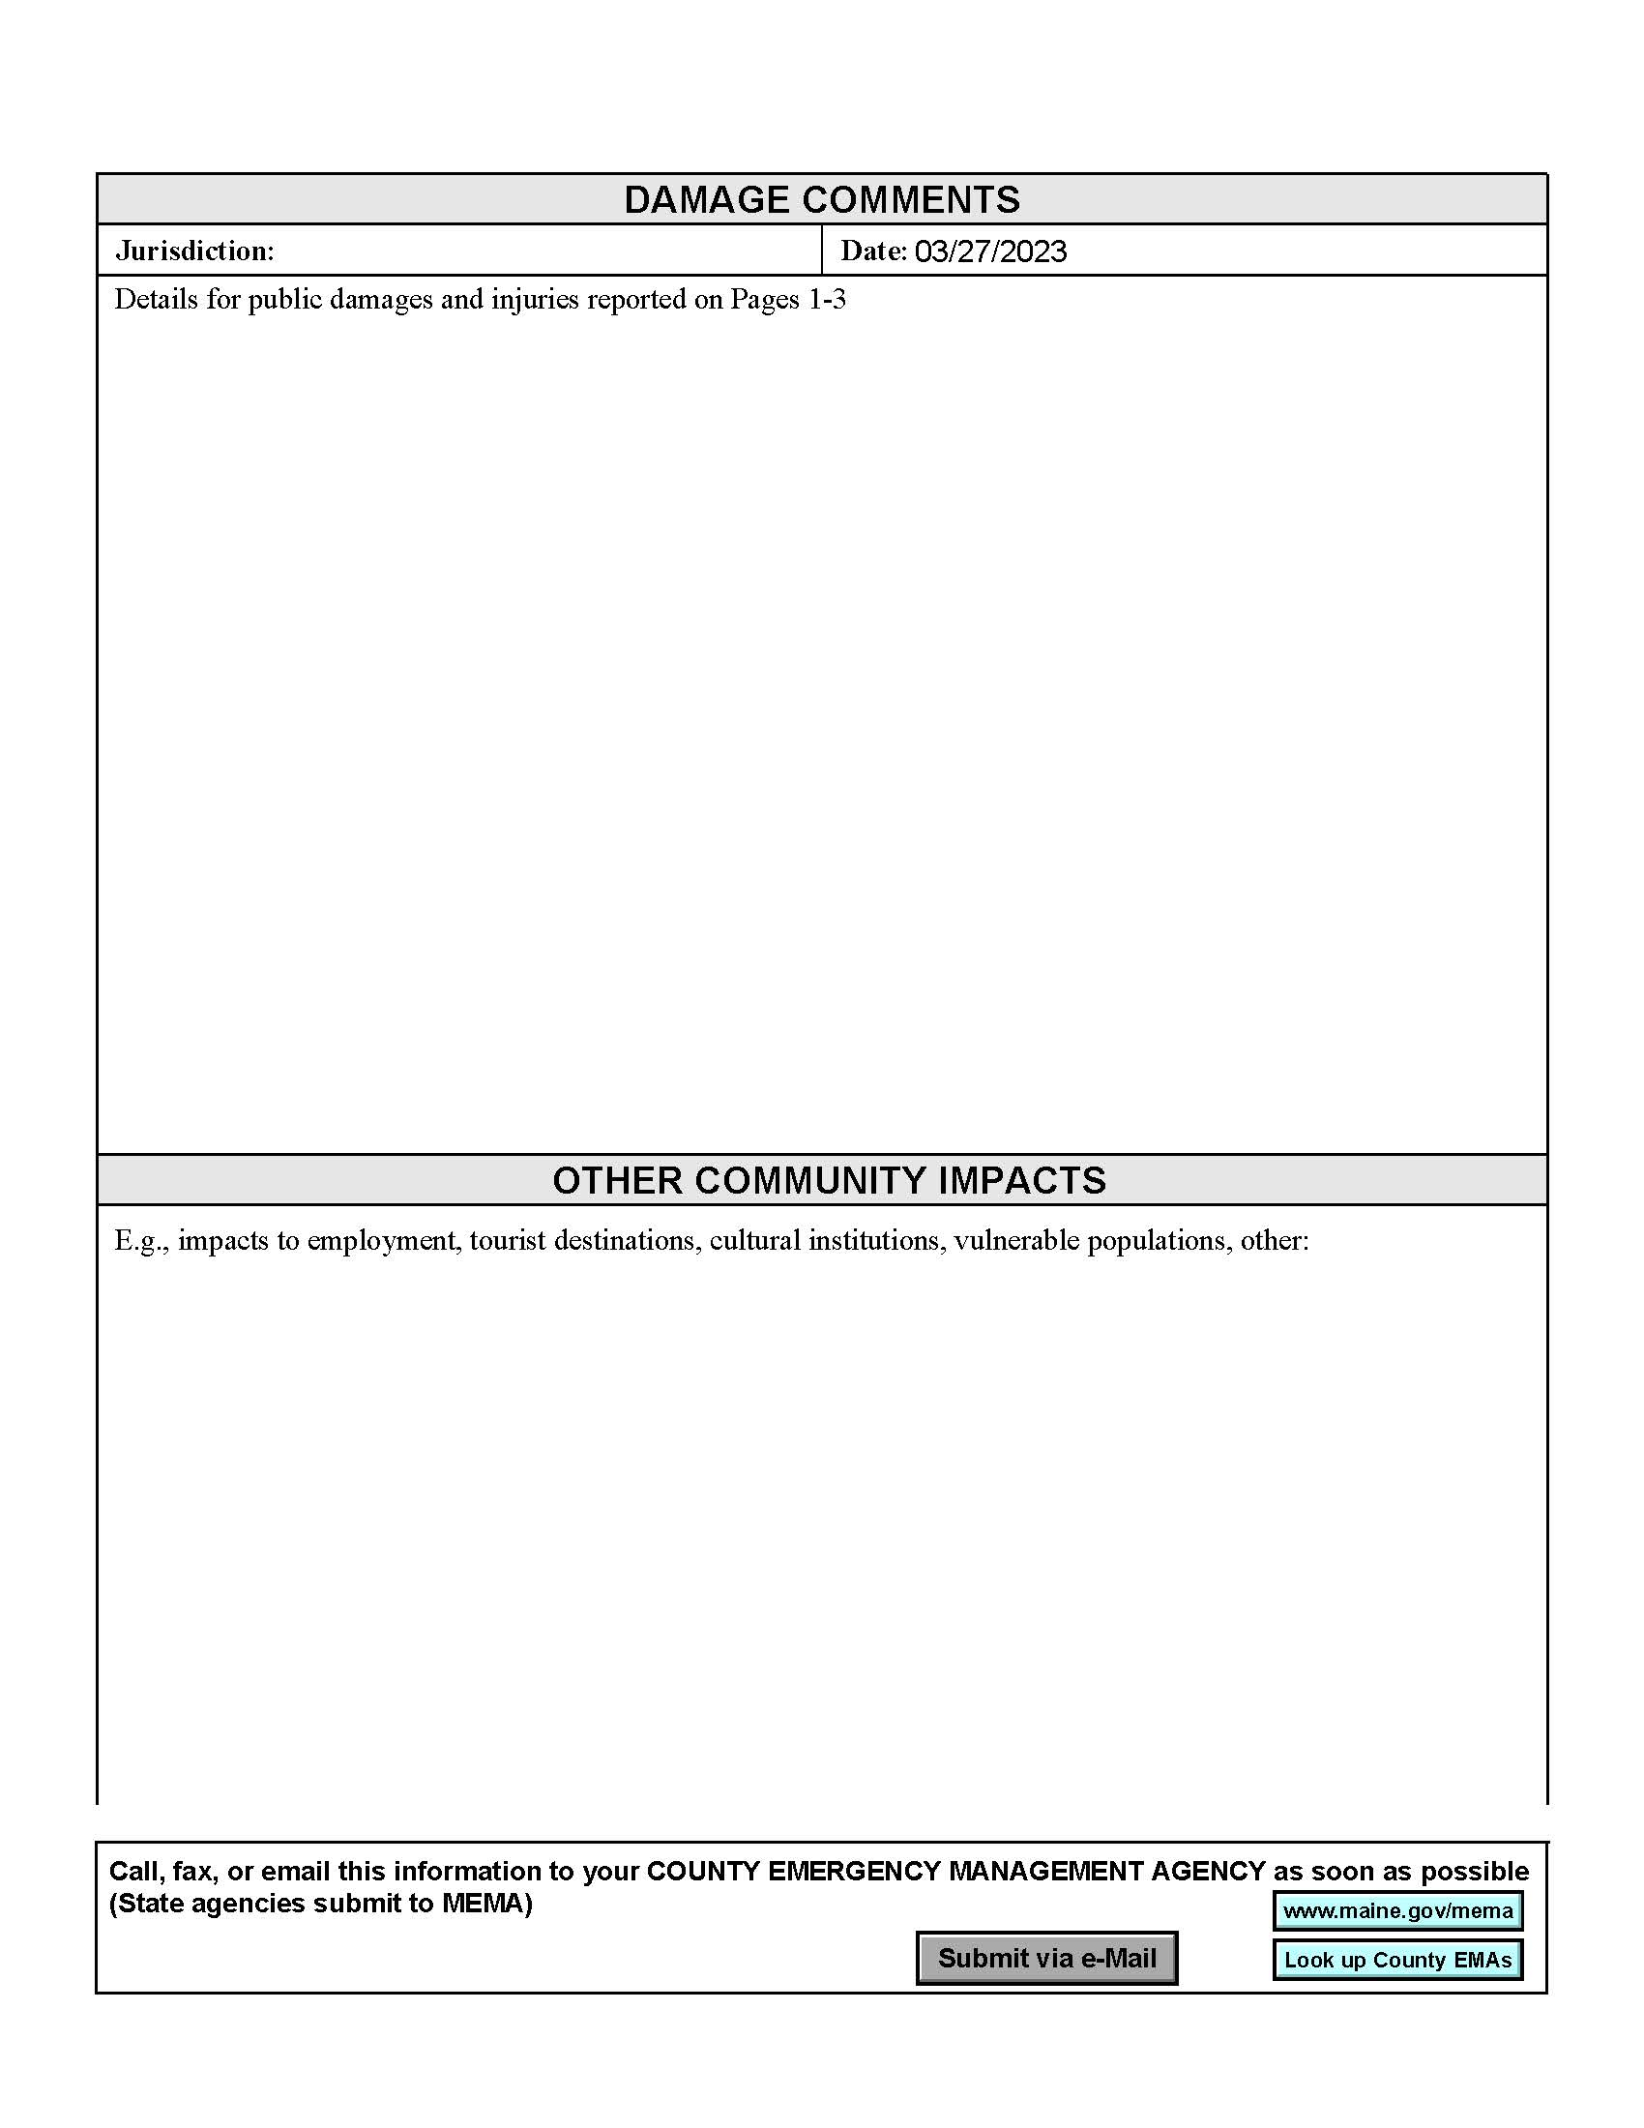
Public Assistance Preliminary Damage Assessment form
Page 4
Space for adding more information
Notes:
Page 4 of the PA PDA form is additional space for notes and descriptions.

Slide 23
PDA Documentation
Individual Assistance (IA) Form
The IA form will assist the State and Federal governments to determine if State and Federal assistance to private citizens will be provided and in what form.
One IA form is completed for each home damaged
May want to hand this form to the homeowner to complete and then have them get it back to the town
Notes:
The Individual Assistance or AA form will record the level of damage to private property, such as homes, farms and businesses.
This will assist the state and federal governments to determine if assistance will be provided to private citizens.
One form will be completed by each home or business and returned to the municipal office or EOC.
The municipality will forward the completed IA forms to the county EOC who will compile all the IA reports and forward to the state EOC.

Slide 24
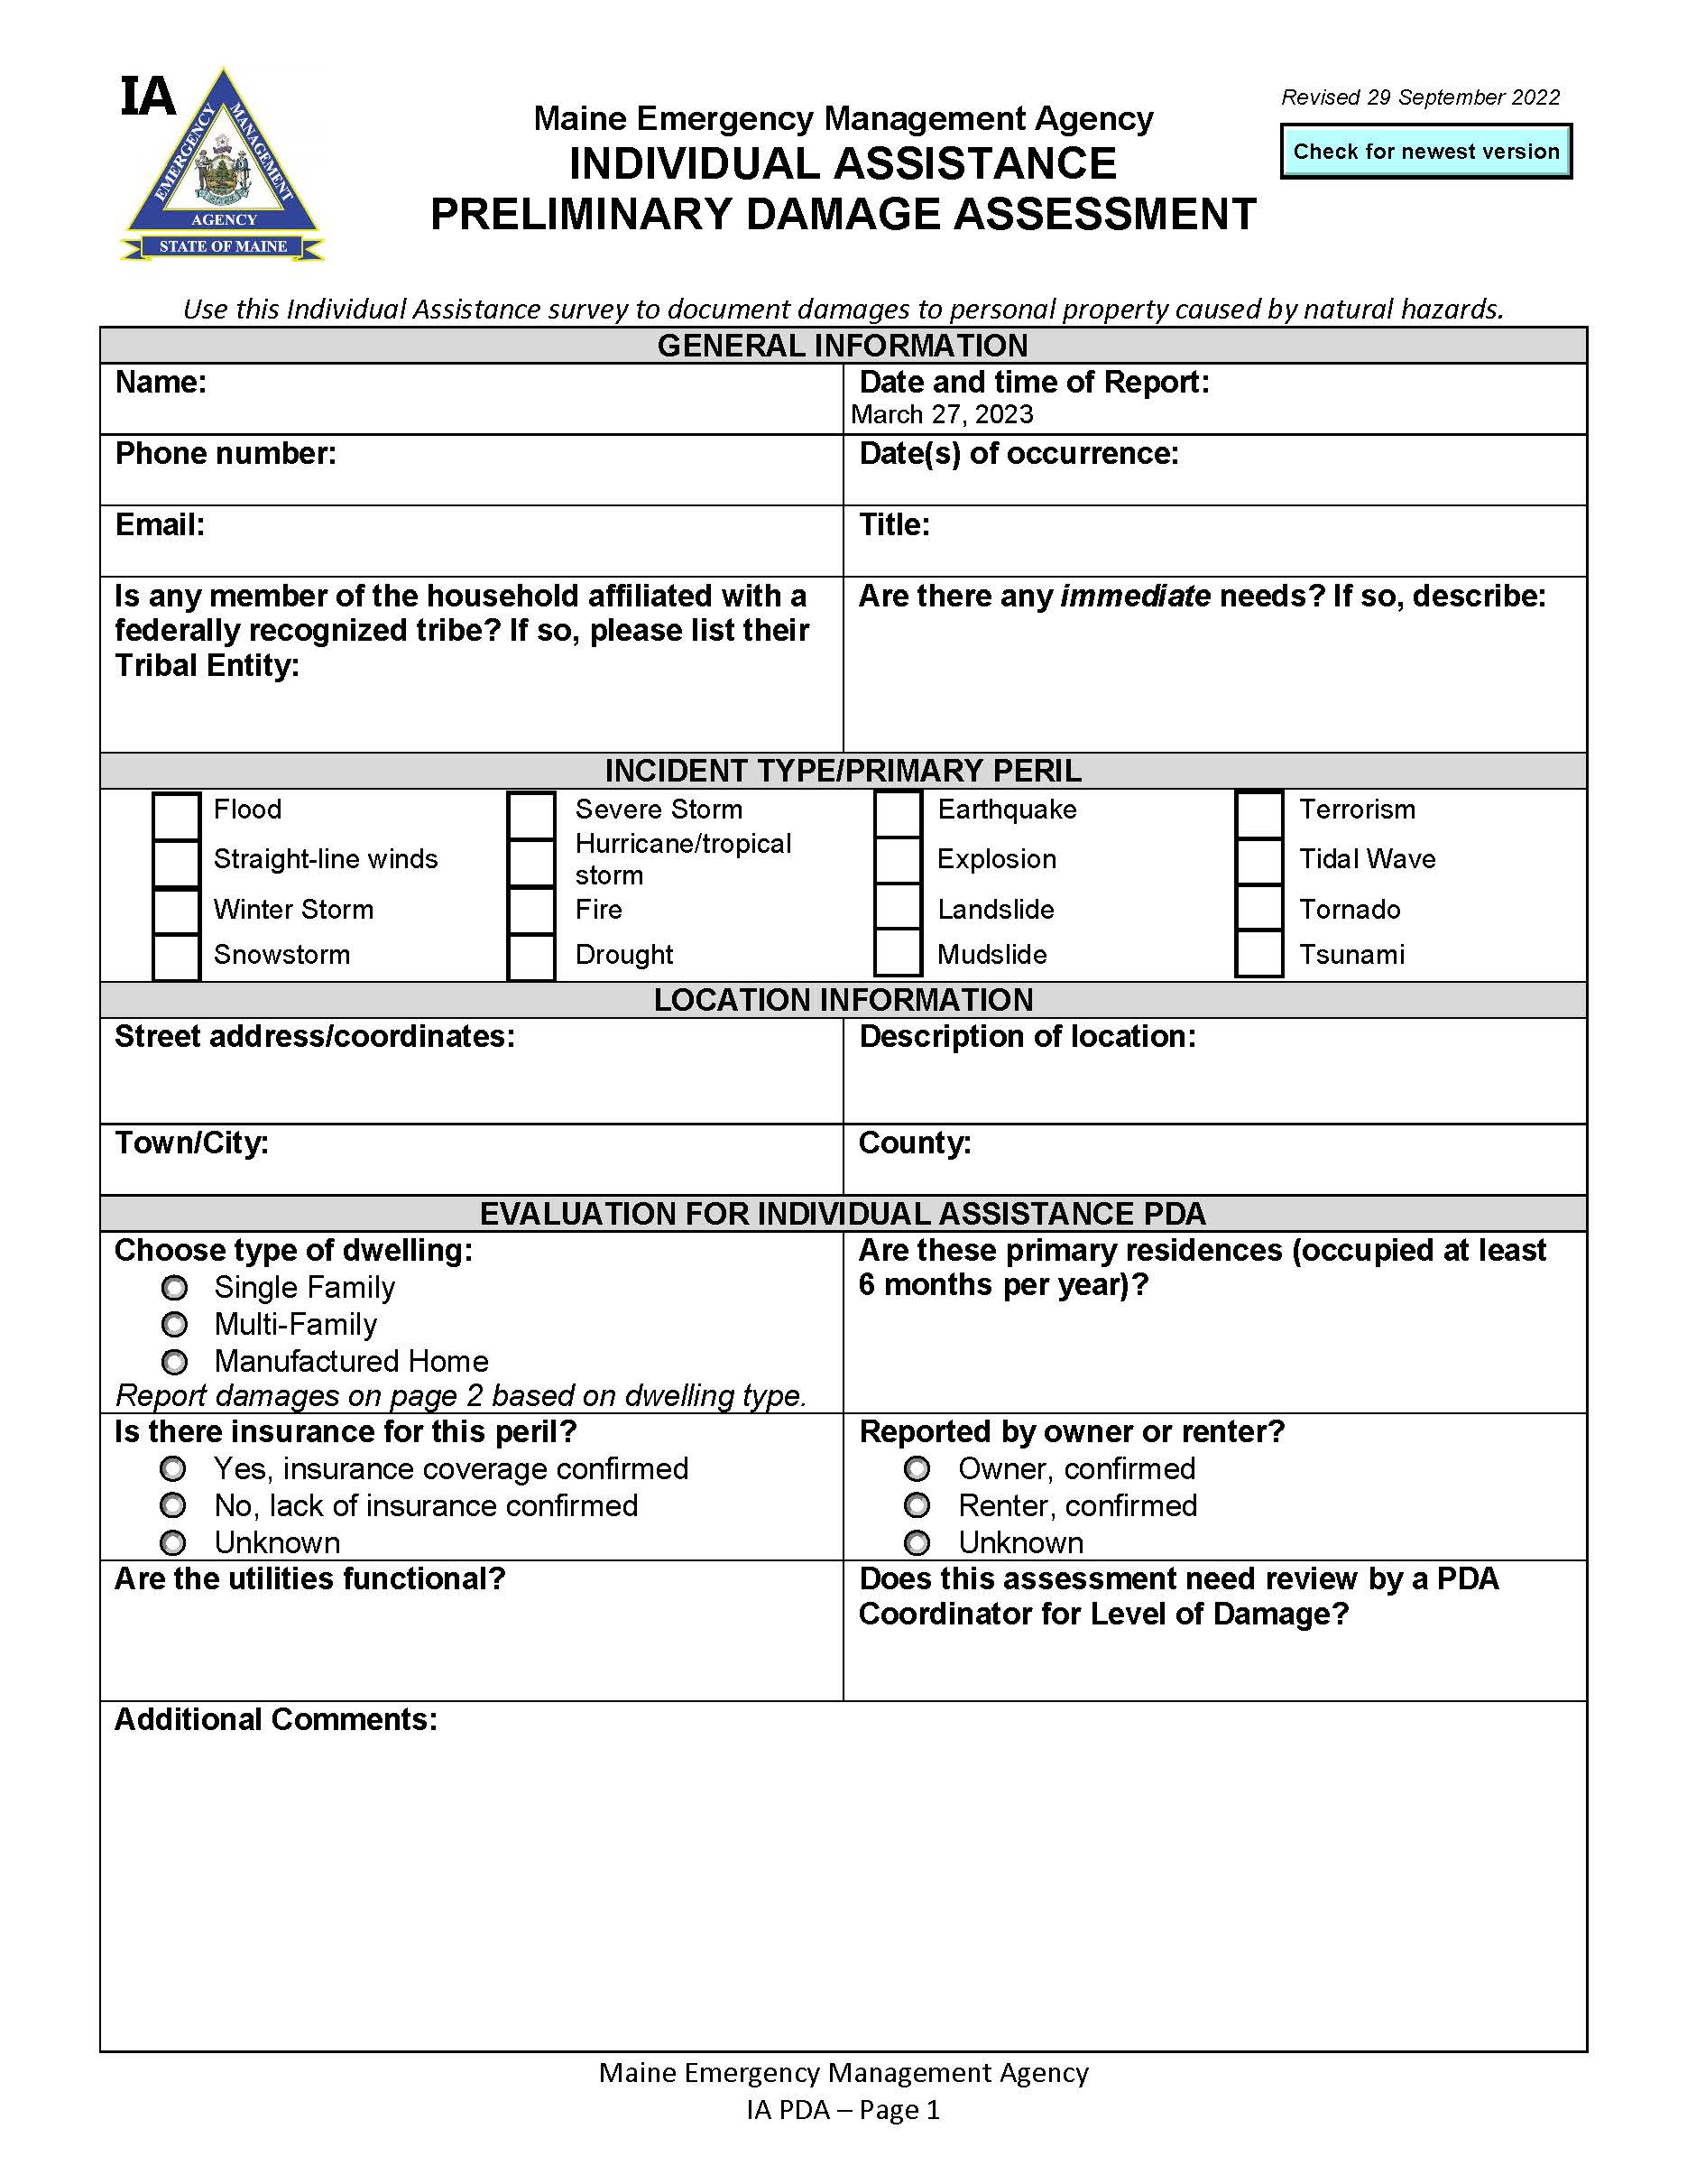
Individual Assistance Preliminary Damage Assessment form
Page 1
Contact Information
Type of Incident
Location of Damage
Property Specifics
Notes:
Page 1 of the IA PDA form lists the contact information for the home owner, the location of the damage, and specific information on the home.

Slide 25
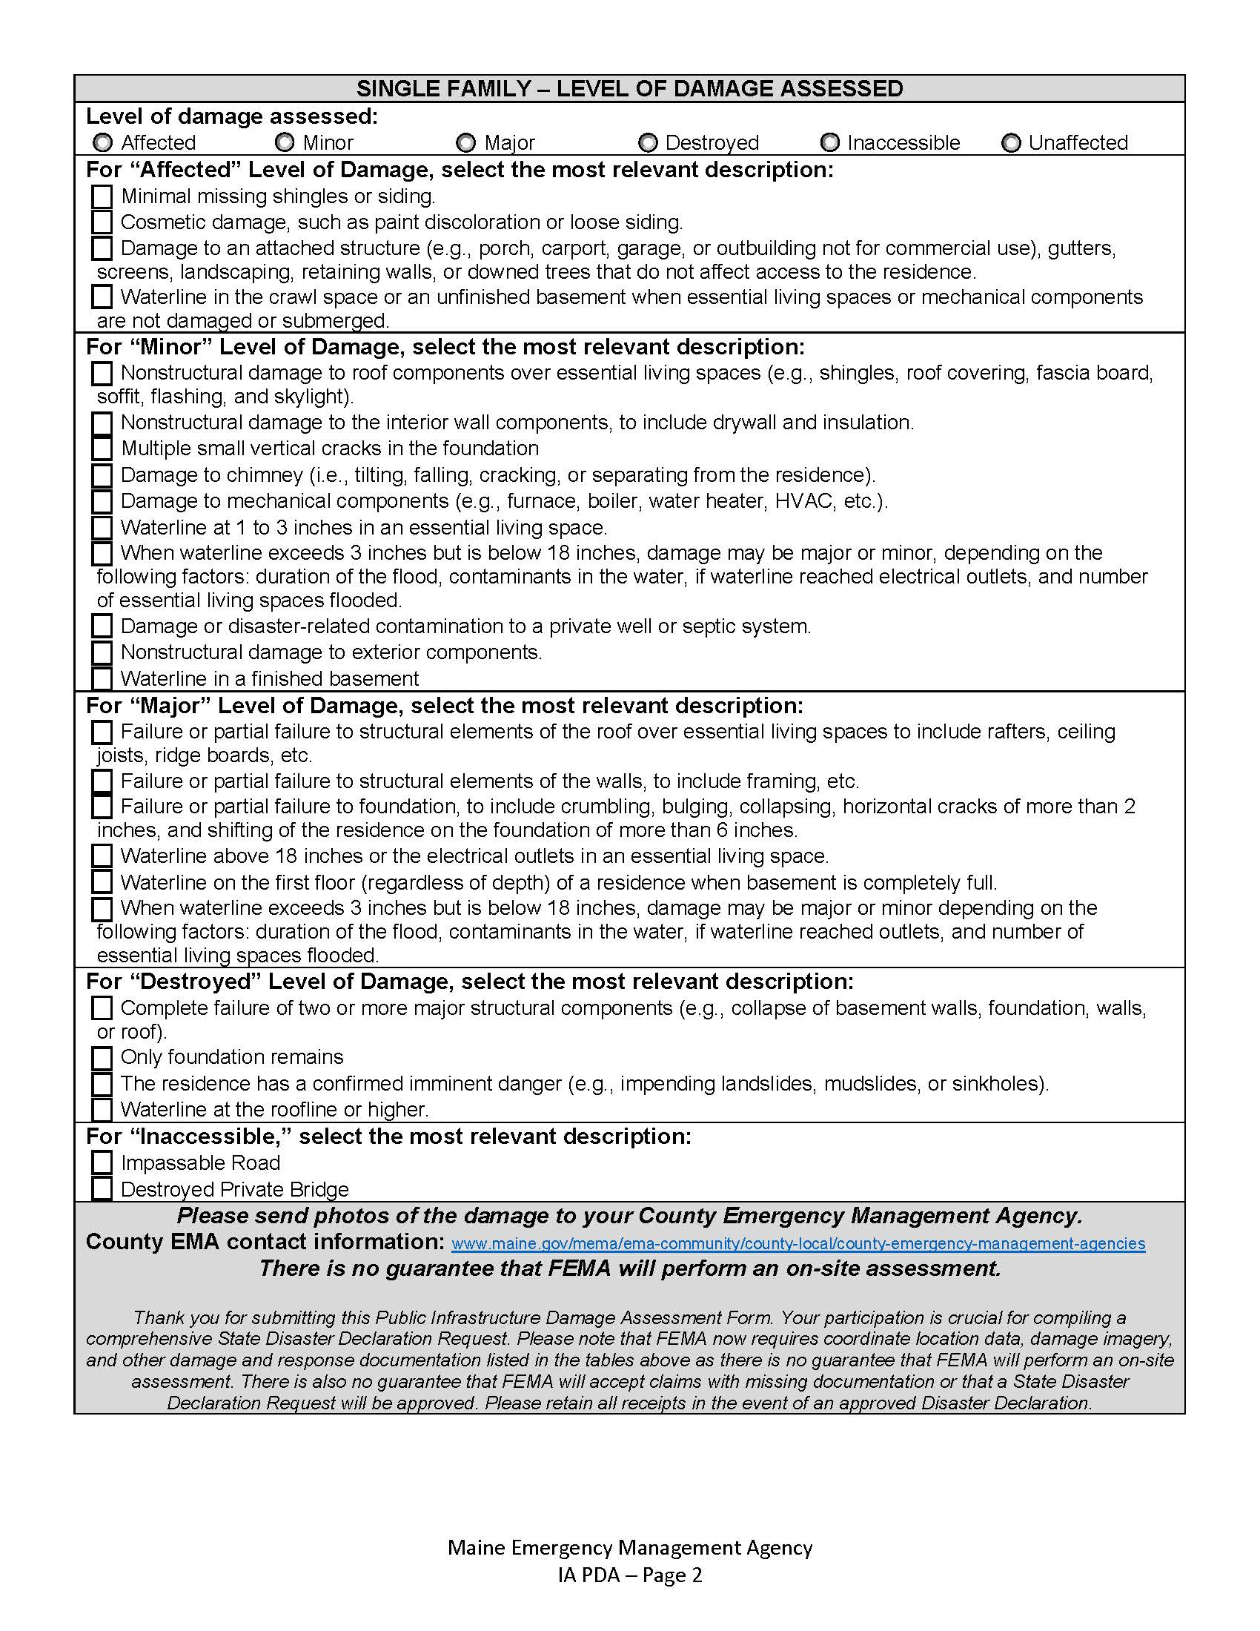
Individual Assistance Preliminary Damage Assessment form
Page 2
Description of the types of “Levels” of property damages for Single Family Homes
Notes:
Page 2 is a checklist to describe the level of damage to single family home.

Slide 26
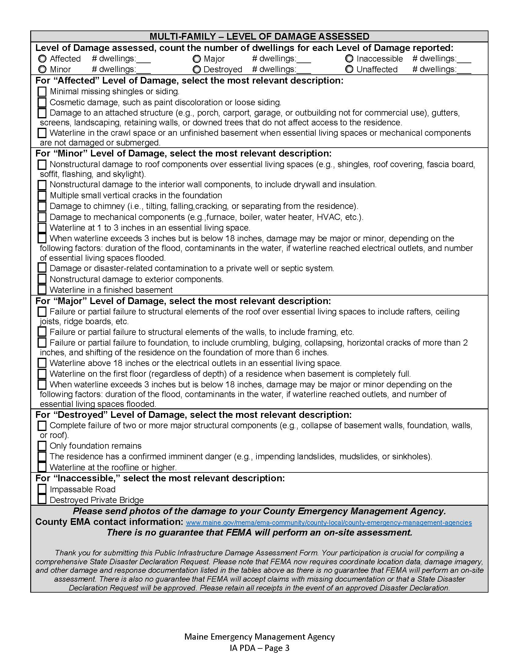
Individual Assistance Preliminary Damage Assessment form
Page 3
Description of the types of “Levels” of property damages for Multi-Family Homes
Notes:
Page 3 is a checklist to describe the level of damage to multi-family homes.

Slide 27
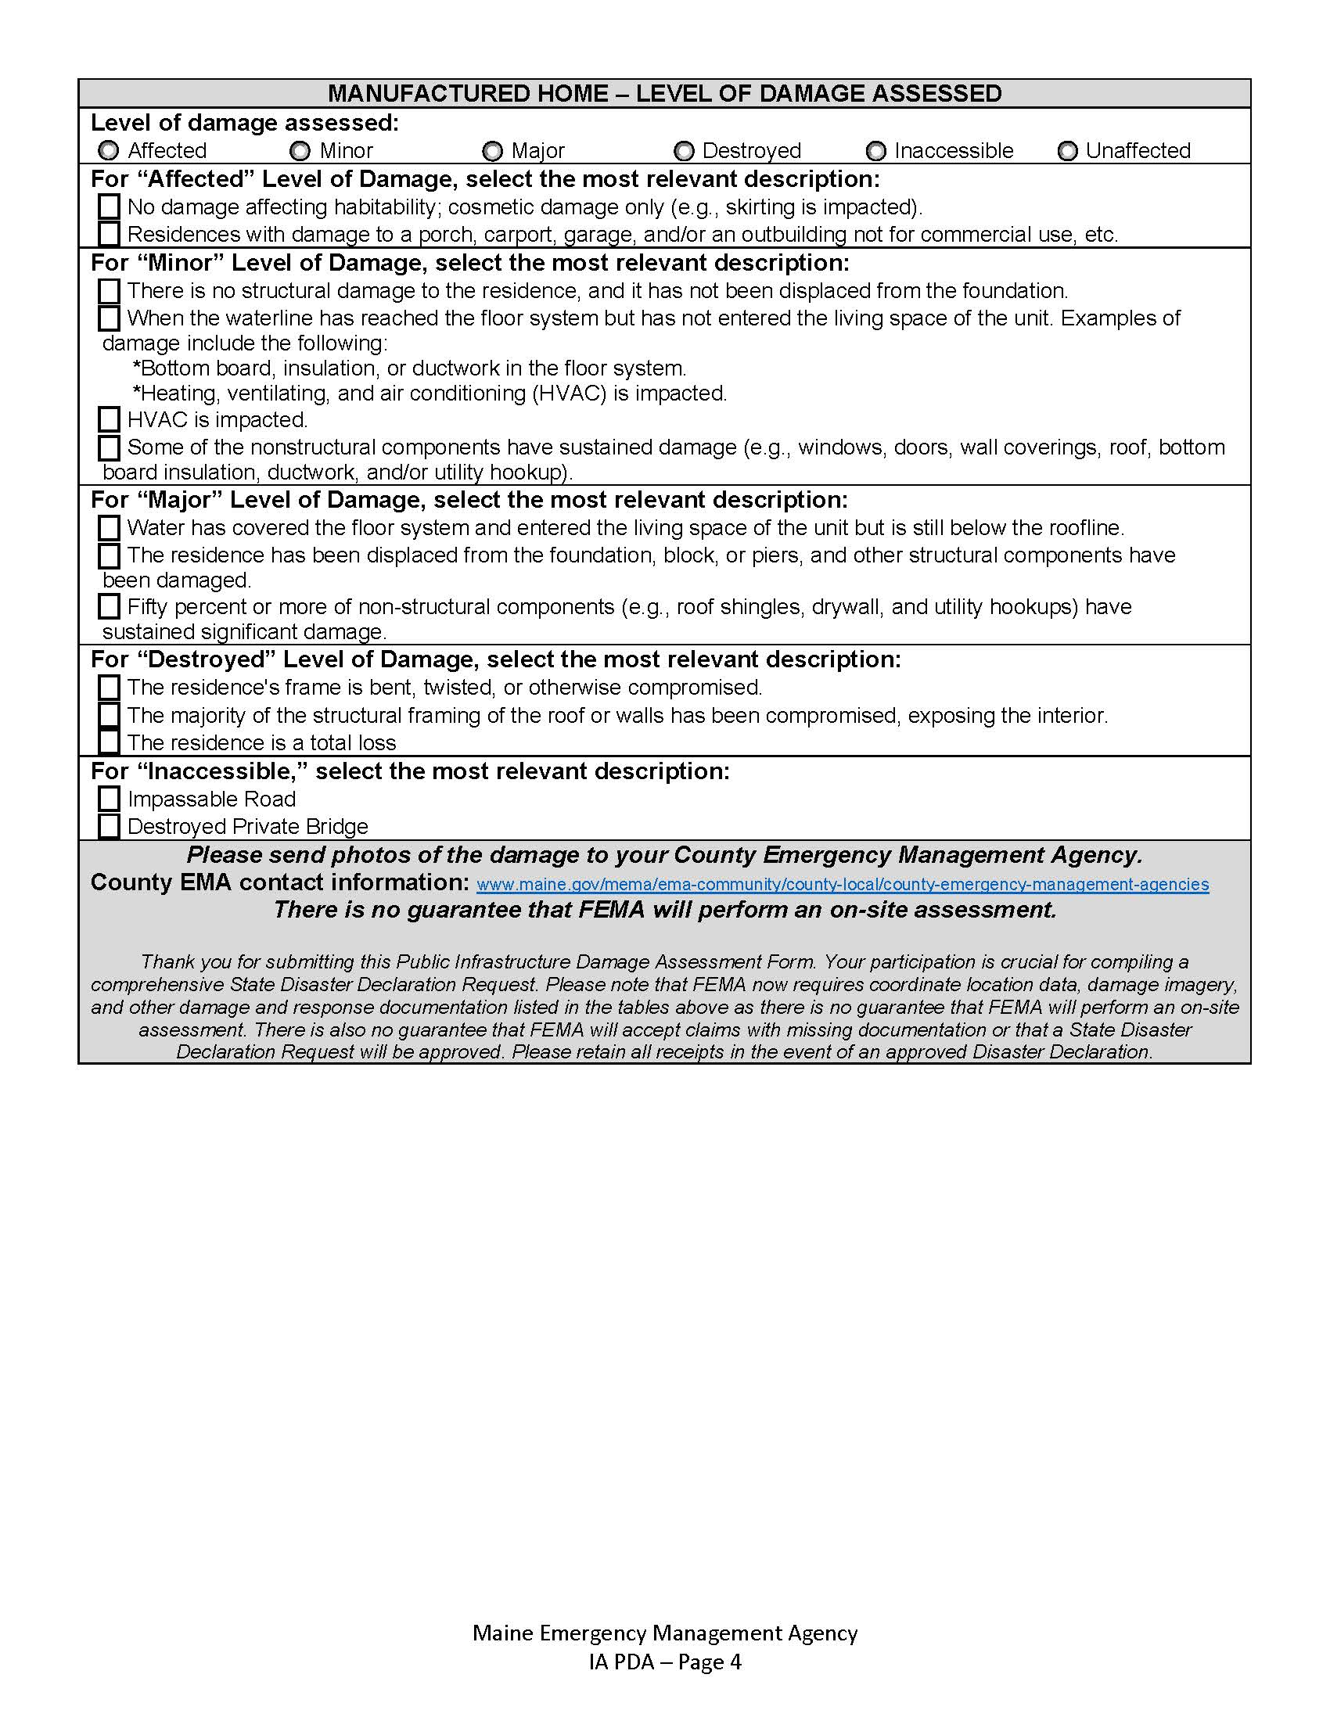
Individual Assistance Preliminary Damage Assessment form
Page 4
Description of the types of “Levels” of property damages for Manufactured Family Homes
Notes:
Page 4 is a checklist to describe the level of damage to single family manufacturer home.

Slide 28
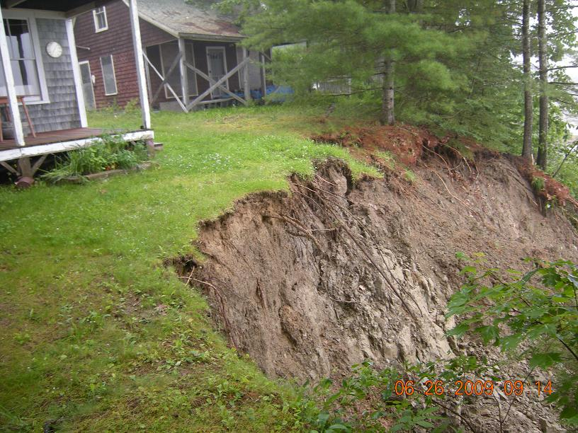
PDA Documentation
PDA Forms
Both forms will be completed at the municipal level
Town residents should report their individual damages to the Town Office or Town EOC
Town officials will collect public damages
Notes:
Both PDA forms, the Public Assistance form and the Individual Assistance form, will be collected by the municipal government. The PA form is completed by the municipality. The IA form will be completed by the resident and tuned into the municipal office.

Slide 29
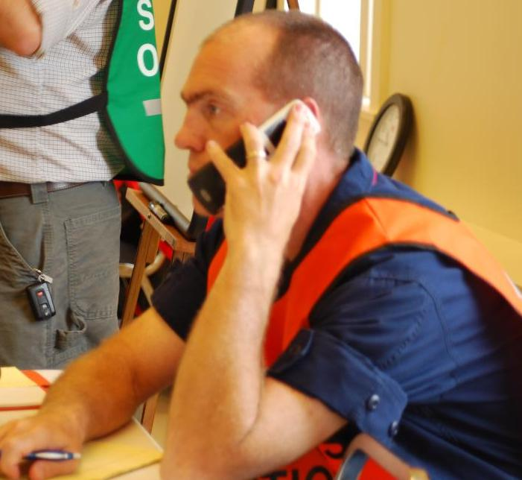
PDA Documentation
Forms shall be sent to the County EMA
The forms can be:
Uploaded to D4H IM
E-Mailed
Faxed
Hand delivered
Telephoned
Radioed
Notes:
The municipality will send the completed PA and IA PDA forms to the county EOC. These forms can be uploaded to D4H Incident Management, emailed, faxed, telephoned, radioed or hand delivered to the County EOC.

Slide 30
Preparing for FEMA
Next Step
The County EMA will forward the PDA forms to the State EMA office.
If the damages reach a certain cost threshold, the Governor will declare a State of Emergency and request a Presidential Declaration
FEMA may send out officials to verify the level of damage ($$). This is the Fed PDA.
If the cost thresholds are still met, FEMA may suggest the President make a Declaration
Notes:
The County EMA office will collect all the forms from the municipalities and forward them to the State EMA office. If you have an update to your PA form or receive a later IA report from a resident, you can still forward them on to the County.
If the public assistance cost estimates reach a certain cost threshold for the State as a whole, the governor will declare a state of emergency and request a presidential disaster declaration from the federal government.
If the federal government accepts the request, FEMA will send out officials to your municipality to verify the level of damage in your community. This is the second stage of the Preliminary Damage Assessment or PDA process.
The County will contact your municipal town office to schedule a time for the FEMA and state EMA assessment. You will need a representative who can speak on behalf of the municipality to take the Feds and state personnel around to the damage locations.
If cost thresholds are met by both the County and the State, FEMA will suggest the President approve a disaster declaration.

Slide 31
Preparing for FEMA
You will need all your supporting data you used to calculate the damage estimates, so hang on to it!
Supporting data may include photographs, video, material take offs, surveys, engineered drawings, detailed cost calculations, receipts, invoices, check stubs, etc.
The PDA Forms are used by the State of Maine; FEMA does not use these forms.
Notes:
When the FEMA and State EMA assessment personnel show up, your municipality will need all of your detailed damage assessment paperwork to include photographs, video clips, material takeoffs, surveys, engineered drawings, detailed cost calculations, receipts, invoices, contracts, check stubs, insurance policies and any other associated paperwork.
FEMA does not need you State PA form. These are only used by the State.

Slide 32
Preparing for FEMA
FEMA may send out representatives to reassess the damages you reported.
They will come develop their own cost estimates
This will determine whether the State and County have reached their cost thresholds.
Then stay tuned.
Notes:
When FEMA shows up for the Public Assistance Preliminary Damage Assessment they will be making their own assessment and verify your costs and calculations.
FEMA will determine whether the sate and county have met the cost threshold.
Then stay tuned. Even after FEMA leaves, they will continue to reach out to you for answers and more paperwork. This process could takes weeks or months.

Slide 33
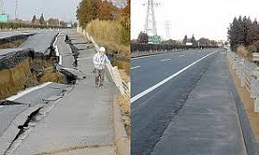
Damage Assessment & Reporting
Gets you quicker from damaged to repaired
Notes:
Damage Assessment is a very important task that needs to be accomplished following a disaster event in order to protect the public and quickly return things to normal. It will also be very important if the municipality is hoping to receive state and federal disaster assistance.
Though the Fire Department typically gets tasked with this responsibility by default, the community should consider organizing other volunteers or town staff to meet this need.

