Slide 1
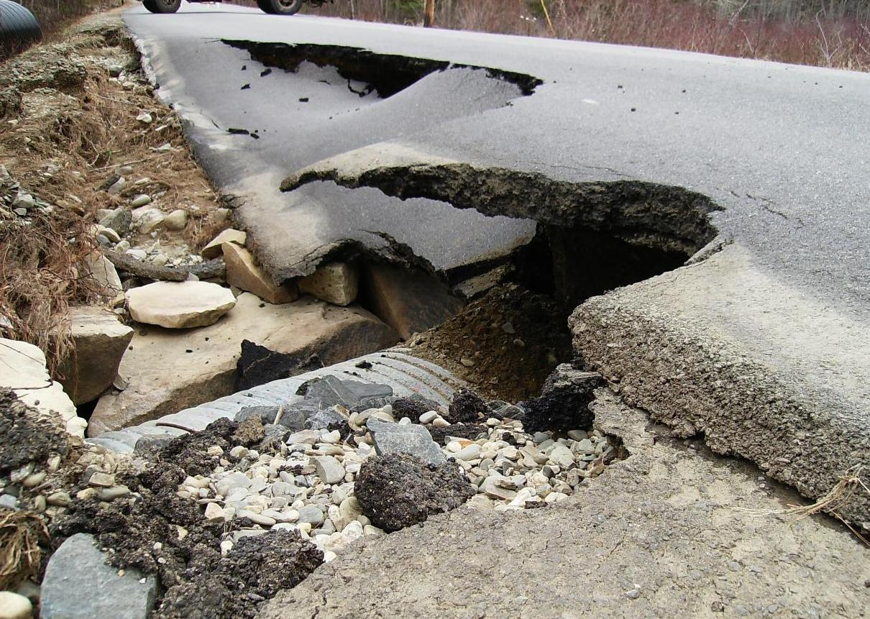
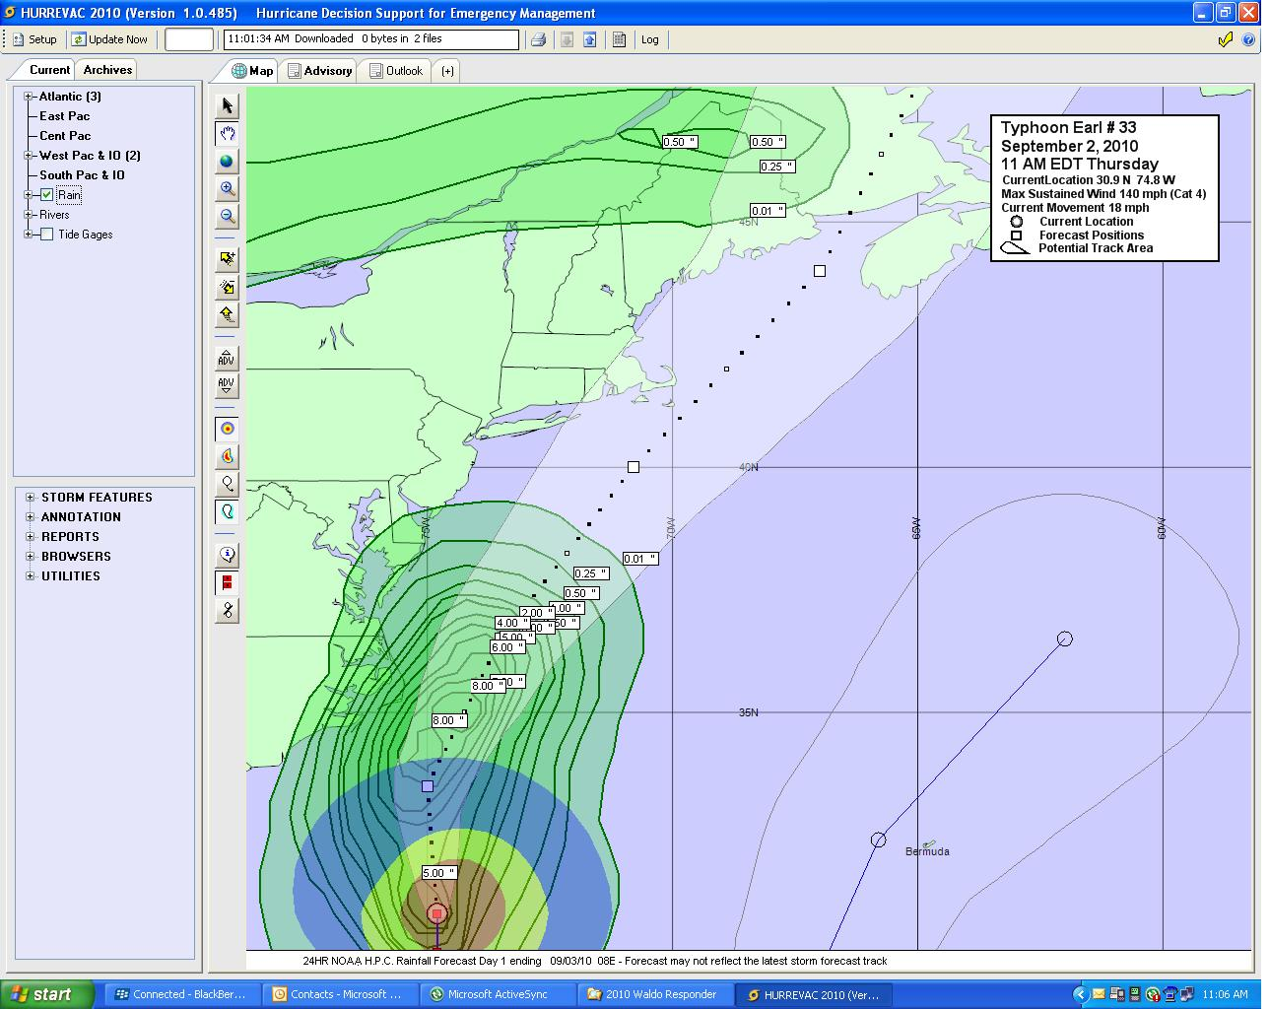
Workshop in Emergency Management Disaster Recovery
Local Disaster Recovery

Slide 2
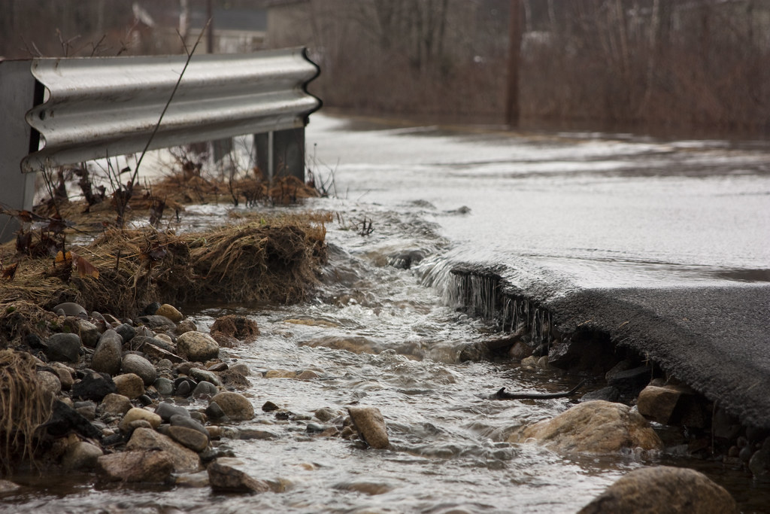
Disaster Recovery
Definitions
Disaster Process
Public Assistance
Individual Assistance

Slide 3
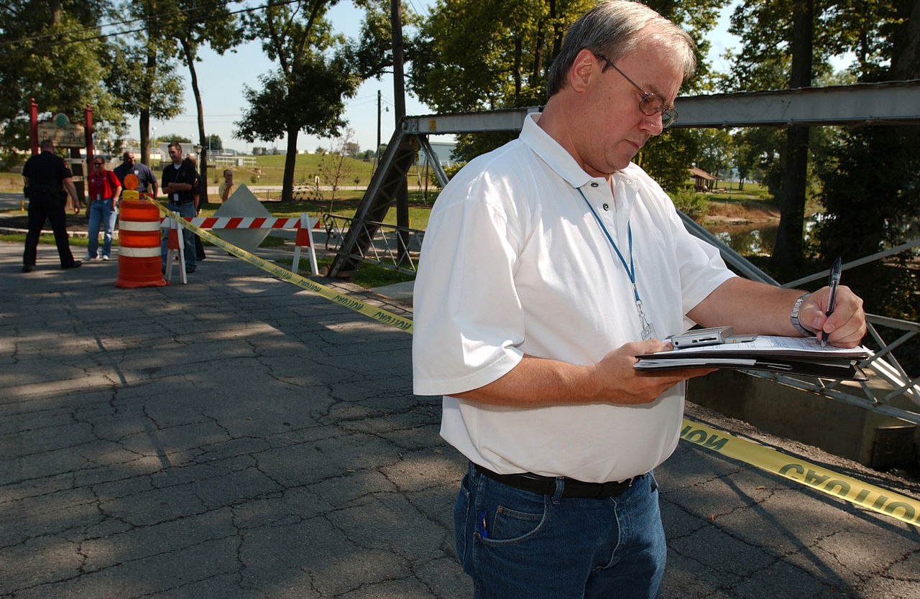
Definitions
Public Assistance: aid to public entities (and certain private non-profit) for emergency services and the repair or replacement of disaster damaged public facilities.

Slide 4
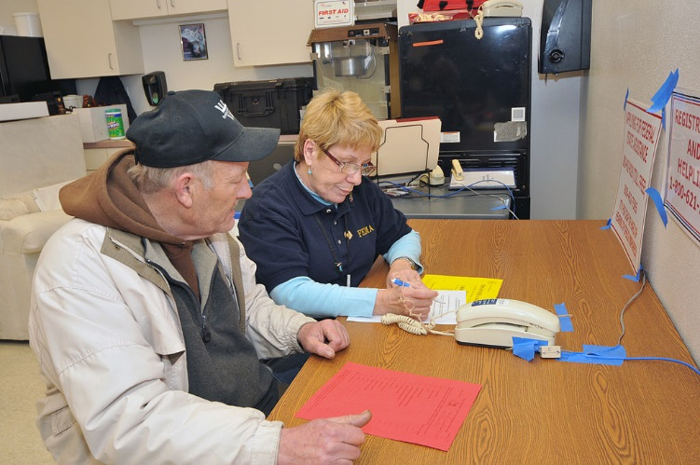
Definitions
Individual Assistance: aid to individuals and households, including businesses and farms

Slide 5
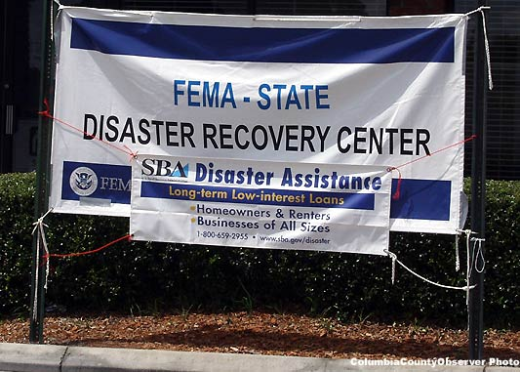
Definitions
Disaster Recovery Center: Following a Presidential disaster declaration that includes the Individual Assistance Program, FEMA may open temporary facilities called Disaster Recovery Centers (DRCs) in order to provide direct customer service.

Slide 6
Initial Damage Assessment
When the disaster danger has passed, the town EOC should submit a Situation Report that lists out what public infrastructure, major facilities, or utilities have been damaged or impacted.
Submit a situation report as soon as possible. The initial report can be called in, but follow up with an e-mail, fax, or D4H-IM submission.
As things change or you gather more information on damages, keep the County EOC updated.
This initial assessment will help you to prioritize resources and your response.

Slide 7
Follow on Damage Assessment
Within 24-72 hours, the town should complete a detailed damage assessment and come up with an estimated cost to repair and the number of homes and businesses damaged.
Include both public damage and private damage.
Take a lot of pictures. (Can’t stress this enough)
Fill out a MEMA “Public Assistance Preliminary Damage Assessment” form and send it to the County EMA office.
The damage assessment forms are needed in order to determine if there was enough damage to get a FEMA disaster declaration.

Slide 8
Disaster Declaration Process
PAPDA forms must show sufficient damages to warrant a State of Emergency declaration by the Governor.
The Governor requests the President authorize a Stafford Act disaster declaration.
FEMA completes a Preliminary Damage Assessment (PDA). FEMA officials may come to your town to validate your damages.
President may issue a Disaster Declaration. This could take weeks or months.

Slide 9
Public Assistance
In order for a County (and its corresponding municipalities) to be eligible for a Public Assistance (PA) declaration, both the County and the State have to reach its PA Damage Threshold.
This level of damage is estimated during the Damage Assessment Form process and verified during FEMA’s Preliminary Damage Assessment or PDA.
The Thresholds for the County and the State are shown on the next slide.

Slide 10
Disaster PA Thresholds
Public Assistance Thresholds
Waldo County $186,946
State $ 2,574,859
Both the County and State Thresholds must be met
Several counties may total to meet the State threshold
Small Projects - $1,062,900
Minimum Project - $4,000

Slide 11
PA Applicant’s Briefing
A meeting conducted by the State to inform prospective applicants of available assistance and eligibility requirements for obtaining Federal assistance under the declared event.
Help accessing the online FEMA Grants portal is accomplished in order to submit a Request for Public Assistance
This will be online.

Slide 12
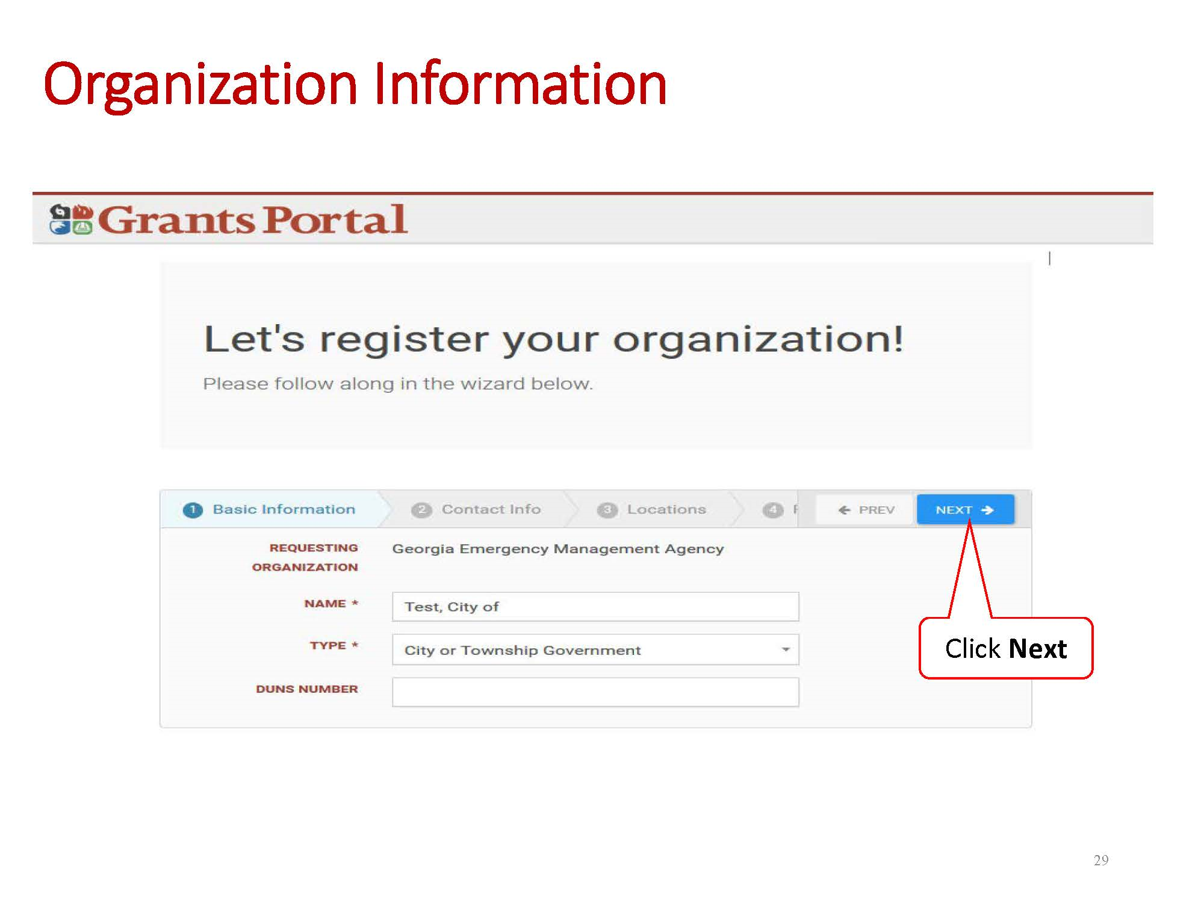
FEMA Grants Portal

Slide 13
PA Eligible Applicants
State
Counties
Cities and Towns
School Districts
Private Non-Profits
Water & Sewer Districts
Hospitals & Clinics
Others as defined by law

Slide 14
PA Cost Eligibility
Costs reduced by insurance
Meets Federal, State and local procurement and fiscal requirements
Use FEMA’s Schedule of Equipment Rates for hourly charges on equipment.
Each individual “project” must be at least $4,000 in size.

Slide 15
PA Cost Eligibility
Labor (Force Account)
No contingency clauses that payment for labor is subject to Federal funding
For emergency work, only overtime work is eligible for “Budgeted” employees.
For emergency work, overtime and straight time work is eligible for “Unbudgeted” employees.
For permanent work, overtime and straight time work is eligible for all employees.
Reassigned employees are considered unbudgeted employees.
Contract employees are eligible for all work.

Slide 16
Types of Work
Public Assistance
Emergency Work
Category A – Debris Removal
Category B – Emergency Protective Measures
Permanent Work
Category C – Roads and Bridges
Category D – Water Control Facilities
Category E – Buildings and Equipment
Category F – Utilities
Category G – Parks, Recreation and Others

Slide 17
Debris Removal (CAT A)
Debris removal is eligible when:
Eliminates immediate threat to life, health, and safety.
Eliminates immediate threat of significant damage to improved property.
Ensures economic recovery of the community and provides a benefit for the community-at-large.
Mitigates risk to life and property by removing Substantially Damaged structures and associated structures and appurtenances
Must meet Environmental and Historic Preservation Compliance requirements

Slide 18
Emergency Protective Measures (Cat B)
Flood fighting
EOC operations
Supplies
Medical Care & Transport
Evacuation
Sheltering
Safety Inspections
Search & Rescue
Fire Fighting
Security
Use of Generators
Public Information
Human remains recovery
Mass Mortuary
Some snow-related activities

Slide 19
Eligible Permanent Work (Cat C-G)
Must repair, restore or replace disaster-damaged facilities in accordance with regulations
Must restore to pre-disaster design, capacity and function in accordance with applicable codes and standards
Must be required as a result of the disaster
May include cost effective hazard mitigation measures

Slide 20
Recovery Scoping Meeting
The first meeting with your FEMA rep.
Your damages will be discussed, your needs assessed, and a plan of action put in place. The FEMA Rep will go over what will be expected of you, and will provide detailed instructions on what to do and how to do it.
Federal and State Permitting
Engineering Studies
Plans and Specs

Slide 21
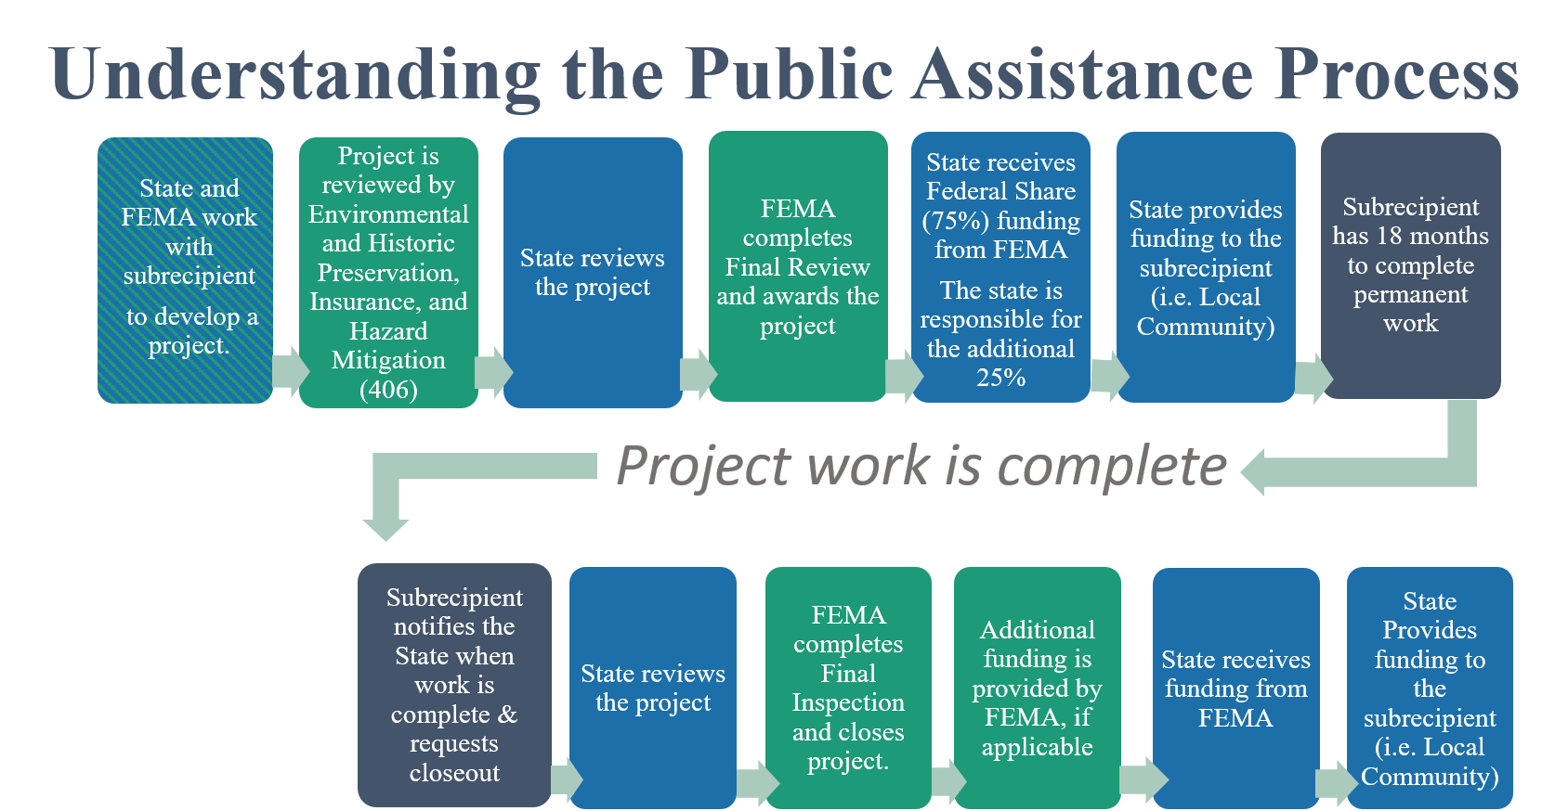
The Public Assistance Process

Slide 22
Hazard Mitigation
Cost effective measures that reduce or eliminate the potential for damages to a facility from a future event.
For a hazard mitigation proposal to be eligible for funding under Public Assistance, the measure must apply only to the damaged elements of the eligible facility or site.

Slide 23
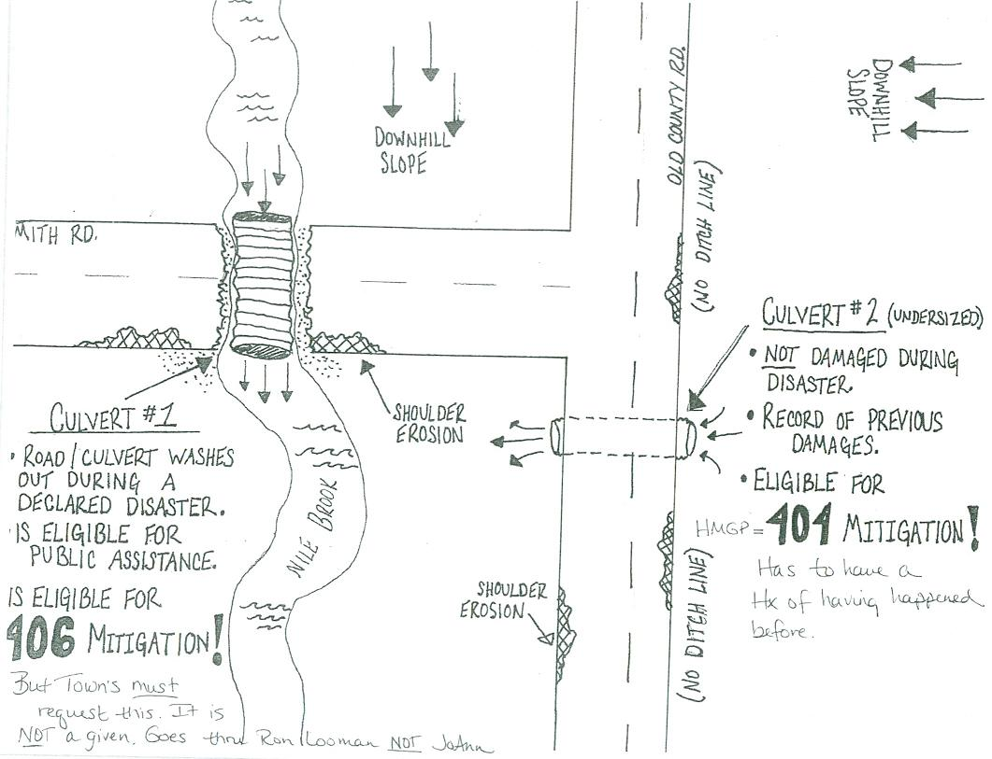

Slide 24
Project Formulation & Forms
FEMA Rep will meet with municipal officials
Typically about 1-2 days of field work (and many days of paperwork, meetings and other frustrations)
Federal reimbursement is 75%
State reimbursement is 15%
Town is responsible for 10%.
Must maintain financial and program records for three years following final payment.

Slide 25
Paperwork
FEMA Bureaucracy
FEMA Grant Portal – everything is uploaded here
Forms are in hardcopy and spreadsheets
Force Account Labor Summary (90-123) - personnel costs
Materials Summary Record (90-124) – supplies/ materials
Rented Equipment Summary Record (90-125) - rented equipment
Contract Work Summary Record (90-126) - work done by contractors
Force Account Equipment Summary (90-127) -equipment use costs
Applicant's Benefits Calculation Worksheet (90-128) - fringe benefit pay for employees
Copies of Insurance Policies & much, much more!

Slide 26
Project Management
Municipal responsibilities
Progress Reports
Financial Reports
Closeout Reports
Project Completion Time Limits
Emergency work - 6 months
Permanent work - 18 months
Time limits for all Projects begin the date of the disaster declaration

Slide 27
Individual Assistance
When the President declares a disaster and authorizes providing Individual Assistance, FEMA’s Individuals and Households Program (IHP) can help homeowners and renters affected by the disaster with housing needs and necessary expenses.
A Disaster Recovery Center may be set up by FEMA for citizens to visit and file for assistance.

Slide 28
Individuals and Households Program
To be considered for IHP housing assistance, the affected home must be the individual’s primary residence and it must be located in the disaster area designated for Individual Assistance.
To be considered for IHP assistance for necessary expenses or serious needs, the loss must have occurred in the disaster area designated for Individual Assistance.
An individual or a pre-disaster member of the household must be a United States citizen, a non-citizen national or a qualified alien.

Slide 29
What does IA pay for?
Temporary Housing
Food Stamps
Legal Services
Veteran’s Assistance
Income Tax Counseling
Low Interest Loans
Unemployment payments
Individual & Family grants
Crisis Counseling
Agricultural assistance
Red Cross Services
Medical and Dental Expenses
Funeral and Burial Costs

Slide 30
Individual Assistance
Sequence of delivery
Insurance
Non-profits/Charities
FEMA Individual Assistance
Small Business Administration
You’re out of luck

Slide 31
Individual Assistance
The Town EOC may be involved by collecting individual damage information and recording it on the Individual Assistance Damage Assessment Form. The town should provide information updates to the public.
Individual applicants will work directly with FEMA, other Federal entities, or with private charities during the Individual Assistance phase.

Slide 32
Disaster Recovery
Please contact Waldo County EMA if you have any questions.
685 Swan Lake Ave, Swanville, ME 04915
(207) 338-3870
ema@waldocountyme.gov

