Slide 1
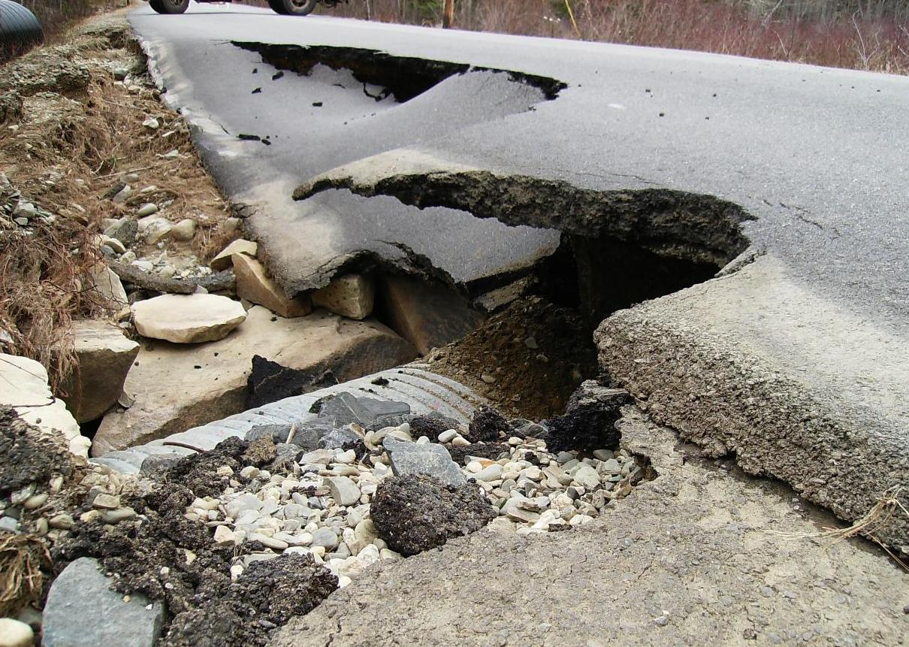
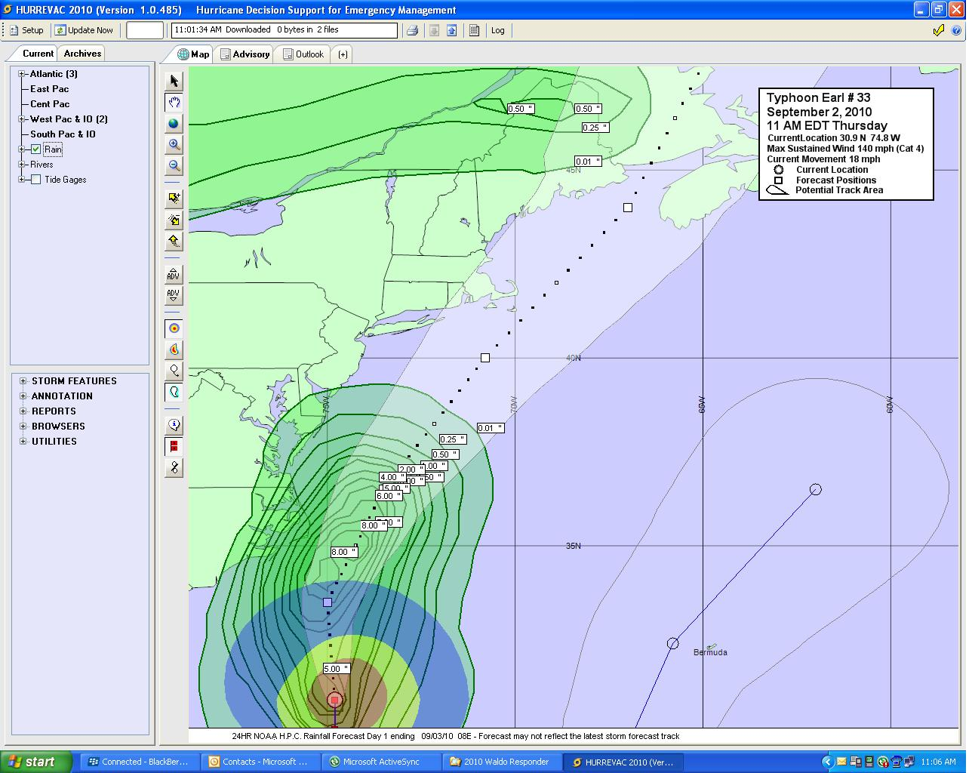
Workshop in Emergency Management Emergency Operations & Reporting
Comprehending Disaster Response

Slide 2
Emergency Operations & Reporting
The Role of the Local Emergency Manager
The Emergency Operations Plan (EOP)
The Town Emergency Operations Center (EOC)
Emergency Functions
Situational Awareness
Information Management
Requesting Resources

Slide 3
Role of the Emergency Manager
Planner
The Town EM coordinates the development of emergency plans and procedures detailing how the Town will respond and recover
Coordinate plan with elected officials, public safety officers, code enforcement, health officer, school officials and other partners.
Understands the County emergency plans and how to interact.

Slide 4
Role of the Emergency Manager
Training and Exercise manager
Coordinates training and drills with town officials in implementing the Town emergency plans
Coordinates training for town officials in the National Incident Management System (NIMS)
Participates in County and State training and exercise opportunities
Tracks lessons learned and manages an improvement plan.

Slide 5
Role of the Emergency Manager
Maintain a Town Emergency Operations Center (EOC)
Locate a facility for an EOC
Equip and supply the EOC facility
Identify EOC staffing
Provide training for the EOC staff
Test the EOC staff with drills
Provide EOC communications systems

Slide 6
Role of the Emergency Manager
Public Educator and Informer
Provide awareness to the public regarding the need to be prepared.
Provide training and education to the public in disaster preparedness.
Distribute emergency public information and warning messages

Slide 7
The Emergency Operations Plan
State Law requires each Town to have a disaster plan that must:
Be approved by the town's governing body.
Have a risk assessment.
Address the hazards and threats that pose the greatest risk to the town.
Address the capabilities and actions needed to respond to and recover from disasters.

Slide 8

Emergency Operations Center (EOC)
The secure facility from which town officials coordinate, monitor and direct emergency response activities during an emergency

Slide 9
The Town EOC
Pre-identify a location
Typically, a room at the town office or fire station
Provide phone, internet and 2-way radios
Sufficient space for EOC staff seated at tables
Cork or marker boards for displaying information
Backup Power
Pre-identify EOC Staff
Elected Officials, EM Director, Public Safety, Road Commissioner/Public Works, CEO, Treasurer, Animal Control, etc

Slide 10
The Town EOC
Communications and Information Links
Neighboring communities’ EOCs
County EOC
Residents
Businesses and Contractors
Community Volunteer Organizations
Large Employers
Medical Facilities/Clinics

Slide 11
The County EOC
The County EOC
requires the disaster information you have
may be able to provide information you don’t have
can coordinate the regional response
will find resources you don’t have
will be the communications hub for all the Towns in the County
will be the link to the State EOC

Slide 12

Town Emergency Functions
Policy
Public Safety
Evacuations
Communications
Public Information
Damage Assessment
Debris Removal and Road Repairs
Individual Assistance and Mass Care

Slide 13
The EOC gathers Situational Information
Situational Awareness
The ability to identify, process, and comprehend the critical information about an incident.
More simply, it is knowing what is going on around you.
How does the Town EOC find out what’s going on?

Slide 14
How does the EOC gather Situational Information?
Deploying assessment teams or first responders into the field.
TV, radio and online news sources
Contacting people in the area.
Coordinating with neighboring towns and the County EOC.
Sending and receiving situation reports.
Utilizing an online situational awareness tool.

Slide 15
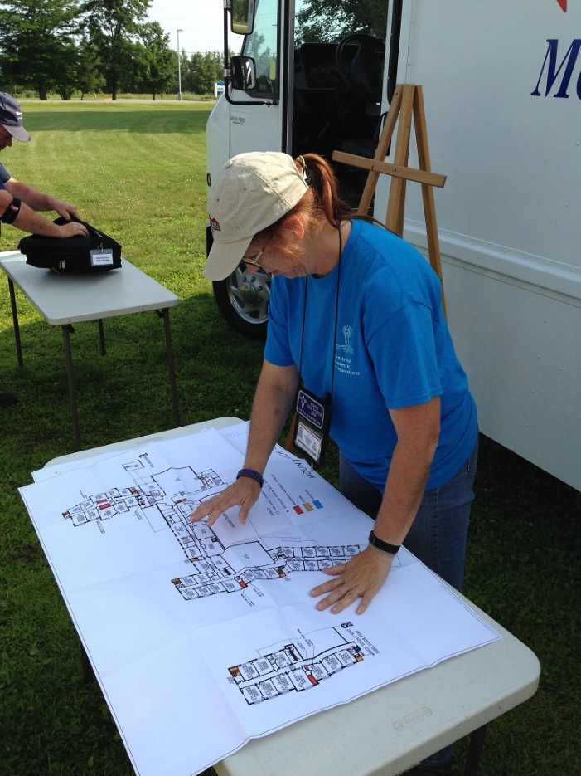
How does the EOC track the info?
Situation Report files
Event Logs
Maps
Status Charts or Boards
Digital online status boards
D4H Incident Management

Slide 16
EOC Situation Information
What information to track and report
Public and Private Damages
Personnel Assignments
Casualties
Status of important facilities
Equipment, Supplies and Donations
Roads Damaged and closed
Current and Forecasted Weather
Funds Expended
Response and Recovery Actions Underway

Slide 17
How to report the Status Info
Situation Reports
Log into D4H Incident Management and update
Send report through EmailMeForm online app
Email attached situation report (SitRep)
Fax a hardcopy SitRep
Call in information on phone or radio
Hand Deliver a hard copy
County EOC will consolidate the town reports and send out a new report to the State and town EOCs.

Slide 18
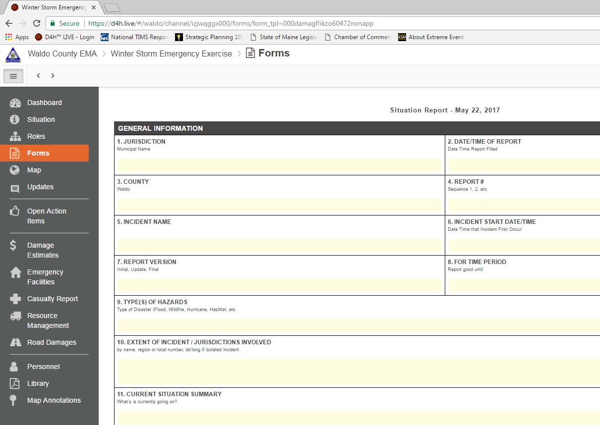
Example D4H IM Report

Slide 19
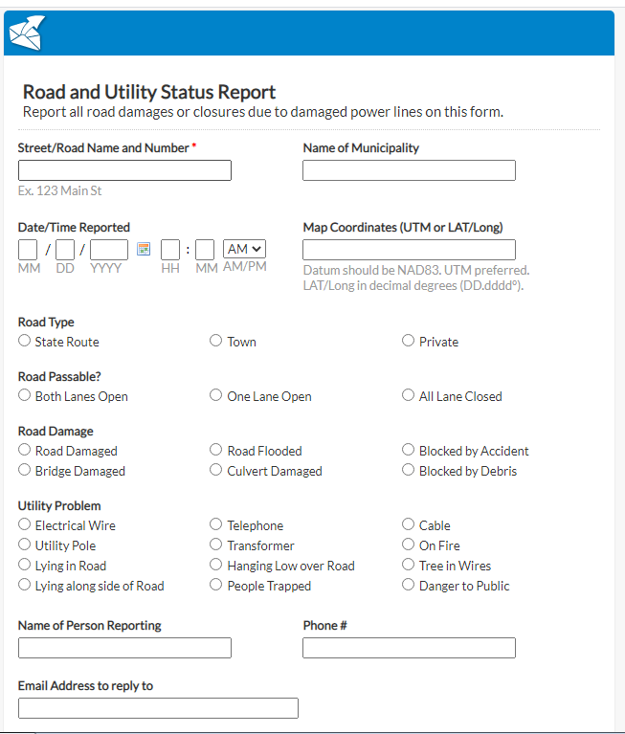
Example E-MailMeForm Fill in and hit the send button. Sends the information in an email to the County EMA staff.

Slide 20
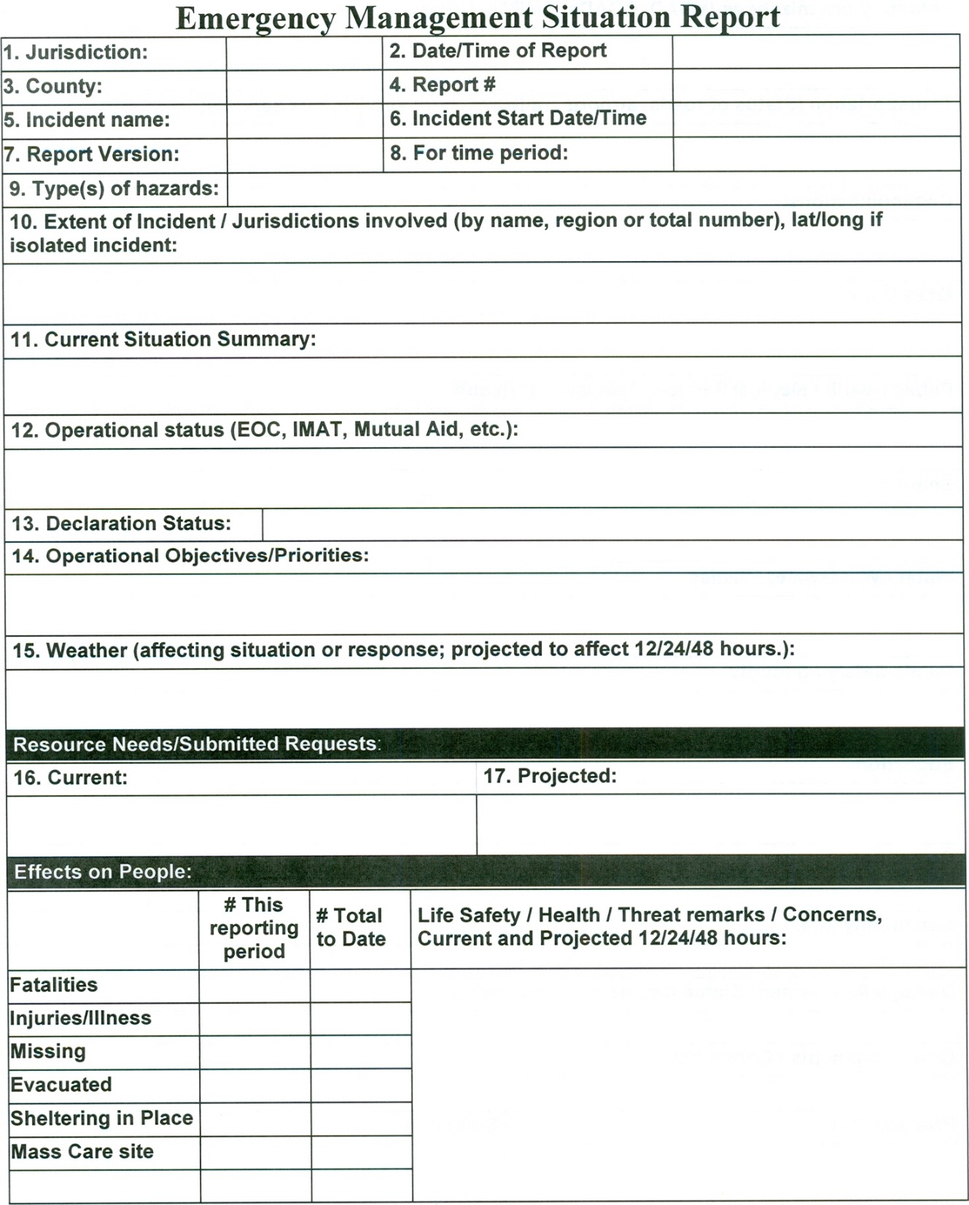
Reports can be:
Faxed
E-Mailed
Posted to D4H IM
Hand delivered
Phoned in
Radio called in
Fill in all that applies

Slide 21
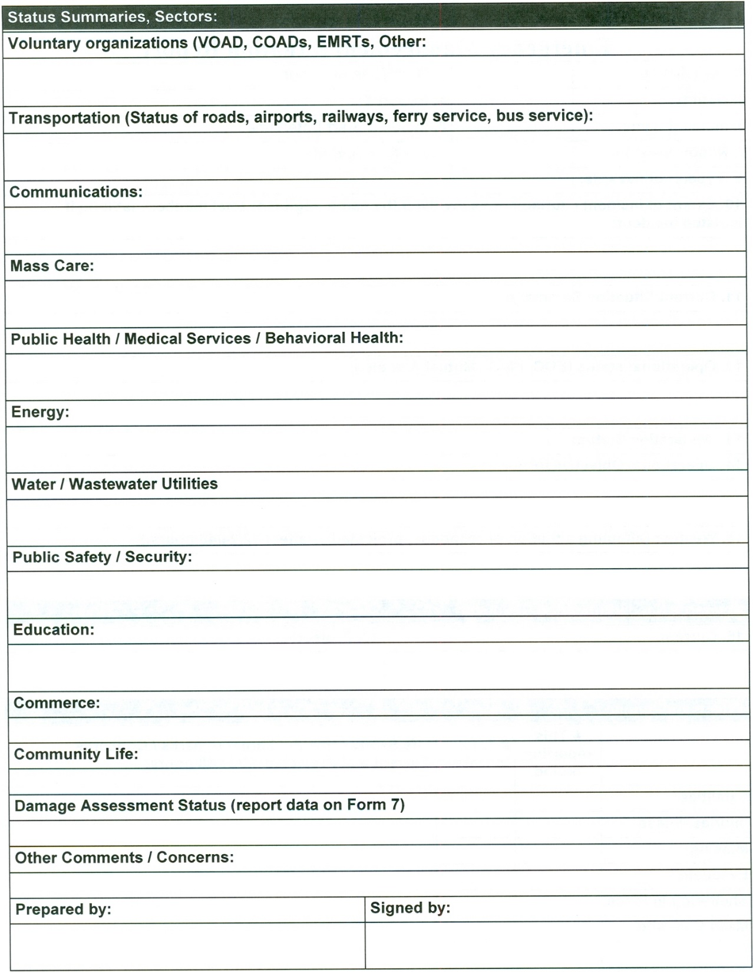
Back side

Slide 22
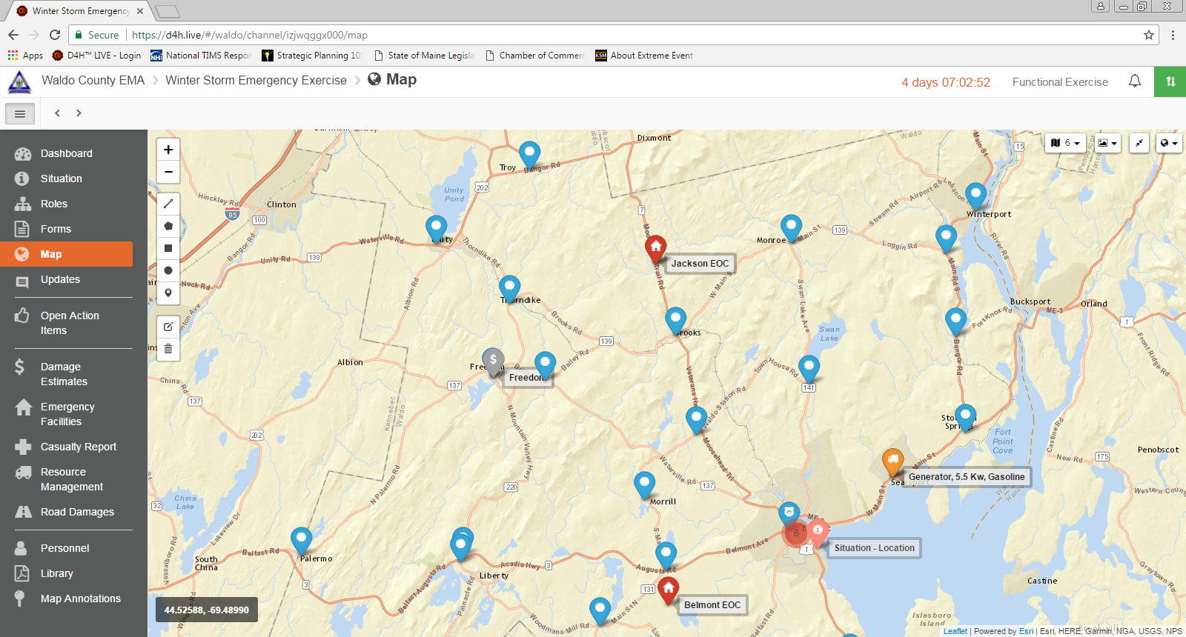
D4H Incident Management
Mapping Tool
Will display all geo-referenced data from status boards

Slide 23
Requesting Resources
When local resources are overwhelmed, the municipality will ask for assistance from:
Mutual Aid Towns
Private entities (businesses, organizations, etc)
County EOC and RCC
Other Counties and their respective towns
State government

Slide 24
Resource Request process
If the RCC can’t get it for you, contact the County EOC
Submit a resource request form to the County
The County will coordinate with the State or the other Counties to acquire the resource
Must be very specific with the request details

Slide 25
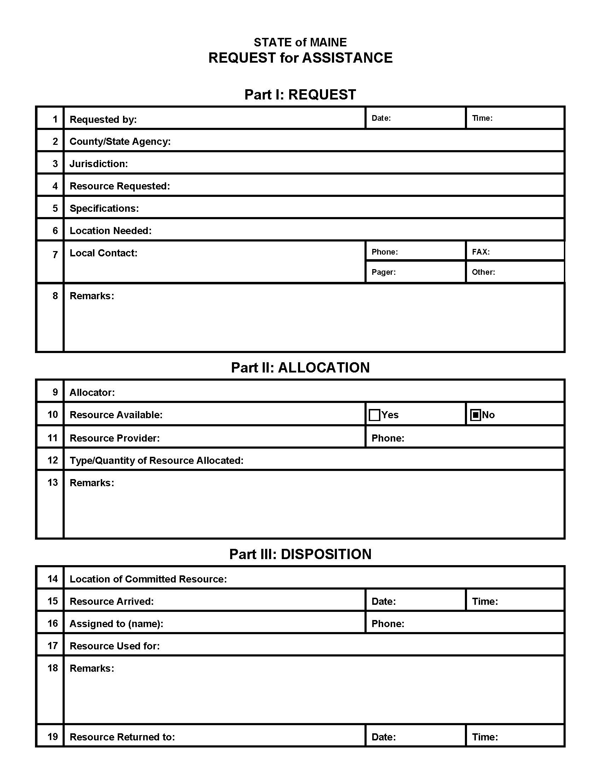
Example hardcopy form
Fill out Part 1 with as much detailed information as you can

Slide 26
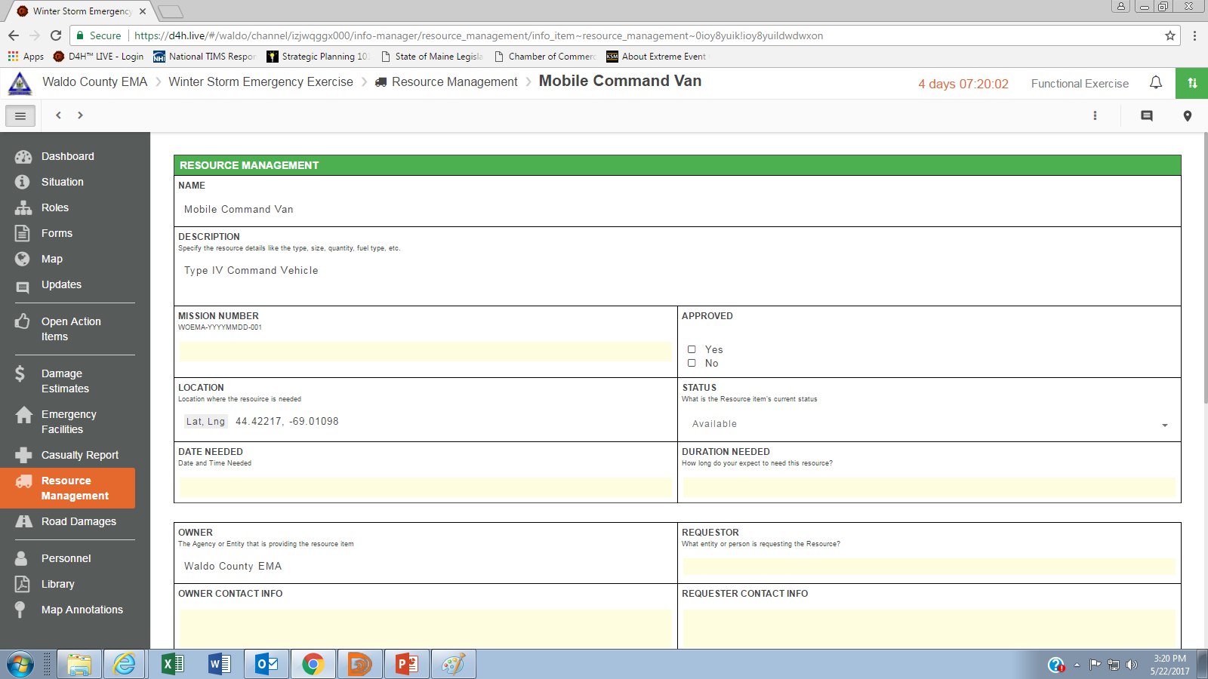
Example D4H IM Resource Mgmt board

Slide 27
Requesting Resources
Understand many resources, even government items, may come with a cost
Example: National Guard forces may charge for salaries, lodging and expendables such as fuel
There may be reimbursements from:
FEMA, if Presidential Declaration
State, if Governor declares an emergency
HazMat Spiller, if incident involves the release of hazardous materials

Slide 28
Example Resources
Incident Management Teams
Ham Radio Teams
Hazardous Materials Response Teams
Search and Rescue Teams
Electrical Power Generators
School Buses
Volunteer manpower
Civil Air Patrol
National Guard
American Red Cross

Slide 29

Emergency Operations & Reporting
Any questions?
Contact Waldo County EMA

